Slide 1





IMPLEMENTING LONG-ACTING ANTIRETROVIRAL THERAPY IN CLINIC: SHARING OUR EXPERIENCE
Midwest AIDS Training + Education Center of Kansas and Nebraska (MATEC-KS/NE) Omaha HIV Program
Omaha, Nebraska
June 22, 2021

Slide 2
Disclaimer
“This program is supported by the Health Resources and Services Administration (HRSA) of the U.S. Department of Health and Human Services (HHS) as part of an award totaling $3,994,961 with 0 percentage financed with nongovernmental sources. The contents are those of the author(s) and do not necessarily represent the official views of, nor an endorsement, by HRSA, HHS or the U.S. Government.”

Slide 3
Disclosures
Speakers:
Susan Swindells, MBBS
  Receives research grants from ViiV Healthcare paid to the University of Nebraska Medical Center
Christine D. Tran, DNP, APRN
  No disclosures
Josh Havens, PharmD
  Received research grant from Gilead Sciences, Inc. paid to the University of Nebraska Medical Center
Maureen Kubat, RN
  No disclosures
Planners
Sara Bares, MD
  Received research grants to the University of Nebraska Medical Center from Gilead Sciences, ViiV Healthcare, and Jannsen
Nikki Regan, APRN, Deanna Hansen, Susan Tusher, LMSW have no disclosures

Slide 4
Learning Objectives
Recall processes and data from long-acting antiretroviral clinical trials
Discuss why patients may desire long-acting antiretroviral therapy
Identify patients who are best candidates for long-acting antiretroviral therapy in commercial use
Discuss cost and process for obtaining access to long-acting antiretroviral therapy through a variety of medical and pharmacy benefit programs
Begin to formulate an implementation process for long-acting antiretroviral therapy for patients in our clinics

Slide 5
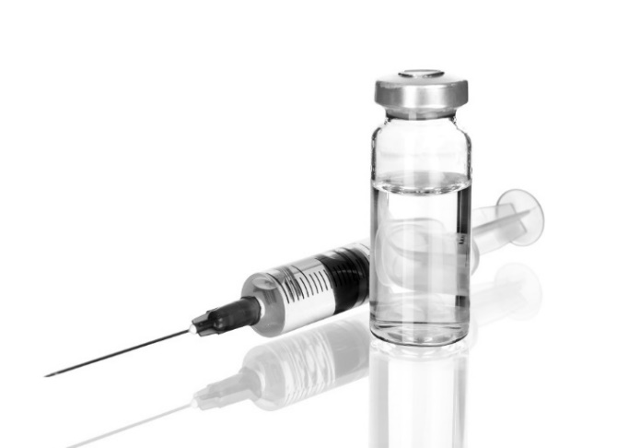
BACKGROUND:
Clinical Trial Review and
What Patients Want
Susan Swindells, MBBS
Professor of Medicine
University of Nebraska Medical Center

Slide 6
How to define “long-acting”?
Route of delivery | Oral | Parenteral | Implant / Device
Dosing frequency | ≥ 1 week | ≥ 1month | ≥ 6months
Owen and Rannard. ADDR. 2016

Slide 7
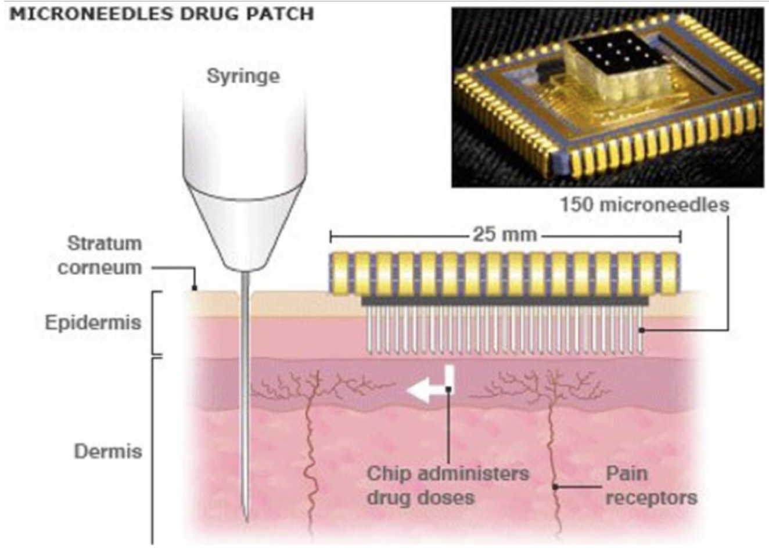
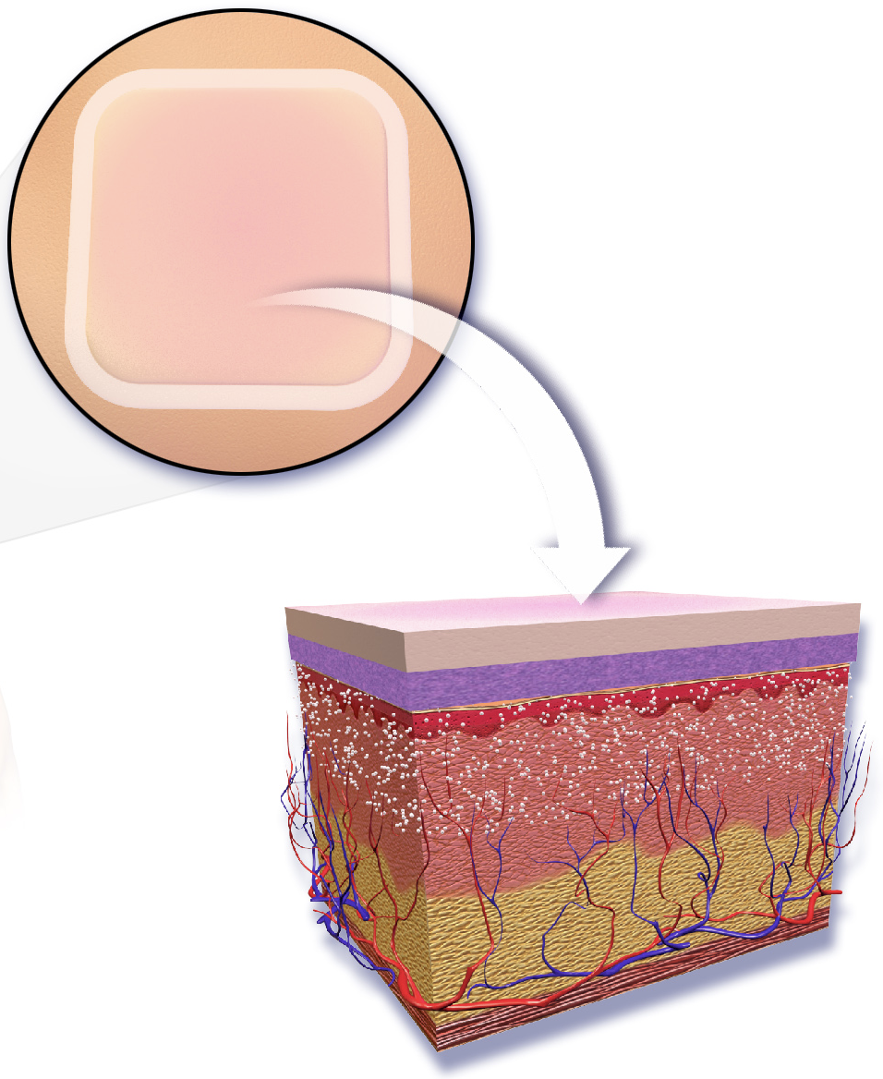
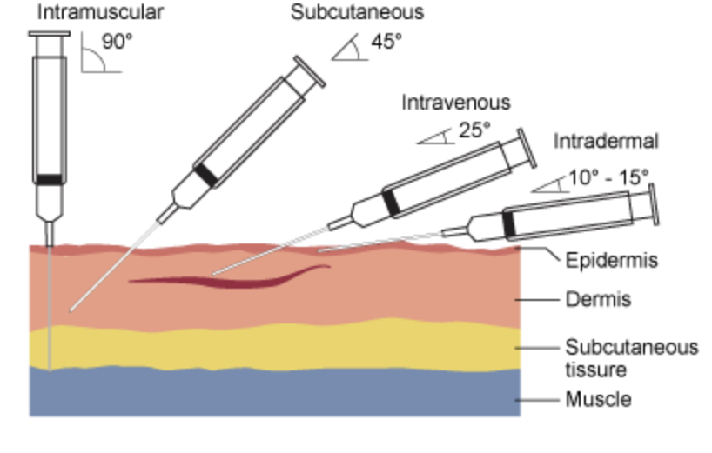
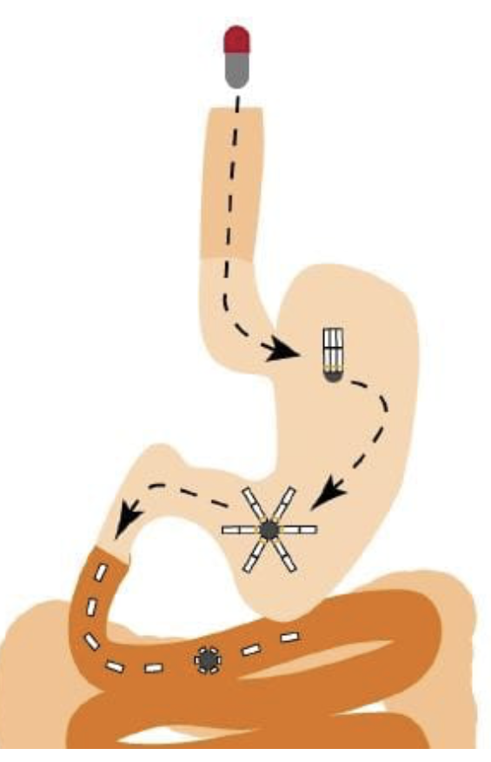

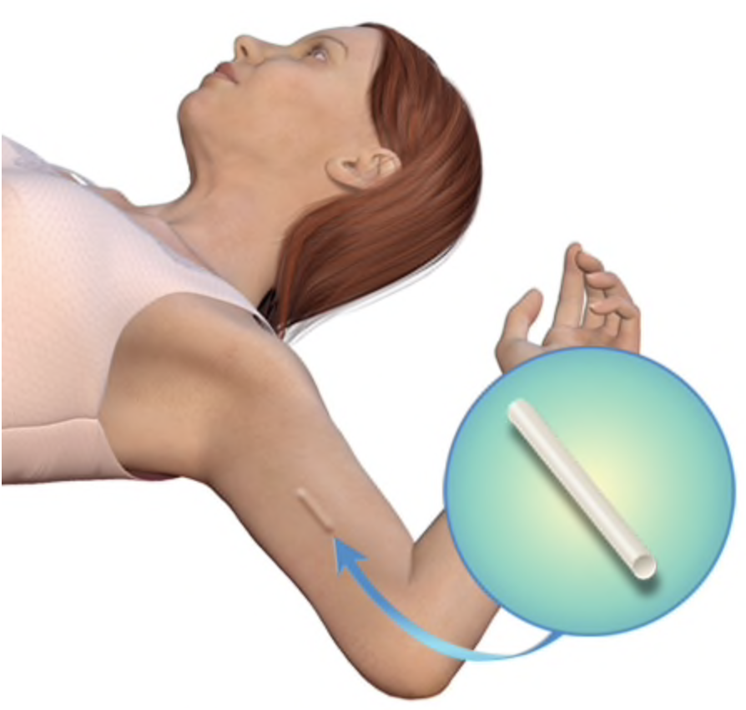
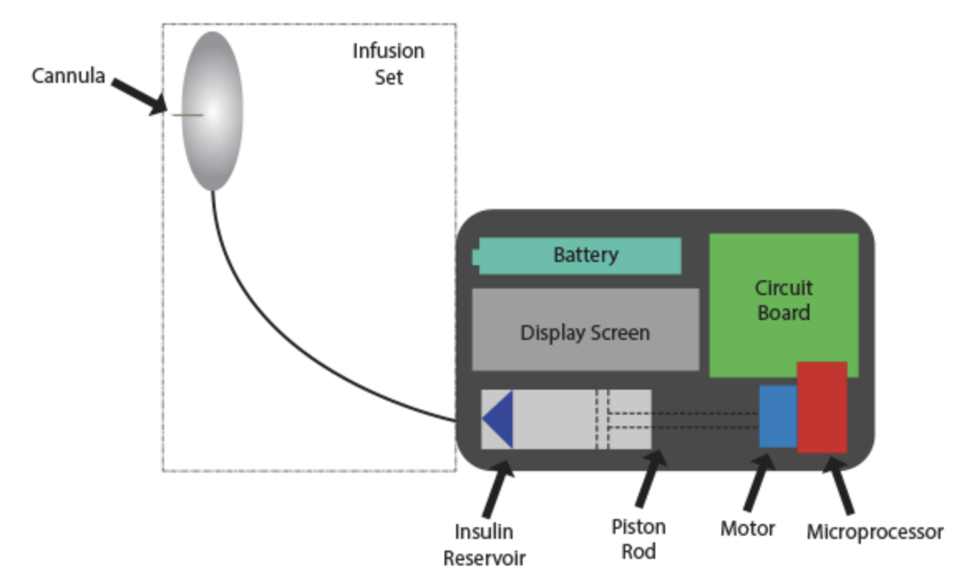
Technology for Drug Delivery
Microneedle drug patch
Long-acting depot injections
Novel oral formulations
Subdermal implant
Vaginal rings
Wearable infusion pump
Thanks to Kim Scarsi

Slide 8
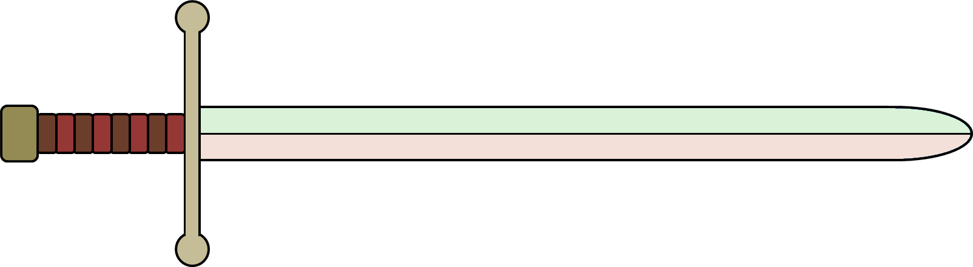
Long-Acting Antiretroviral Therapy:
Potential Opportunities and Challenges
OPPORTUNITIES
Less frequent dosing
Avoidance of “pill fatigue”
Oral dosing by-passed; bioavailability ~100%
Less adverse events
Less drug-drug interactions
Protection of health privacy
Avoidance of HIV-related stigma
Improved adherence?
CHALLENGES
Large injection volumes
Need for oral lead in
Management of missed doses
Coverage of the “tail”
Development of drug resistance
Management of drug-drug interactions
Management of serious adverse events
Unknown dosing for children & pregnant women

Slide 9
LA ARVs in Development or Clinical Use
ARV Class | Agent | Formulation | Development Stage
NRTI | MK-8591 | Implant | Preclinical
 | TAF | Implant | Preclinical (Px)
 | GS-9131 | Implant | Preclinical
NNRTI | Rilpivirine | Injectable | Phase III/NDA
 | Elsulfavirine | Injectable | Preclinical
PI | Atazanavir | Injectable | Preclinical
 | Ritonavir | Injectable | Preclinical
INSTI | Cabotegravir | Injectable | Phase III/NDA, Phase II/III (Px)
 | Raltegravir | Injectable | Preclinical
Entry Inhibitors | Ibalizumab | Intravenous | FDA Approved (Tx)
 | PRO 140 | Intravenous and Injectable | Phase III
 | Albuvirtide | Intravenous and injectable | Approved in China
 | bNAbs (e.g., VRC01) | Intravenous | Phase II/III
 | Combinectin | Intravenous | Preclinical
Capsid Inhibitors | GS-CA1 | Injectable | Preclinical

Slide 10
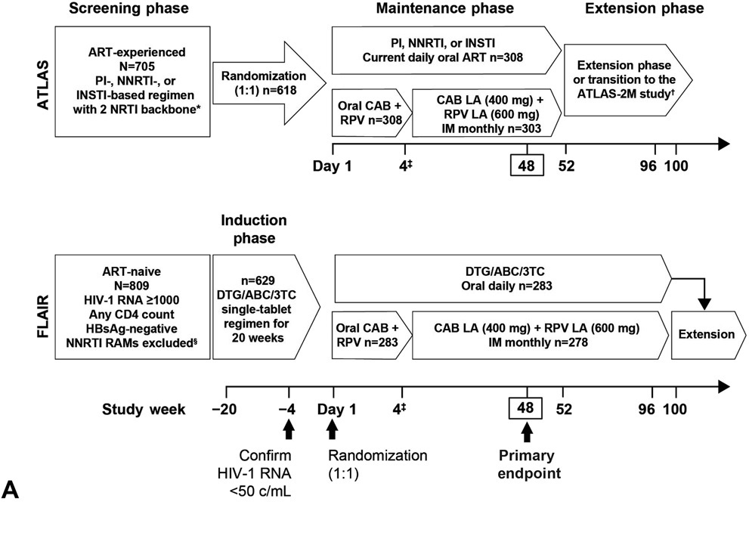
PHASE 3 ATLAS & FLAIR DESIGNS

Slide 11
ATLAS Virologic Snapshot Outcomes at Week 48 for ITT-E: Noninferiority Achieved for Primary and Secondary Endpoints
CAB LA + RPV LA
CAR
  Virologic Outcomes
  Adjusted Treatment Difference (95% CI)*
Primary endpoint:
LA noninferior to CAR (HIV-1 RNA
≥50 c/mL) at Week 48
0.6
-1.2
2.5
6% NI
margin
Virologic nonresponse (≥50 c/mL)
Difference (%)
CAB, cabotegravir; CAR, current antiretroviral; CI, confidence interval; ITT-E, intention-to-treat exposed; LA, long-acting; NI, noninferiority; RPV, rilpivirine.
*Adjusted for sex and baseline third agent class.
Swindells NEJM 2020

Slide 12
ATLAS Virologic Snapshot Outcomes at Week 48 for ITT-E: Noninferiority Achieved for Primary and Secondary Endpoints
  Virologic Outcomes
CAB LA + RPV LA
CAR
  Adjusted Treatment Difference (95% CI)*
Primary endpoint:
LA noninferior to CAR (HIV-1 RNA
≥50 c/mL) at Week 48
0.6
-1.2
2.5
6% NI
margin
CAR
CAB LA + RPV LA
Difference (%)
Key secondary endpoint:
LA noninferior to CAR (HIV-1 RNA
<50 c/mL) at Week 48
-3.0
−10% NI
margin
-6.7
0.7
Virologic nonresponse (≥50 c/mL)
Virologic success
(<50 c/mL)
No virologic data
Difference (%)
Swindells NEJM 2020
Slide 13 of 37
CAB, cabotegravir; CAR, current antiretroviral; CI, confidence interval; ITT-E, intention-to-treat exposed; LA, long-acting; NI, noninferiority; RPV, rilpivirine.
*Adjusted for sex and baseline third agent class.

Slide 13
FLAIR Virologic Snapshot Outcomes at Week 48 for ITT-E:
Noninferiority Achieved for Primary and Secondary Endpoints
  Virologic outcomes
  Adjusted treatment difference (95% CI)*
CAB LA + RPV LA
DTG/ABC/3TC
Primary endpoint:
LA noninferior to DTG/ABC/3TC
(≥50 c/mL) at Week 48
−0.4
−2.8
2.1
6% NI
margin
Difference (%)
Virologic nonresponse (≥50 c/mL)
3TC, lamivudine; ABC, abacavir; CAB, cabotegravir; CI, confidence interval; DTG, dolutegravir; ITT-E, intention-to-treat exposed; LA, long-acting; NI, noninferiority; RPV, rilpivirine.
*Adjusted for sex and baseline HIV-1 RNA (< vs ≥100,000 c/mL).
Orkin NEJM 2020

Slide 14
FLAIR Virologic Snapshot Outcomes at Week 48 for ITT-E:
Noninferiority Achieved for Primary and Secondary Endpoints
  Virologic outcomes
  Adjusted treatment difference (95% CI)*
CAB LA + RPV LA
DTG/ABC/3TC
Primary endpoint:
LA noninferior to DTG/ABC/3TC
(≥50 c/mL) at Week 48
−0.4
−2.8
2.1
6% NI
margin
Difference (%)
DTG/ABC/3TC
CAB LA + RPV LA
Key secondary endpoint:
LA noninferior to DTG/ABC/3TC
(<50 c/mL) at Week 48
0.4
−10% NI
margin
−3.7
4.5
Virologic nonresponse (≥50 c/mL)
Virologic success
(<50 c/mL)
No virologic data
Difference (%)
3TC, lamivudine; ABC, abacavir; CAB, cabotegravir; CI, confidence interval; DTG, dolutegravir; ITT-E, intention-to-treat exposed; LA, long-acting; NI, noninferiority; RPV, rilpivirine.
*Adjusted for sex and baseline HIV-1 RNA (< vs ≥100,000 c/mL).
Orkin C, NEJM 2020.

Slide 15
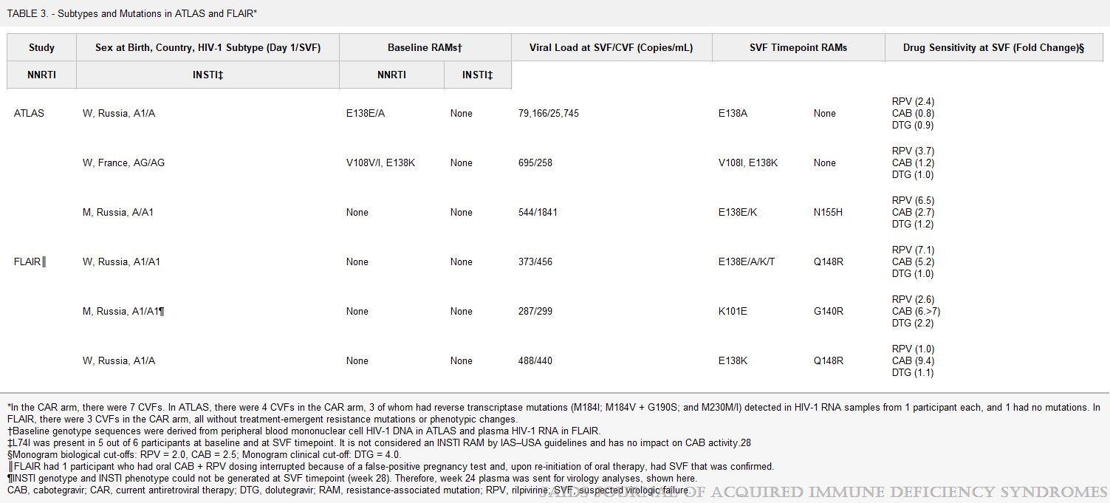
Confirmed Virologic Failure With Resistance: CAB LA + RPV LA Arm
Plasma CAB and RPV concentrations at the time of failure were below the population means but within the range for the large majority of individuals who maintained virologic suppression
Rizzardini JAIDS 2020

Slide 16
Univariate analysis of CVF outcome by 10 pre-specified factors including ATLAS, FLAIR & ATLAS 2M
Presence of ≥2 factors associated with increased CVF risk: proviral RPV RAMs,
HIV-1 subtype A6/A1, and/or BMI ≥30 kg/m².
Cutrell AIDS 2021

Slide 17
ATLAS & FLAIR COMBINED SAFETY RESULTS
Mean (SD) weight change at week 48 from baseline was an increase of 2.34 kg (5.67)
and 1.17 kg (5.22) in the LA and CAR arms, respectively.
Rizzardini JAIDS 2020

Slide 18
ATLAS & FLAIR COMBINED DATA

Slide 19
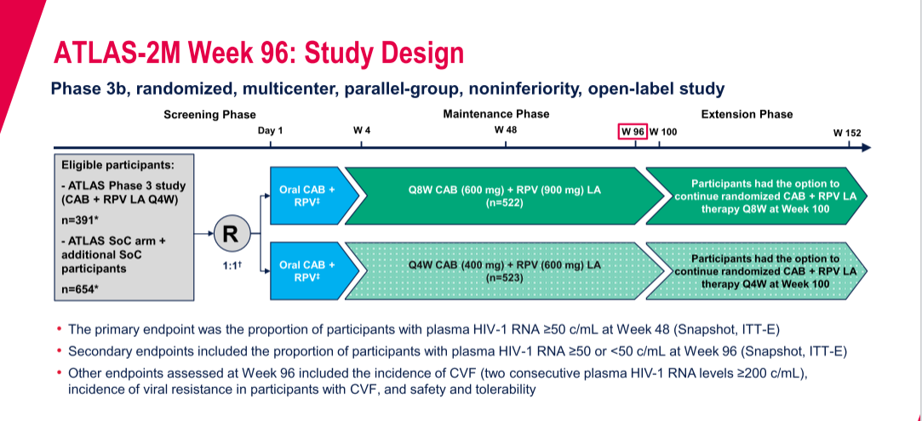
CAB + RPV LA Every 8 Weeks Remains Noninferior to Every 4 Weeks at Week 96 in ATLAS 2M
Jaeger CROI 2021

Slide 20
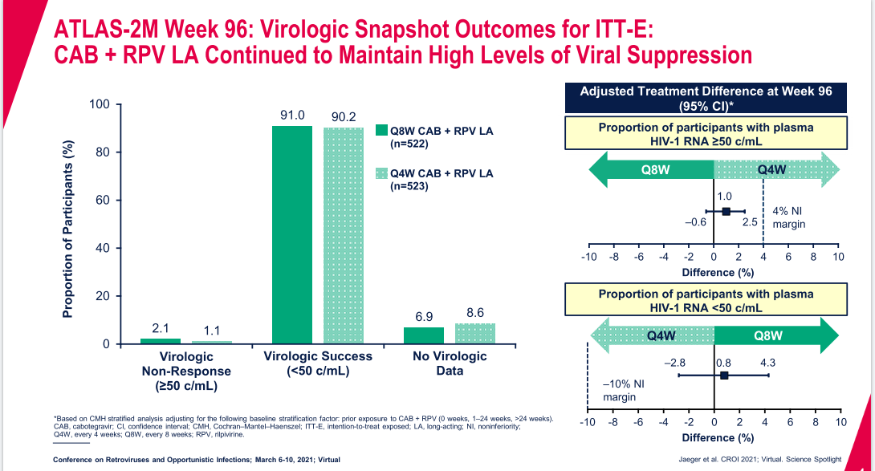

Slide 21
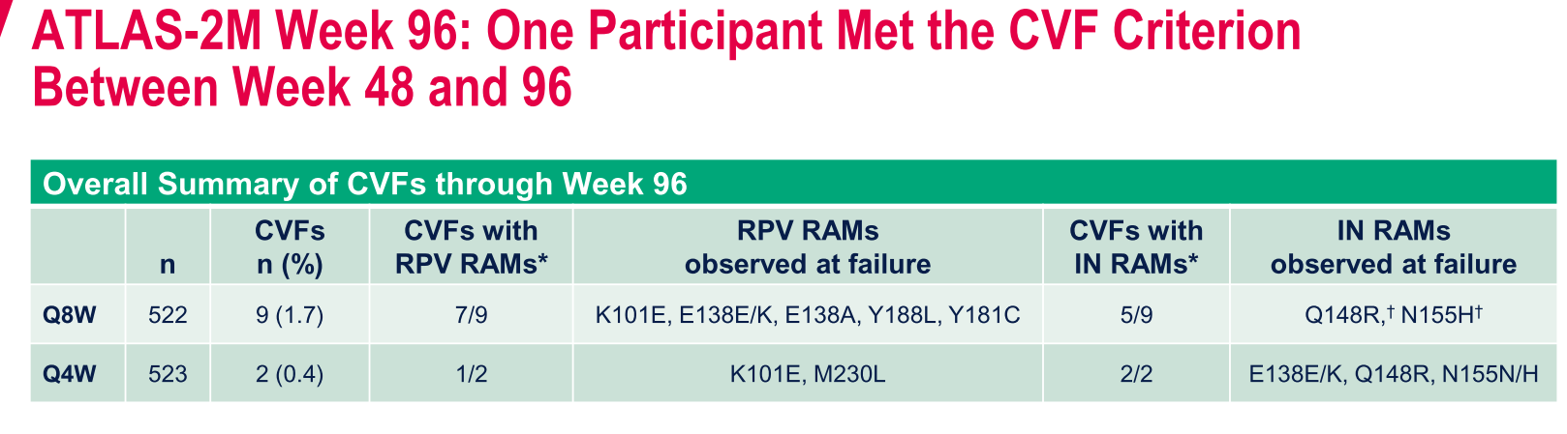
Summary Of CVF Events
Jaeger CROI 2021

Slide 22

Do Our Patients Want ART by Injection?

Slide 23
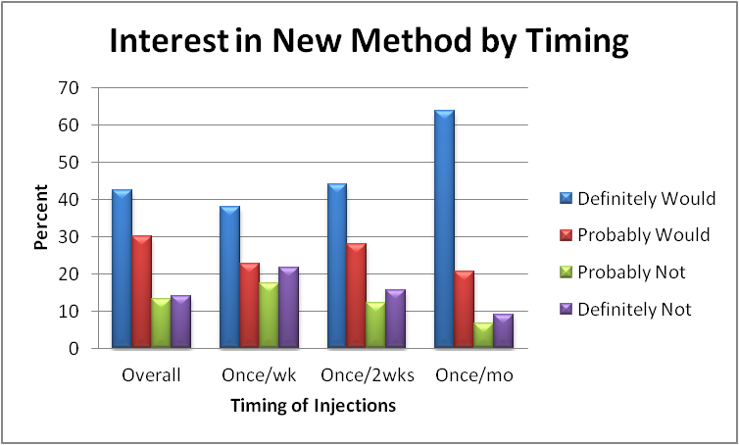
400 patients
68% male
53% AA
Mean age 47
Williams et al Nanomedicine 2012

Slide 24
ATLAS & FLAIR COMBINED DATA

Slide 25
LA/ER formulations:
What can we learn
from other disease areas?

Slide 26

WHAT CAN WE LEARN FROM PrEP STUDIES?

Slide 27

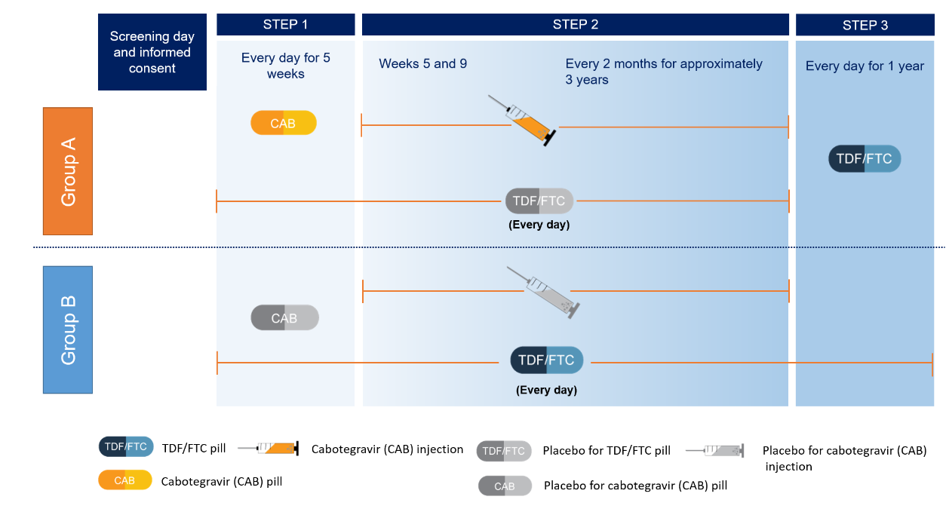

Cabotegravir PrEP Studies in MSM/TGW and CGW
Cisgender men and transgender women who have sex with men
Non-inferiority, double-blind, double-dummy design
N=4566 at 43 sites in Argentina, Brazil, Peru, South Africa, Thailand, United States, Vietnam
Protocol Chairs: Raphael Landovitz and
Beatriz Grinsztejn
Cisgender women
Superiority, double blind, double dummy design
N=3224 at 20 sites in Kenya, Malawi, South Africa, Swaziland, Uganda, Zimbabwe
Protocol Chairs: Sinead Delaney-Moretlwe and
Mina Hosseinipour
27
Slide 24 of 37

Slide 28

HIV Incidence – ITT
0.07
0.06
TDF/FTC
0.05
Cabotegravir
1 year
2 years
3 years
0.04
Cumulative Incidence
HR 0.34 (0.18, 0.62)
p=0.0005
0.03
0.02
0.01
0
0
9
17
25
33
41
49
57
65
73
81
89
97
105
113
121
129
137
145
153
161
169
177
185
193
Weeks since enrollment
Number at risk
2247 2243 | 2133 2138 | 2081 2092 | 2019 2032 | 1913 1921 | 1764 1776 | 1624 1632 | 1494 1488 | 1294 1312 | 1132 1119 | 965 957 | 816 795 | 643 644 | 516 503 | 400 401 | 310 318 | 230 243 | 149 172 | 85 111 | 33 42 | 0 0 | 0 0 | 0 0 | 0 0 | 0 0
0 0 | 1 3 | 6 4 | 8 5 | 12 6 | 14 8 | 22 9 | 25 11 | 27 11 | 29 11 | 30 12 | 32 12 | 33 12 | 35 12 | 35 13 | 36 13 | 36 13 | 37 13 | 38 13 | 39 13 | 0 0 | 0 0 | 0 0 | 0 0 | 0 0
TDF/FTC
Cabotegravir
Cumulative number of events
TDF/FTC
Cabotegravir
- Landovitz RJ et al. AIDS 2020, #OAXLB0101
66% reduction in incidence with CAB vs TDF/FTC
Clear demonstration of the benefits of an LA formulation as compared
to standard one-pill-once-per-day

Slide 29

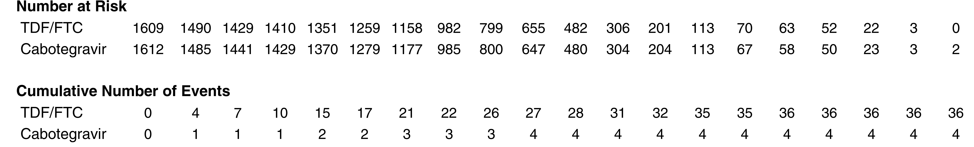
Cumulative HIV incidence – ITT
Cabotegravir PrEP Study in Cis-gender Women
  CAB-LA superior to daily oral TDF/FTC in HPTN 084
Women in the CAB group had an 89% lower risk of HIV infection, compared to TDF/FTC group
Delany-Moretlwe, HIV R4P 27 Jan 2021, LB1479

Slide 30
Why LA/ER antiretrovirals may play a major role in the future of HIV treatment and prevention
Schizophrenia -- adherence
Osteoporosis -- convenience
Contraception -- choice
Prostate cancer – all 3!

Slide 32
Use of LAIs in Chronic Schizophrenia
The majority of patients with schizophrenia relapse after 5 years and poor adherence is the most common cause.
The discontinuation rate for oral antipsychotics is 26%-44%.
Up to a third of patients are at least partially non-adherent.
Non-adherence is associated with increased relapse, hospitalization and suicide.
Long-acting injectable treatment is associated with lower rates of relapse, discontinuation and hospitalization versus oral anti-psychotics, and increased cost-effectiveness, functionality, quality of life and patient satisfaction.
- Kaplan et al., Patient Preference and Adherence; 2013
Thanks to Charles Flexner

Slide 33
Use of LAIs in Osteoporosis
Adherence to oral bisphosphonates for the treatment of osteoporosis is low.
At least one-third of patients do not consistently take oral bisphosphonates as prescribed.
Rates of adherence to oral tablets decrease over time.
Patients overwhelmingly prefer a once-yearly injectable product (IV zoledronic acid).
- Fobelo Lozano et al., Eur J Hosp Pharm; 2017

Slide 34
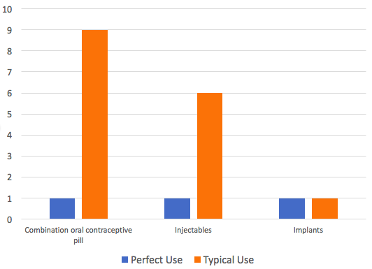
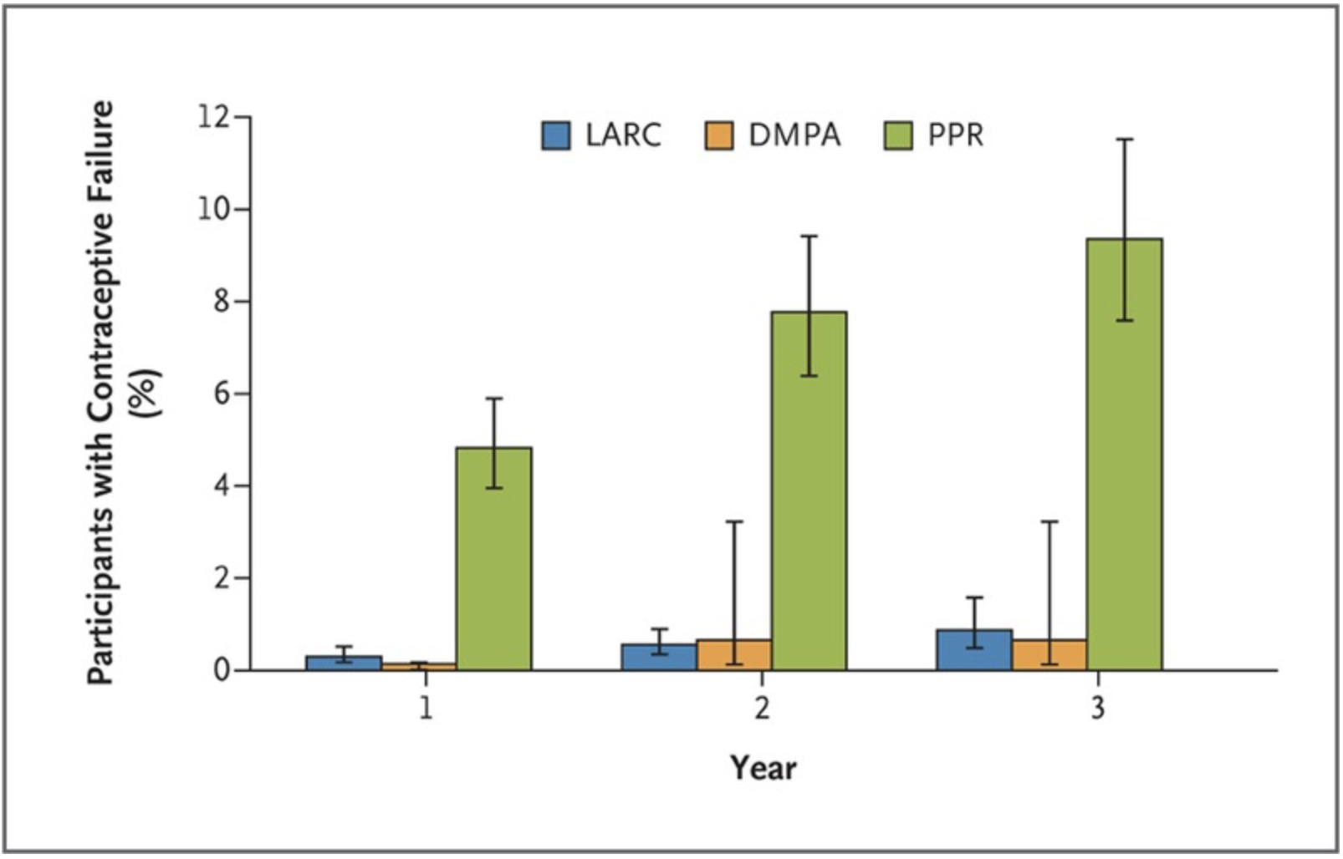
Adherence to long-acting therapies:
Lessons from contraception
Perfect vs. Typical Use
Prospective cohort of 7486 participants over 3 years
Implants Injections Other hormonal methods*
* Pill, patch, vaginal ring
Winner et al. NEJM 2012; 366:1998-2007
Thanks to Kim Scarsi
Notes:
we identified 334 unintended pregnancies. The contraceptive failure rate among participants using pills, patch, or ring was 4.55 per 100 participant-years, as compared with 0.27 among participants using long-acting reversible contraception (hazard ratio after adjustment for age, educational level, and history with respect to unintended pregnancy, 21.8; 95% confidence interval, 13.7 to 34.9).
Bars depict the cumulative percentage of participants who had a contraceptive failure with long-acting reversible contraception (LARC), depot medroxyprogesterone acetate (DMPA), or pill, patch, or ring (PPR) at 1, 2, or 3 years. Participants using PPR had significantly more unintended pregnancies than those using LARC (P<0.001) or DMPA (P<0.001).

Slide 35
Implementation will Be Challenging
Thank you to Andrea Mantsios

Slide 36
SUMMARY
More choices for patients and providers
All treatment trials so far only include pts with optimal adherence
Randomized treatment trial data for those with adherence challenges will not be available for some [A5359/LATITUDE]
Risk factors for virologic failure are different
  Some failures with resistance may occur despite “good adherence”
Providers and patients will need to consider options carefully
Clinics will need to adjust workflow/address logistics

Slide 37
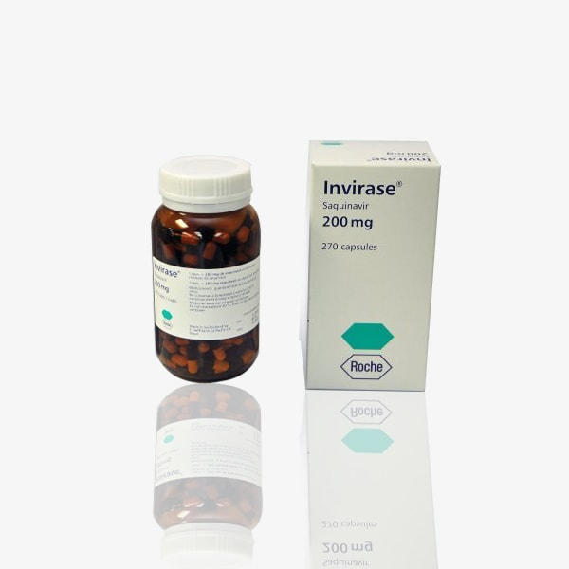
REMEMBER – THIS IS FIRST IN CLASS

Slide 38


Slide 39
Patient Eligibility and Education
Christine D. Tran, DNP, APRN
Nurse Practitioner, Infectious Disease
Nebraska Medicine

Slide 40
PREPARATION
Creating our Clinical Protocol
    Eligibility Criteria
    Dosing Considerations
    Patient Education

Slide 41
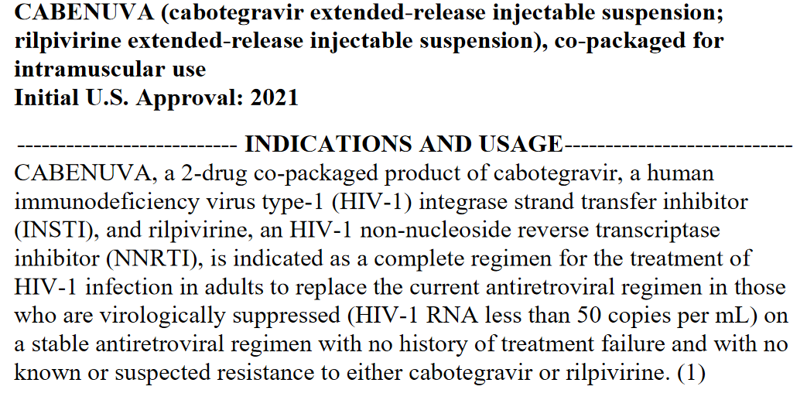
Prescribing Information
https://gskpro.com/content/dam/global/hcpportal/en_US/Prescribing_Information/Cabenuva/pdf/CABENUVA-PI-PIL-IFU2-IFU3.PDF

Slide 42
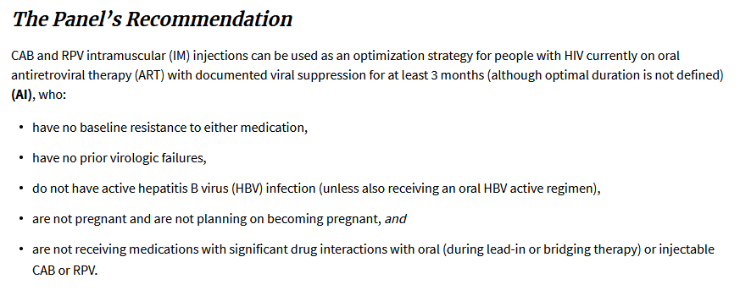
DHHS Guidelines Panel Recommendations
https://clinicalinfo.hiv.gov/en/guidelines/adult-and-adolescent-arv/hhs-adults-and-adolescents-antiretroviral-guidelines-panel

Slide 43
Eligibility Criteria
Able to come to clinic for injections every month
Virologically suppressed (HIV-1 RNA < 50 copies/mL) for 3 months
On stable ART regimen for the last 6 months
No major known INSTI or NNRTI resistance-associated mutation except for K103N
No prior hypersensitivity reaction to cabotegravir, rilpivirine (or other integrase inhibitors: bictegravir, dolutegravir)
Not currently receiving any of the following medications: carbamazepine, oxcarbazepine, phenobarbital, phenytoin, rifabutin, rifampin, rifapentine, systemic dexamethasone, or St John’s wort
Not co-infected with hepatitis B
Not currently pregnant or planning to conceive in near future (insufficient data)

Slide 44
Dosing Considerations
Transitioning to long-acting injectables
  Recommend patient and/or clinic select a monthly injection date prior to first injection as it helps to have a consistent monthly injection date
  Pick a day between the 1st and 28th of the month
    Month 1 (at least 28 days): Oral lead-in
    Month 2 (one-time dosing): Initiation injections
    Month 3 (and beyond): Continuation injections
Dosing flexibility
Missed injections

Slide 45
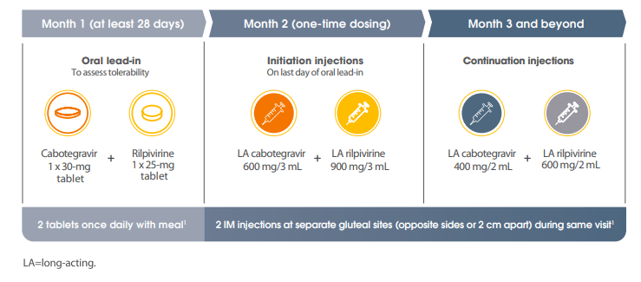
Transitioning Dosing
https://assets.gskstatic.com/pharma/us/viiv/Cabenuva-Dosing-Administration-Guide.pdf

Slide 46
Dosing Flexibility
  Injections can be given up to 7 days before or 7 days after the targeted treatment date
  If patients receive injections within 7 days before/after their targeted treatment date, the following monthly dose should be scheduled for the original monthly injection date
  If patient plans to miss a scheduled injection visit by > 7 days, prescribe oral therapy with cabotegravir/rilpivirine to replace up to 2 consecutive monthly injection visits
  Patients who miss a scheduled injection visit should be clinically reassessed to ensure resumption of therapy remains appropriate

Slide 47
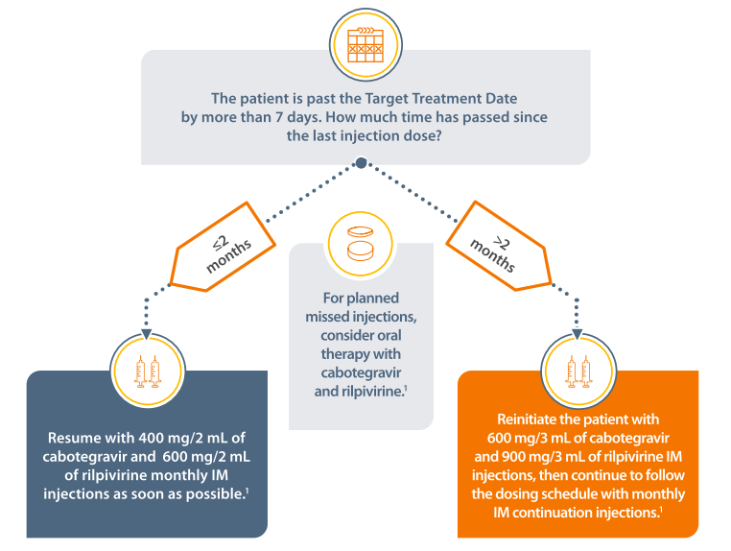
Missed injection
https://assets.gskstatic.com/pharma/us/viiv/Cabenuva-Dosing-Administration-Guide.pdf

Slide 48
Planned Missed Injection
  First dose of oral therapy (cabotegravir 30 mg + rilpivirine 25 mg) should be taken approximately 1 month after the last injection dose of cabotegravir/rilpivirine
  Continue oral therapy daily until the day injection dosing is restarted
  If oral treatment will continue for > 2 months, an alternative fully suppressive regimen should be chosen based on treatment history and availability of resistance testing results

Slide 49
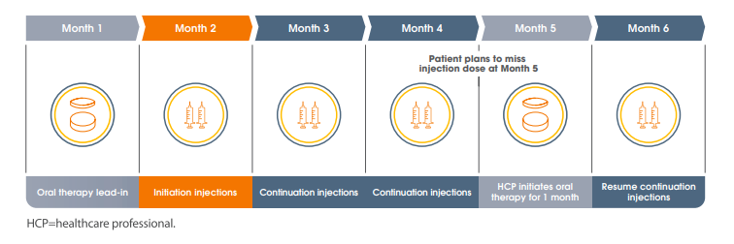
Planned Missed Injection
https://assets.gskstatic.com/pharma/us/viiv/Cabenuva-Dosing-Administration-Guide.pdf

Slide 50
Patient Education
Review clinical protocol with patient
  Provide verbal and written information
Review what to expect with injections
  Provide injection overview - process, side effects, length of visits
  Preferred position for administration - lying down
Allow time for patient to ask questions
Offer “Patient Liaison”
  Experienced patient willing to talk to potential patients
Complete “Patient Agreement”
    Effort and commitment, on behalf of the medication recipient and the clinic staff, in order to be successful
    Capture contact information

Slide 51
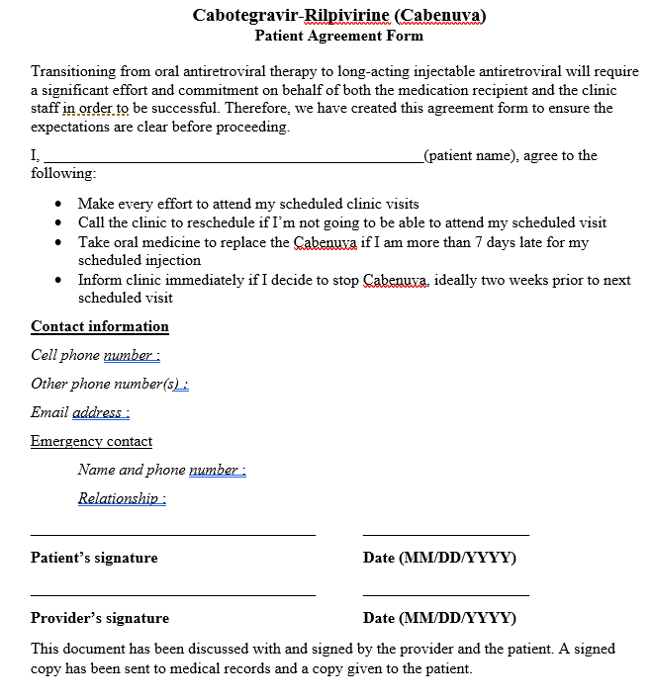

Slide 52
Accessing Medication
Josh Havens, PharmD, BCPS
Clinical Pharmacist, HIV Program
Assistant Clinical Professor, College of Pharmacy
University of Nebraska Medical Center

Slide 53
Additional Learning Objective
Understand the enrollment, procurement, and billing processes for commercially available long-acting injectable antiretroviral therapy, Cabenuva (CAB/RPV)

Slide 54
Full Process
Enrollment
Coverage Determination
Prior Authorization
Access Options
Secondary Coverage Options

Slide 55
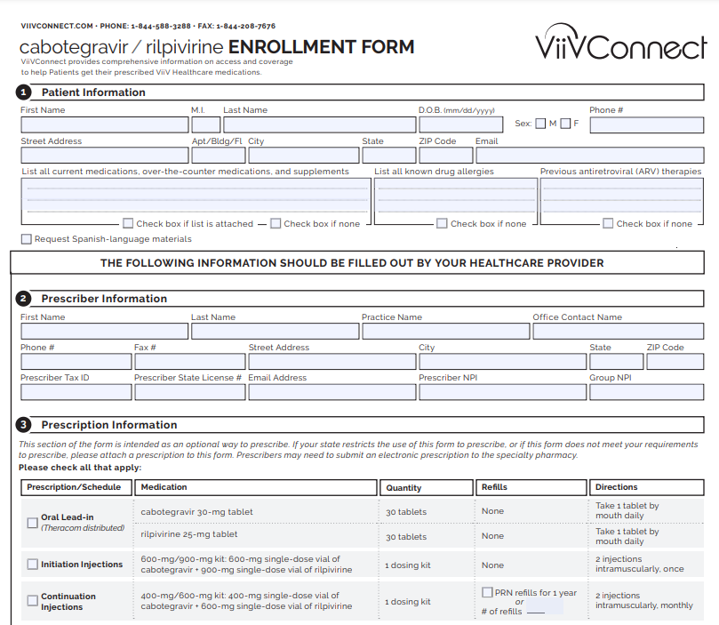
Enrollment
Form
ViiV Connect Website (https://www.viivconnect.com/content/dam/cf-viiv/viiv-connect/master/pdf/CABENUVA_Enrollment_Form.pdf)

Slide 56
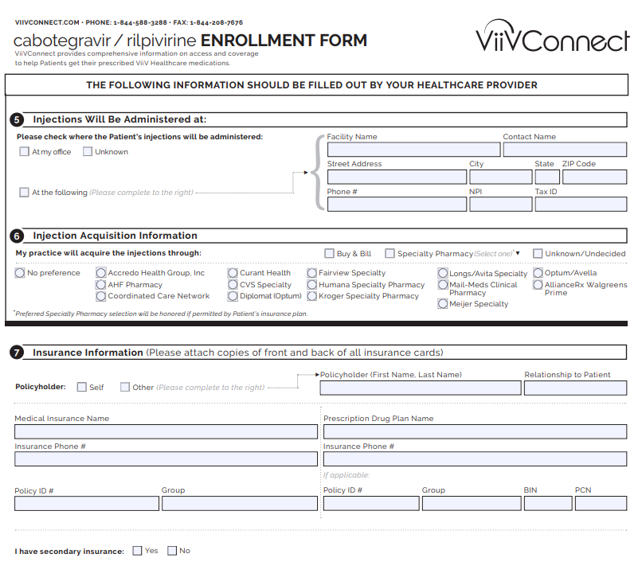
Enrollment
Form
ViiV Connect Website (https://www.viivconnect.com/content/dam/cf-viiv/viiv-connect/master/pdf/CABENUVA_Enrollment_Form.pdf)

Slide 57
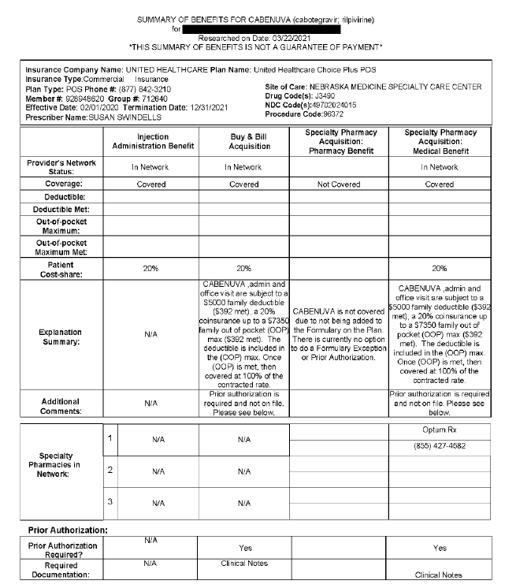
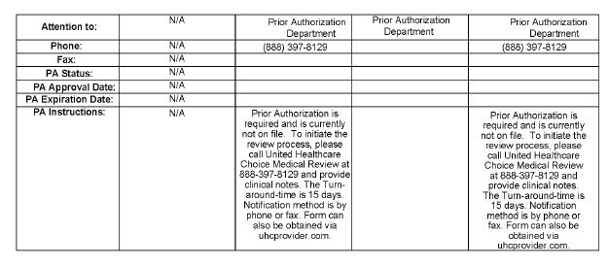
Coverage Determination/Prior Authorization
ViiV Connect reviews coverage and provides clinic with options for prescription and acquisition.

Slide 58
Access Options
 | Buy-and-Bill | White Bagging | Brown Bagging
Description | Clinic acquires and bills for drug and administration | Prescription sent to specialty pharmacy; drug mailed to clinic for administration | Prescription sent to specialty pharmacy; patient picks it up and takes to provider for administration
Medical Benefit | X | X
Pharmacy Benefit |  | X | X
Administration Fee | X | X | X
Clinic Inventory Control | X | X
Comments | CAB/RPV requires cold-chain storage. Thus, the “brown bag” option is unlikely to be an option for access. Medical claims subject to deductible/out-of-pocket for administration fees Wholesaler limited distribution for buy-and-bill (Cardinal, ASD, Besse, Curascript, McKesson)
Adapted from Cabenuva Website: https://www.viivconnect.com/content/dam/cf-viiv/viiv-connect/master/pdf/CABENUVA_Acquisition_Guide.pdf

Slide 59
Cost
 | Loading Dose (600/900mg) | Maintenance Dose (400/600mg)
Average Wholesale Price (AWP) | $7,200 | $4,800
Wholesaler Acquisition Cost (WAC) | $5,900 | $3,960
340B Acquisition Cost | $4,567 | $3,045
ADAP Acquisition Cost | $1,800 | $1,200
Comments | All estimated prices¹; ADAP price estimated to be 25% of AWP
¹AWP/WAC estimated pricing provided by NASTAD; 340B received from Cardinal Health

Slide 60
Uninsured Patient Assistance
  Live in the United States
  Income <500% of the Federal Poverty Level
    (1 person - $64,400, 2 person - $87,100, 3 person $109,800)
  Not eligible for Medicaid
  AND
  Have no prescription coverage
  OR
  Have Medicare Part B, D, or Advantage Plan and spent at least $600 out of pocket
Adapted from ViiV Connect Website: https://www.viivconnect.com/injectable/patient-assistance-program

Slide 61
Secondary Coverage Options
ViiV Copay Assistance
  $13,000 of annual assistance with out-of-pocket drug costs
  Does not cover physician office visit or administration fees
  Primary coverage must not be government funded (Medicare, Medicaid, VA, or Tricare)
  Access up-front or as rebate
    Up-front – if specialty pharmacy route – billing information provided to pharmacy by ViiV Connect
    Rebate – patient fills out rebate form and supplies supporting documentation
Adapted from ViiV Connect Website: https://www.viivconnect.com/injectable/patient-savings-program

Slide 62
Secondary Coverage Options
ADAP
  Subject to respective state formulary and billing preferences
  Billing
    Drug – billed to ADAP pharmacy benefit manager
    Physician/Admin Fees – invoiced to state ADAP program as an Outpatient/Ambulatory Health Service category
Grant Foundations – primarily for Medicare D members
  Patient Advocate Foundation¹
  Good Days: Chronic Disease Fund²
¹Accessed at https://www.patientadvocate.org/connect-with-services/copay-relief/
²Accessed at https://mygooddays.org

Slide 63
Bridge Program
Coverage for commercially insured patients waiting on CAB/RPV formulary placement
  No coverage for government funded, uninsured, or commercially insured (when coverage is excluded) patients
Program length of 12 months
Enrollment
  Complete enrollment form
  ViiV Connect will contact provider and coordinate shipment if patient wants to proceed
Does not cover physician/administration fees
Adapted from: https://www.viivconnect.com/content/dam/cf-viiv/viiv-connect/master/pdf/CABENUVA_Bridge_Program_Brochure.pdf

Slide 64
Resources
https://www.viivconnect.com/content/dam/cf-viiv/viiv-connect/master/pdf/CABENUVA_Enrollment_Form.pdf
https://www.viivconnect.com/injectable/resources/

Slide 65
Administration Considerations,
Side Effect Management &
Optimization of Adherence
Maureen Kubat, BSN, RN
Clinical Research Coordinator
University of Nebraska Medical Center

Slide 66
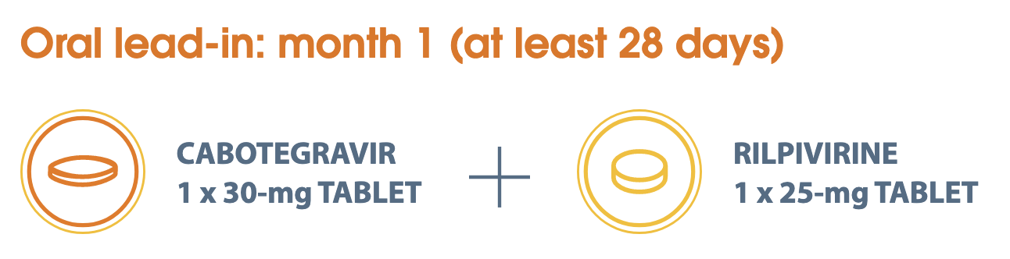
Medication Supply Considerations
Oral Lead-In dosing shipped directly to patient or provider
  Oral cabotegravir not available at retail pharmacies
  One tablet of each, once daily
Schedule first injection on day 28-30
    Patient ideally takes last oral dose on the day of Initiation injections
    IMPORTANT: plan with patient to ensure success
https://cabenuvahcp.com/dosing-and-drug-interactions/

Slide 67
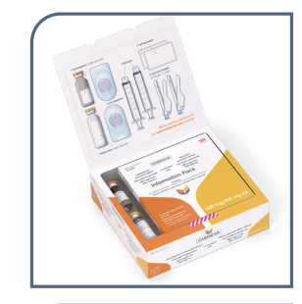
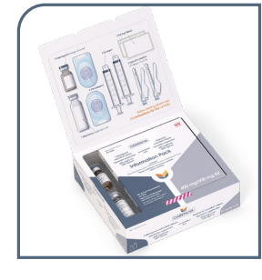
Medication Supply Considerations
Initiation Injection Kits
Continuation Injection Kits
Single-dose vials of cabotegravir-LA 600mg/3mL and rilpivirine-LA 900mg/3mL
2 syringes, 2 labels, 2 vial adapters, 2 needles (23-gauge, 1 ½ inch)
Single-dose vials of cabotegravir-LA 400mg/2mL and rilpivirine-LA 600mg/2mL
2 syringes, 2 labels, 2 vial adapters, 2 needles (23-gauge, 1 ½ inch)
https://cabenuvahcp.com/dosing-and-drug-interactions/

Slide 68
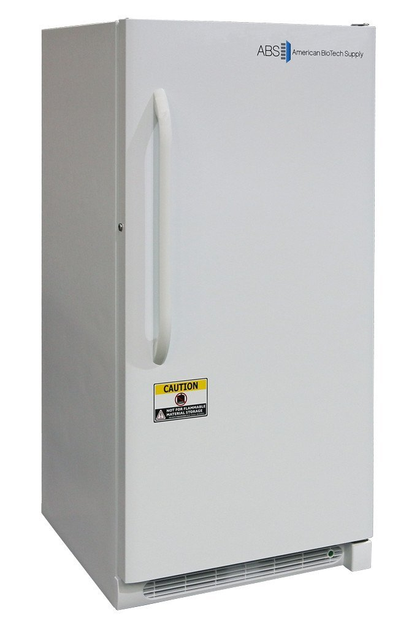
Medication Supply Considerations
Kits will arrive via cold-chain supply
Store in refrigerator at 2-8 ℃ (36-46 ℉) in original carton until ready for use
Once removed from refrigerator, medication must be used within 6 hours
  Cannot be cycled in and out of refrigerator
Once drawn up for injection, must be used within 2 hours
Kit dimension: 6.2” x 5.6” x 1.7”

Slide 69
Pre-Initiation Injection Considerations
Clinic Considerations | Patient Considerations
Space: Room with exam table Staffing and Clinic Flow 15 minutes for medication to warm to room temperature 5 minutes for injection preparation 5 minutes for injection administration 10-15 minutes patient observation Universal site selection for cabotegravir LA vs. rilpivirine LA | Education Patient-friendly schedule Body habitus Consider 2” needles* for: BMI >30 kg/m² Increased fat distribution in hips & buttocks Assess for scar tissue, tattoos, nodules from previous injections, presence of gluteal implants at injection sites.
* 2” 21-gauge safety needles are not included in kits and need to be separately ordered
https://cabenuvahcp.com/injection-education/

Slide 70
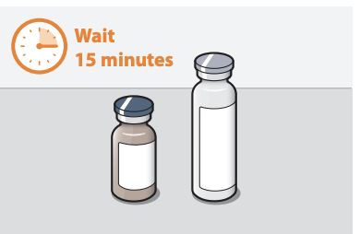
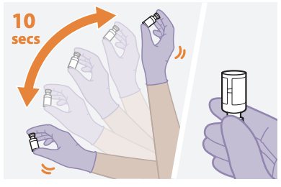
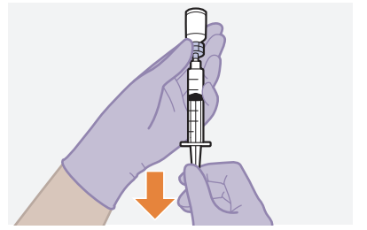
Administration Considerations: Medication Preparation
Remove kit from fridge and allow to warm to room temperature for 15 minutes
Label each syringe with patient and medication information, including the time medications are drawn into syringes
    Medications can be in syringes for up to 2 hours before discard is required
Shake each medication vigorously to evenly distribute contents—no reconstitution is needed
Draw up cabotegravir-LA and rilpivirine-LA, each into a separate syringe, using adaptors in the kits
    Do not combine medications
Attach needles to syringes
https://cabenuvahcp.com/injection-education

Slide 71
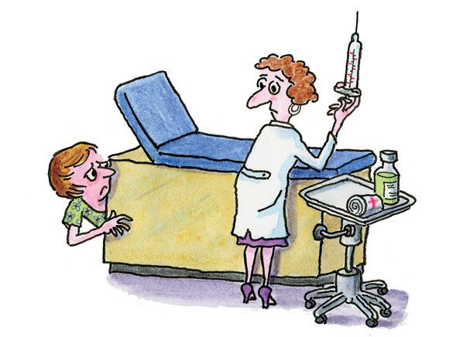
Administration Considerations: Patient Preparation
Goal= Ease anxiety
Not necessary to change out of clothing
Maximize patient autonomy
  Sequence of injections
    Rilpivirine-LA is thicker, Cabotegravir-LA is thinner
  Timing of injections
  Positioning as appropriate
Employ relaxation techniques
  Distraction
  Deep-breathing
  Music
Have patient lay on exam table
  Promotes safety and relaxation

Slide 72
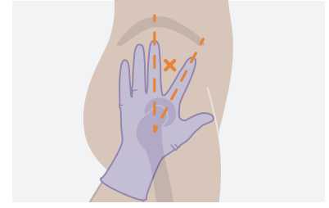
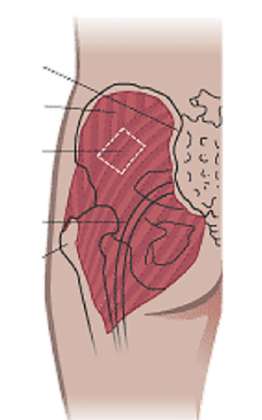
Administration of Medications
Don gloves and isolate the muscle at the site of the injection
  Preferably have the patient lay on the exam table, on side, with hip facing up
  Note: each medication should be given into a separate site, on opposite sides, or at least 2 cm apart
  Have patient flex isolated muscle and feel for muscle movement to ensure placement
Ventrogluteal Site
Dorsogluteal Site
https://cabenuvahcp.com/injection-education/

Slide 73
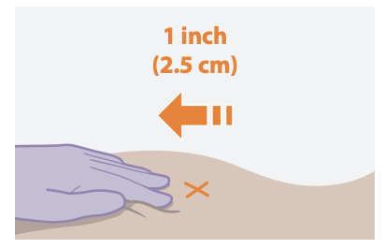
Administration of Medications
Have patient relax completely
Clean isolated area with alcohol wipe
Use the Z-track technique to minimize medication leakage from the injection site
  Firmly drag the skin covering the injection site, displacing it by about an inch
  Keep it held in this position for the duration of the injection
Slowly and steadily inject the medication to avoid excessive pressure
Withdraw the needle and release the stretched skin immediately
Apply pressure and bandage
Monitor patient for 10-15 minutes after first injection
Z-track technique
https://cabenuvahcp.com/injection-education

Slide 74
What to Expect from Injections
During injections, patients may experience:
Pain/discomfort – most common
Muscle spasm
Sensation of “feeling the medication going in”
Sensation of medication dripping down the leg

Slide 75
Side Effects
Injection Site Reactions | Systemic Side Effects
Pain or soreness at the site • most common ISR 1st injections generally the most painful Nodules Itching Swelling Bruising Muscle spasm | Headache Fatigue Nausea Dizziness Fever Rash • Encourage patient to call – should evaluate
https://cabenuvahcp.com/dosing-and-drug-interactions

Slide 76

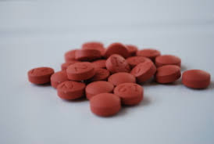

Managing Side Effects
Heat/cold
Ibuprofen/acetaminophen
  Before and/or after injections
Encourage movement, but not overexertion
Plan activities accordingly
Anticipatory guidance goes a long way!

Slide 77

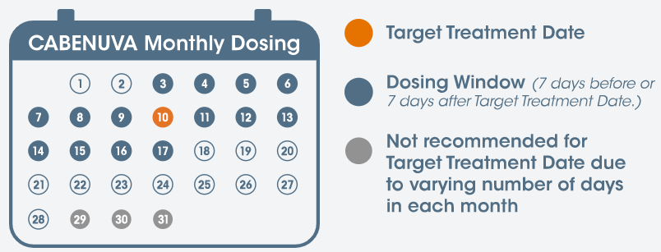
Scheduling Injections
Pick target date of the month between 1st – 28th
Injection window will be the 14 days around that (+/- 7 days on either side)
cabotegravir and rilpivirine
https://cabenuvahcp.com/content/dam/cf-viiv/cabenuva-hcp/master/pages/dosing/CalendarGraphic.svg

Slide 78
Scheduling Considerations
Clinic | Patient | Exceptions
Staffing Space | Work School Personal Travel | Walk-ins Triaging patient concerns/issues unrelated to injections

Slide 79
Missed Injections - Unplanned
Time Since Last Injection | Recommendation
<2 months | Resume with 400-mg (2-mL) cabotegravir and 600-mg (2-mL) rilpivirine IM monthly injections as soon as possible
>2 months | Re-initiate the patient with 600-mg (3-mL) cabotegravir and 900-mg (3-mL) rilpivirine IM injections, then continue to follow the 400-mg (2-mL) cabotegravir and 600-mg (2-mL) rilpivirine IM monthly injection dosing schedule
If >7 days but </= 2 months since last injection, resume with continuation dose injections
If >7 days and > 2 months since last injections, restart with initiation dose injections; then resume standard monthly dosing
CABENUVA [package insert]. Research Triangle Park, NC: ViiV Healthcare; 2021

Slide 80
Missed Injections - Planned
Oral bridging
Oral cabotegravir available through ViiV
Oral rilpivirine can be prescribed at pharmacy
First dose taken approximately 1 month after last injections
Continue until the day of the next injections
If oral ART will continue for > 2 months, consider an alternate regimen based on patient history
CABENUVA [package insert]. Research Triangle Park, NC: ViiV Healthcare; 2021

Slide 81

Retention strategies
** Patients who may benefit the most from LA therapy may also be at highest risk for non-adherence

Slide 82
Retention strategies
Reminder calls and/or texts prior to visit
Immediate call if appointment is missed
Scheduling patients at risk for non-adherence on the early side of the window to allow for rescheduling within window if appointment is missed
Obtain multiple ways to contact patient
  Phone number(s) – text, voicemail
  Email
  EMR patient portal/messaging
  Obtain friends/family contact info
  Verify contact info at each visit

Slide 83
Retention strategies
Consider patient “contract” or agreement
  Explains expectations for both clinic and patient
Consider transportation support
Retention coordinator
  Point person for managing retention efforts
Software/flowsheet to track appointments

Slide 84
Resources
https://cabenuvahcp.com

Slide 85
QUESTIONS?
GROUP DISCUSSION

Slide 86
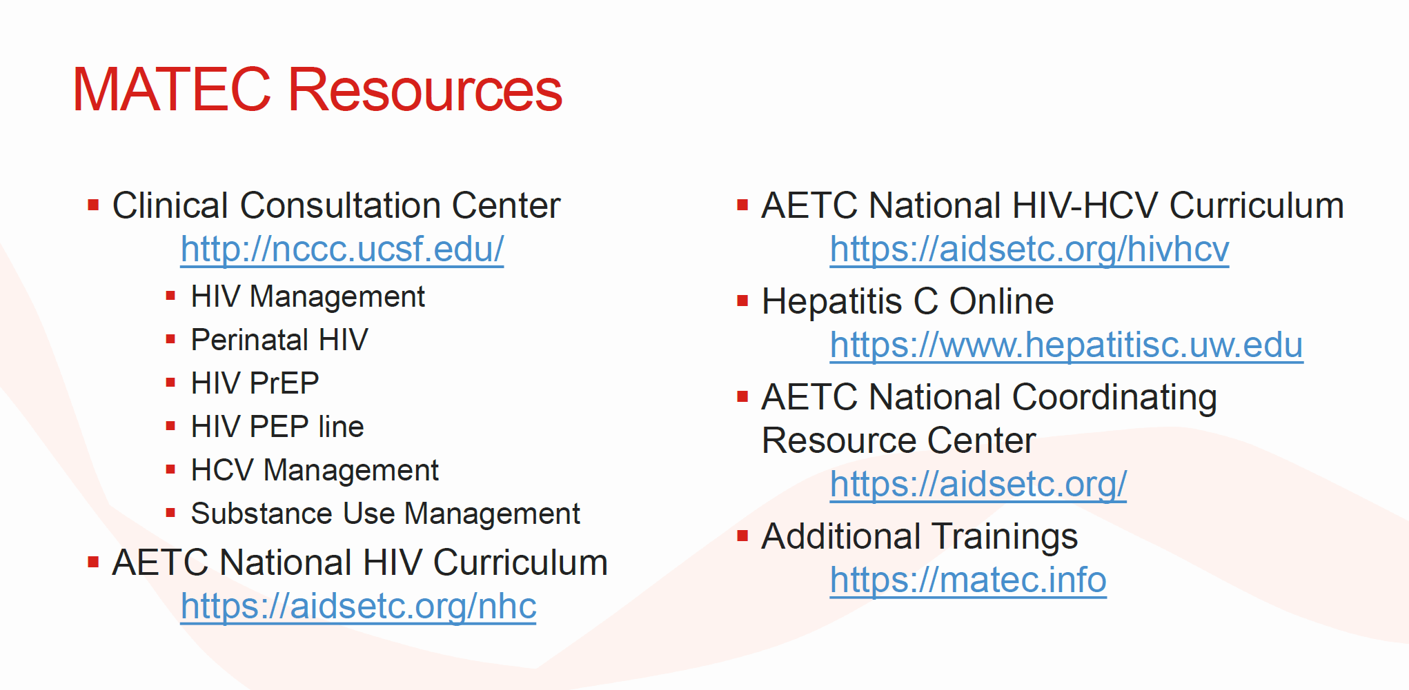

Slide 87
Contact Information
MATEC-Kansas/Nebraska Clinical Team
  Donna Sweet, MD, AAHIVS, MACP - Clinical Director dsweet@kumc.edu
  Susan Tusher, LMSW - Program Director stusher@kumc.edu
  Sara Bares, MD - Associate Professor, Infectious Diseases, UNMC sara.bares@unmc.edu
  Nikki Regan, MSN, APRN, NP-C – Omaha HIV Program Coordinator nregan@nebraskamed.com

