Slide 1
Project ECHO®
HIV TeleECHO Clinic
Perinatal HIV Update:
Screening, Prevention, & Treatment
8/2021
Renee Mercier, PharmD
Professor, UNM COP & DOIM
Associate Medical Director, Truman Health Services
Notes:
Version date: 08 2021

Slide 2
Conflict of Interest Disclosure Statement
Speaker has nothing to disclose.
This presentation was reviewed by UNMHSC and SCAETC faculty to ensure it meets Continuing Education guidelines.
This project is supported by the Health Resources and Services Administration (HRSA) of the U.S. Department of Health and Human Services (HHS). Under grant number U1OHA33225 (South Central AIDS Education and Training Center). It was awarded to the University of New Mexico. No percentage of this project was financed with non-governmental sources. This information or content and conclusions are those of the authors and should not be construed as the official position or policy of, nor should any endorsements be inferred by HRSA, HHS, or the U.S. Government.

Slide 3
Learning Objectives
Recognize all pregnant persons should be screened for HIV.
Describe HIV prevention strategies.
Identify who should be started on HIV treatment and describe the impact.
Notes:
Goal: inform all about the new updates related to hiv so that we can all contribute to ending the hiv epidemic (EHE) in the US and address remaining stigma related to misinformation

Slide 4
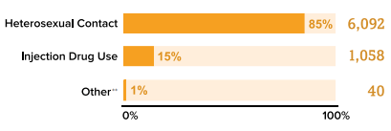
HIV in U.S. Cis Women
HIV diagnoses decreased 7% among women overall from 2014-2018
7,190 new HIV dx among women in 2018
85% were attributed to heterosexual contact
57% Black/African American
Women aged 25-34 had highest number new HIV dx (27%)
1 in 5 (19%) PWH in U.S. are cis women
CDC. Diagnoses of HIV Infection in the United States and dependent areas, 2018.
Notes:
Improvements made but disparities remain

Slide 5
HIV in U.S. Cis Women
1 in 10 cis women are unaware that they have HIV
Women may be unaware of their partner’s risk (IDU,MSM)
89% reported having condomless vaginal sex in the prior year
24% report condomless anal sex in the prior year; only 20% of those screened for HIV
https://www.cdc.gov/hiv/group/gender/women/index.html ; CDC. Diagnoses of HIV infection in the United States and dependent areas, 2018. HIV Surveillance Report 2020;31; Evans, ME et al. Am J Obst Gynecol. 2018;219(4):383.

Slide 6
Screening Pregnant Persons
Most cis women with HIV are of child-bearing age
Majority of new infections in 25-44yo
100-175 Infants born with HIV in US every year
40-85% of infants with HIV are born to women without documented HIV status prior to delivery
https://www.cdc.gov/hiv/group/gender/women/index.html; ww.cdc.gov/hiv/risk/gender/pregnantwomen/facts/index.html;
Clin Perinatol 2010;37:751-63; Obstet Gynecol 2008;112:739-4.2
Notes:
Screening guidelines:
CDC guidelines: Branson BM, et al. MMWR Recomm Rep. 2006;55(RR-14):1-17. [Thought that those who don’t know their status account for 50% of new infections (Marks, et al. 2006)] Test all pts 13-64 yo, Test all pregnant women, Test all pts with TB or STI
Test high risk patients at least annually
USPTF guidelines: Moyer, Virginia et al. Annals of Internal Medicine. 2013. Test all 15-65 yo, Test all pregnant women, Test <15 & >65 yo if at risk, Grade A recommendation.
Among mothers of HIV-infected infants (Reports to CDC 2003-2007): 62% at least one prenatal visit, 27% diagnosed with HIV after delivery, 29% received some ART during pregnancy
Annual number of HIV infections through perinatal transmission have declined more than 90% since the early 1990s. 2011 130, 2012 175, 125 2013, 130 2014, 100 2015.
Of the 1,995 children living with diagnosed perinatal HIV at the end of 2015, 65% were black/African American, 15% were Hispanic/Latino, 11% were white, 3% Asian, 4% multiple races.
At the end of 2014, 9,525 adults and adolescents (aged 13 and older) were living with HIV acquired through perinatal transmission. Of these, 60% (5,691) were black/African American, 23% (2,225) were Hispanic/Latino, and 12% (1,133) were white.

Slide 7
HIV Testing Guidelines
Test all pregnant persons at the initiation of care
Re-test during the 3rd trimester
high-risk; receiving care in facility where HIV incidence in pregnancy >1/1000 or in areas with high HIV incidence
Incarcerated
Re-test if sexually transmitted infection or acute retroviral syndrome
Rapid screening during labor if status unknown
Confirm positives post-partum
In those at high-risk, teach about signs/ symptoms of Acute Retroviral Syndrome (ARS)
https://www.cdc.gov/hiv/group/gender/women/index.html; https://stacks.cdc.gov/view/cdc/44065
Notes:
48% undetectable in 2014. (52% undetectable 2013 data; up from 30% undetectable CDC 2012 data)
Consider re-testing, especially if high risk, during the third trimester before 36weeks
“High risk” according to perinatal guidelines: receiving care in facilities that have an HIV incidence in pregnant women of at least 1 per 1,000 per year, are incarcerated, or who reside in jurisdictions with elevated HIV incidence
Screening guidelines:
CDC: Branson BM, et al. MMWR Recomm Rep. 2006;55(RR-14):1-17. [Thought that those who don’t know their status account for 50% of new infections;Marks, et al. 2006] Test all pts 13-64 yo, Test all pregnant women, Test all pts with TB or STI, Test high risk patients at least annually
USPTF: Moyer, Virginia et al. Annals of Internal Medicine. 2013. Test all 15-65 yo, Test all pregnant women, Test <15 & >65 yo if at risk. Grade A recommendation
Not infectious: Urine, Saliva, Sweat, Tears, Nasal secretions, Sputum, Vomitus, Stool
Image: https://healthylife.werindia.com/your-road-to-healthy-life/hiv-is-not-transmitted-by
https://www.cdc.gov/hiv/risk/estimates/riskbehaviors.html
Potentially infectious: Blood, Breast milk, Tissue, Semen, Vaginal secretions, Visibly bloody fluids,
Other bodily fluids (Cerebral spinal fluid, Synovial fluid, Pleural fluid, Pericardial fluid, Amniotic fluid)
Image: https://healthylife.werindia.com/your-road-to-healthy-life/hiv-is-not-transmitted-by

Slide 8
Preventing HIV During Pregnancy
HIV acquisition during pregnancy is associated with a 2.8-fold increase in transmission to infant compared to those with chronic HIV infection
High-levels of viral load in pregnancy
Low levels of passively transferred maternal antibody
Absence of antiretroviral therapy because infection in pregnant person is initially undetected
Risk reduction: barrier protection, needle exchange, opioid replacement treatment
Drake AL, et al. (2014). PLoS Med 11(2): e1001608
Notes:
Reducing Acquisition of HIV: Increased testing & linkage to care, Delayed or fewer partners, Less risky activities, Increased condom use, Empowerment and negotiation skills, Reducing alcohol & drug use, Reduce psychosocial barriers , STI treatment, HIV PEP, HIV PrEP

Slide 9
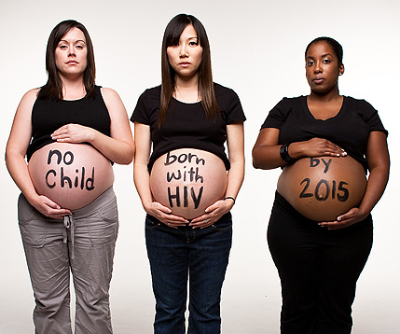
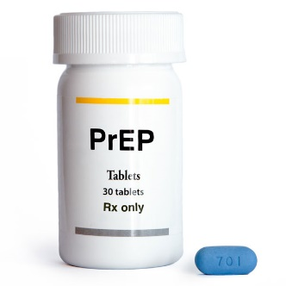
Preventing HIV During Pregnancy
Barrier protection: condoms
Risk reduction: needle exchange, medication assisted treatment
Partner with HIV on ART with VL<20
HIV PrEP
Not specific FDA-approved indication
Pregnancy is NOT a contraindication
Observation studies show safety
Tenofovir disoproxil fumarate/ emtricitabine) 1 po daily
NEJM 2011; 365: 493-505; AIDS 2011;25(16):2005-08; JAMA 2014;312:362-71.
CDC. Recommendations for HIV prevention with adults and adolescents with HIV in the United States, 2021.
Notes:
Truvada® (tenofovir disoproxil fumarate/emtricitabine)
MAT= medication assisted treatment for substance use disorder

Slide 10
Effect of Antiretroviral Therapy (ART) on risk of vertical HIV transmission
25%
Without ART
40% if breastfeeding
<1%
With ART
Optimal perinatal treatment
Conner, et al. NEJM 1994; 331(18).
https://aidsinfo.nih.gov/guidelines/html/3/perinatal-guidelines/0
Notes:
Higher rate in Asia and Africa (25-40%): other medical conditions, prolonged breastfeeding
Give AZT even if resistance: crosses placenta readily, reduces genital viral load.
Conner, et al. Reduction of Maternal-Infant Transmission of HIV-1 with Zidovudine Treatment. NEJM 1994; 331(18).
Unexpected results: Study halted secondary to efficacy. Almost 70% reduction risk of transmission. All patients offered zidovudine.
CDC reported children with AIDS secondary to perinatal transmission peaked at 945 in 1992 with 95% reduction in 2004 mostly a result of identifying HIV-infected pregnant women. MMWR 2006;55:1-17

Slide 11
Start ART in all those with HIV
Start ASAP in all people with HIV as long as the patient is ready (A1 recommendation)
Must start conditions
Opportunistic infection, Tuberculosis
Co-infection with hepatitis B or hepatitis C
HIV-associated kidney disease
Pregnant persons
ART= Antiretroviral therapy (HIV treatment)
https://aidsinfo.nih.gov/news/1592/statement-from-adult-arv-guideline-panel---start-and-temprano-trials
Notes:
Current regimens are easier to take, more effective, and safer than older regimens.
Many single-tablet once-daily regimens are currently FDA approved.
ART is recommended for treatment:“ART is recommended for all HIV-infected individuals, regardless of CD4 T lymphocyte cell count, to reduce the morbidity and mortality associated with HIV infection.” (A1)
ART is recommended for prevention: “ART also is recommended for HIV-infected individuals to prevent HIV transmission.” (A1)
ART should be initiated as soon as possible. On a case-by-case basis, ART may be deferred because of clinical and/or psychological factors
Patients should understand that indefinite treatment is required; ART does not cure HIV
Address strategies to optimize adherence

Slide 12
ART in Pregnancy
If pregnant person’s viral load is suppressed, continue current regimen
Preferred regimens:
Backbone NRTI
Tenofovir DF/emtricitabine or abacavir/lamivudine (if HLA-B*5701 not present)
TAF/FTC recommended as alternative
Addition of either
INSTI (dolutegravir or raltegravir)
Boosted PI (atazanavir/ritonavir qday or darunavir/ritonavir twice a day)
https://clinicalinfo.hiv.gov/en/guidelines/perinatal/whats-new-guidelines
Notes:
NRTI=nucleoside reverse transcriptase inhibitor
INSTI=integrase strand transfer inhibitor
PI= protease inhibitor
TDF/FTC=tenofovir DF/emtricitabine
ABC/3TC=abacavir/lamivudine
Patients considering pregnancy or those who are pregnant can be counseled that ART during pregnancy generally does not increase the risk of birth defects
Although in general, the same regimens recommended for treatment of non-pregnant adults should be used in pregnant persons, the Panel has added “if appropriate drug exposure is achieved during pregnancy” to other considerations (e.g., adverse effects for pregnant persons, fetuses, or infants that outweigh benefits).
The Panel recommends that in most cases, pregnant persons who present for obstetric care on fully suppressive ARV regimens should continue their current regimens unless the regimen includes didanosine, stavudine, or full-dose ritonavir.
ART regimens with high transplacental passage, ie tenofovir, abacavir, 3tc, ftc. Raltegravir in late pregnancy in those with high viral loads because of rapid rival suppression.
Alternative: lop/rit, efv, rpv. Insufficient data for TAF
Schalkwijk, S et al. CID 2017;65(8):1335-41. Rilpivirine exposure lowered during late pregnancy but virologic suppression maintained and no perinatal transmission in nonrandomized, open-label, multicenter, phase 4 study including 16 pregnant cis women.
Dolutegravir: Early report of neural tube defects in those who were on dolutegravir at the time on conception. No increased risk seen when drug used later in pregnancy. Trial still ongoing. Drug Safety Communication from FDA
https://www.fda.gov/Drugs/DrugSafety/ucm608112.htm
http://www.ema.europa.eu/ema/index.jsp?curl=pages/news_and_events/news/2018/05/news_detail_002956.jsp&mid=WC0b01ac058004d5c1

Slide 13
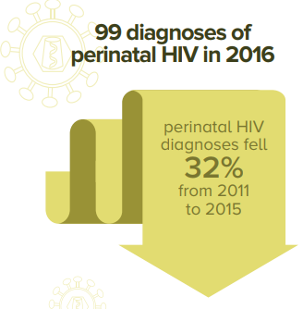
ART in Pregnancy
Pregnancy may alter ARV absorption, distribution and metabolism
Dose adjustment, drug-drug interactions
Increased risk for pre-term labor when person on perinatal ART
No increase in infant morbidity/mortality
Report all cases of ARV drug exposure
www.apregistry.com
need pregnant person’s consent
https://www.cdc.gov/hiv/group/gender/pregnantwomen/index.html https://aidsinfo.nih.gov/guidelines/html/3/perinatal-guidelines/0
Notes:
Extreme caution if methergine used for postpartum hemorrhage if on PI or NNRTI or cobicistat
Increased risk for pre-term labor when mom on perinatal HAART.
Hoffmann, RM et al. Adverse Pregnancy Outcomes Among Women Who Conceive on ART. CID. 2019;68(2):273-9. Seen on intention to treat analysis, in those on ART at conception, more likely to have spontaneous abortion or stillbirth compared with women randomized to stop ART however findings did not remain significant in the as-treated analysis. More data are needed on pregnancy outcomes among women conceiving on ART, particularly with newer regimens. (This study, most common used regimen was lopinavir/ritonavir +TDF/FTC. Some on AZT/3TC, rilpivirine, atazanavir, raltegravir. Study performed in Argentina, Botswana, Brazil, China, Hait, Peru, Thailand, US. 277/1652 had a pregnancy. Noted that rates of spontaneous abortion in study similar to rates in HIV-unifected general population for early pregnancy)

Slide 14
Intra-Partum Management
Pregnant person’s
HIV Status
HIV-Status Unknown
HIV-Positive^{b,c}
HIV-Negative
Obtain rapid Point of Care (POC) 4th Generation HIV test forª:
1. All patients with unknown HIV status at time of labor
2. All persons in labor who tested negative for HIV early in pregnancy but are at increased risk AND not retested in 3rd trimester
Start IV ZDV immediately in all women with Positive Rapid HIV-antibody testing
Standard of Care
1. Administer IV zidovudine regardless of mode of delivery:
Loading dose: 2 mg/kg IV over 1 hour
Maintenance dose: 1 mg/kg/hour continuous infusion until the umbilical cord is clamp
2. Continue home ARV while inpatient

Slide 15
ART at Delivery
IV Zidovudine (ZDV)
During labor if 37-week VL >1000 copies/mL or if viral load is not known
Not required if VL<50 copies/mL near delivery & if no concerns for adherence
Some experts recommend if VL>50;
transmission risk HIV RNA [50-<1000] (1-2%) compared to < 50 copies/mL (1% or less)
Safe to pregnant person & baby so may consider in all
Begin when admitted in labor or 3 hours before scheduled C-section
Standard Loading dose 2 mg/kg then start continuous infusion of 1 mg/kg/hour until the cord is clamped
Continue home ART regimen throughout delivery (even if NPO)
Patient may need to bring home ARV medications to hospital
https://aidsinfo.nih.gov/guidelines/html/3/perinatal-guidelines/0
Briand, et al. CID 2013; 57(6):903-914
Notes:
AZT or ZDV =zidovudine
NPO=nothing by mouth

Slide 16
Neonatal Management
Perinatal HIV Transmission Risk | Description (As it relates to the mothers) | Neonatal ARV Management
Low Risk | ART during pregnancy with HIV RNA level <50 copies/mL) near delivery and no adherence concerns | ZDV for 4 weeks
High Risk | No antepartum or intrapartum ARV drugs Only intrapartum ARV drugs Antepartum and intrapartum ARV drugs but did not have viral suppression (HIV RNA level <50 copies/mL) near delivery Acute or primary HIV infection during pregnancy or breastfeeding (in which case, the birth parent should immediately discontinue breastfeeding) | ZDV, 3TC, and raltegravir from birth to age 6 weeks or ZDV, lamivudine (3TC), and nevirapine (NVP) (treatment dose) for birth to age 6 weeks

Slide 17
Resources
Clinical Consultation Center http://nccc.ucsf.edu/
HIV Management
Perinatal HIV
HIV PrEP
HIV PEP line
HCV Management
Substance Use Management
AETC National HIV Curriculum https://aidsetc.org/nhc
UNM Project ECHO- HIV PrEP TeleECHO Clinic hivecho@salud.unm.edu https://echo.unm.edu/teleecho-programs/hiv
AETC National Coordinating Resource Center https://targethiv.org/library/aetc-national-coordinating-resource-center-0
Additional Trainings scaetcecho@salud.unm.edu
Notes:
UNM Project ECHO-HIV TeleECHO Clinic; 12-1pmMT every Tuesday
1st Tues of each month = HIV PrEP (Prevention) TeleECHO
Other Tues of each month = HIV teleECHO
PrEP curriculum online: https://healthhiv.org/programs/hpcp/
Find an HIV TeleECHO clinic in your area: https://echo.unm.edu/locations-2/echo-hubs-superhubs-united-states/
Additional Trainings: SCAETCecho@salud.unm.edu https://aidsetc.org/aetc-program/south-central-aetc : includes preceptorships, telephone/email consultation, on-site trainings, HIV TeleECHO
AETC National HIV Curriculum: 6 core modules for self study; regularly updated; CME, CNE
Clinical Consultation Center HIV PrEP line: 888-448-7737 (9am-8pm ET M-F); https://nccc.ucsf.edu/clinician-consultation/prep-pre-exposure-prophylaxis/
AETC National HIV Curriculum, module on PrEP. https://www.hiv.uw.edu/go/prevention/preexposure-prophylaxis-prep
Clinical Consultation Center HIV PEP line: 888-448-4911 (9am-8pm ET M_F, 11am-8pm ET weekends & holidays); PEP Quick Guide: nccc.ucsf.edu/clinical-resources/pep-resources/pep-quick-guide-for-occupational-exposures/
AETC National HIV Curriculum, module on Non-occupational PEP. https://www.hiv.uw.edu/go/prevention/nonoccupational-postexposure-prophylaxis
NCRC AETC HIV/HCV coinfection national curriculum: https://aidsetc.org/hivhcv
https://aidsvu.org/preptoolkit2018/
https://primeinc.org/hiv?s=aetc

Slide 18
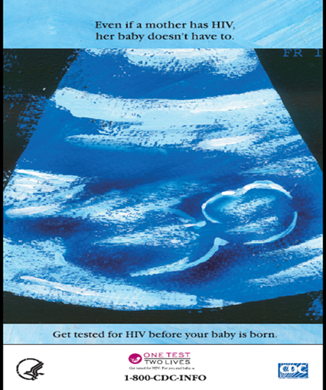
References
National Perinatal HIV Hotline (1-888-448-8765)
HIV ART Pregnancy Registry: www.apregistry.com
Panel on Treatment of HIV-Infected Pregnant Women and Prevention of Perinatal Transmission. Recommendations for Use of Antiretroviral Drugs in Pregnant Women with HIV Infection and Interventions to Reduce Perinatal HIV Transmission in the United States. Last updated 2/10/21. https://clinicalinfo.hiv.gov/en/guidelines/perinatal/whats-new-guidelines
https://www.cdc.gov/hiv/group/gender/pregnantwomen/
https://www.aids.gov/hiv-aids-basics/prevention/reduce-your-risk/ pregnancy-and-childbirth/
HIV in Women. CDC https://www.cdc.gov/hiv/group/gender/women/index.html
Notes:
Clinical Consultation Center HIV PrEP line (855-448-7737)

