Slide 1
Project ECHO® - UNM
HIV TeleECHO Clinic
Benefits of SVR Post-DAA Therapy
10 August 2021
Paulina Deming, PharmD, PhC
Associate Professor of Pharmacy- College of Pharmacy
Assistant Director HCV Programs- ECHO institute
University of New Mexico Health Sciences Center
Notes:
Version_ 08 2021

Slide 2
Conflict of Interest Disclosure Statement
Speaker has nothing to disclose.
This presentation was reviewed by UNMHSC and SCAETC faculty to ensure it meets Continuing Education guidelines.
This project is supported by the Health Resources and Services Administration (HRSA) of the U.S. Department of Health and Human Services (HHS). Under grant number U1OHA33225 (South Central AIDS Education and Training Center). It was awarded to the University of New Mexico. No percentage of this project was financed with non-governmental sources. This information or content and conclusions are those of the authors and should not be construed as the official position or policy of, nor should any endorsements be inferred by HRSA, HHS, or the U.S. Government.

Slide 3
Learning Objectives
Describe the impact of sustained virologic response (SVR) on the risk of diabetes in patients treated with direct-acting antivirals (DAAs) for Hepatitis C virus (HCV) compared to untreated patients
Describe the impact of SVR on development of liver complications including hepatocellular carcinoma in patients with HCV

Slide 4
Background
Chronic Hepatitis C virus (HCV) infections known to confer risk of diabetes
HCV direct-acting antiviral (DAA) therapy reported to have beneficial impact on diabetic control in patients treated for HCV with known diabetes

Slide 5
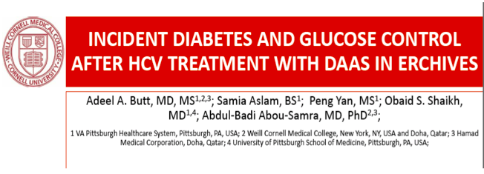
Objective: determine the impact of newer DAA regimens upon incidence and risk of diabetes
Methods: data from the Veterans Health Administration (ERCHIVES: electronically retrieved cohort of HCV-infected veterans)
All persons with confirmed chronic HCV infection
Excluded patients with prevalent diabetes, co-infection with HIV or HBV, or received both interferon and DAA therapy
Used a propensity matched control for each identified patient
Butt AA et al. Clin Infect Dis.2020;70(6):1153-1160.
Notes:
Did allow patients who received IFN plus boc or telap

Slide 6
Butt AA et al. Clin Infect Dis.2020;70(6):1153-1160.

Slide 7
Probability of DM-free Survival
Butt AA et al. Clin Infect Dis.2020;70(6):1153-1160.

Slide 8
Long-Term Follow Up of F2/F3 Fibrosis After Achieving SVR in SOF-based Clinical Trials
Gilead SVR Registry
2348 patients with F2 or F3 fibrosis who achieved SVR with DAA treatment were enrolled for long-term follow up to 144 weeks
Demographics
 | F2 n=1490 | F3 n=858
Mean age, years (range) | 55 (19–80) | 57 (19–82)
Male, % | 856 (57) | 615 (72)
Median registry f/u, years (range) | 2.5 (0–3.8) | 2.3 (0–3.3)
Patients were enrolled in the Gilead SVR Registry within 3 months of achieving SVR.
Liver-Related Complications After SVR
Complication | F2 N=1456 | F3 N=838
HCC, n Exposure-adjusted incidence rate/100 p-y | 2 0.06 | 5 0.25
Liver related events (Ascites/Varices/Encephalopathy/Jaundice) | 7 | 21
Deaths | 4 | 5
HCV relapse, n | 0 | 1
HCV re-infection, n | 4 | 2
Achieving SVR after DAA treatment is linked to low likelihood of development of HCC, decompensation, and death in F2 and F3 patients
Zeuzem, EASL 2018, FRI-366

Slide 9
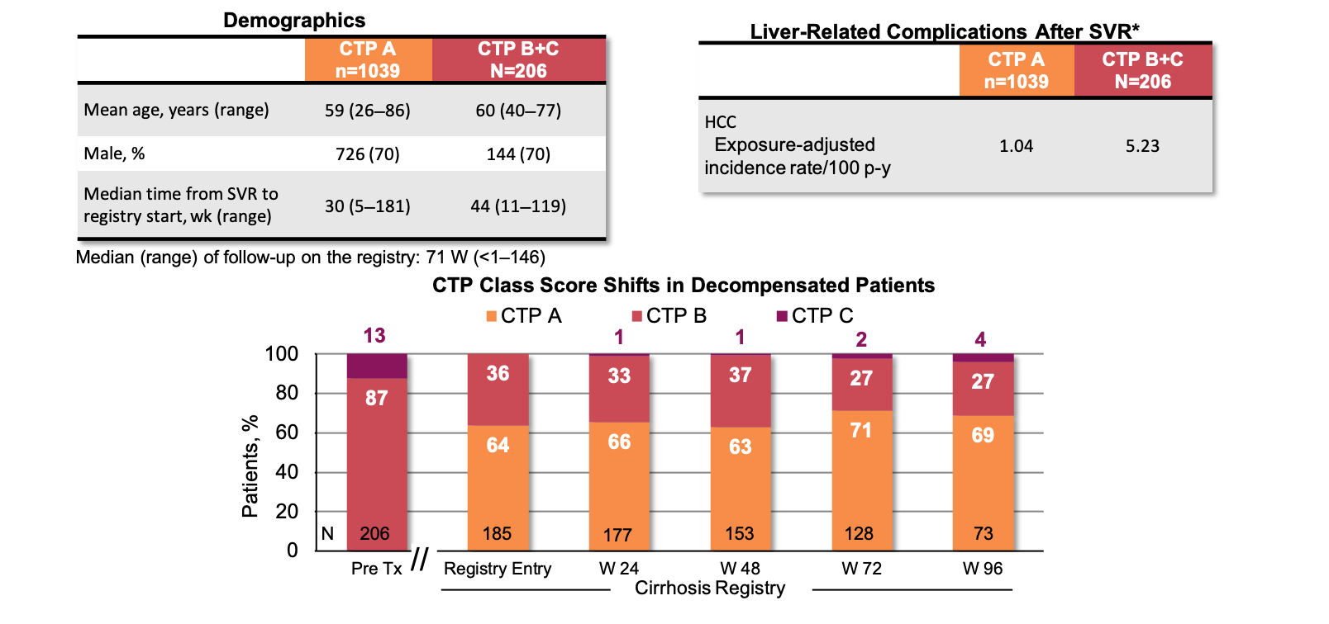
Long-Term Follow Up on Patients with Cirrhosis After Achieving SVR in SOF-based Clinical Trials
Gilead Cirrhosis Registry
1245 patients with decompensated and compensated cirrhosis followed after SVR with a SOF-based regimen
The majority of patients with decompensated cirrhosis showed improvement in CTP class and the rate of de novo HCC was decreased with the achievement of SVR
*13 reported deaths were excluded from the analysis. 6 were due to liver-related causes.
Mangia, EASL 2018, GS-018

Slide 10
Gilead Long-Term SVR Registries
Kaplan-Meier Analysis of Time to HCC Since Achieving SVR12
Proportion of patients
with no HCC event (%)*
Cumulative events over time : at risk (events)
F2 |  | N= 1490 (0) | 1453 (1) | 1380 (1) | 1176 (1) | 1070 (1) | 965 (2)
F3 |  | N= 858 (0) | 832 (4) | 782 (4) | 648 (4) | 572 (4) | 508 (5)
CPT A |  | N= 1037 (0) | 1014 (2) | 868 (7) | 677 (7) | 592 (12) | 466 (16)
CPT B+C |  | N= 205 (0) | 200 (4) | 185 (11) | 174 (16) | 151 (19) | 90 (20)
Registry Entry
The rate of de novo HCC was decreased with the achievement of SVR, including patients with decompensated cirrhosis.
*0-60% is not included
Integrated Analysis: Gilead Long-Term SVR Registries, EASL 2018

Slide 11
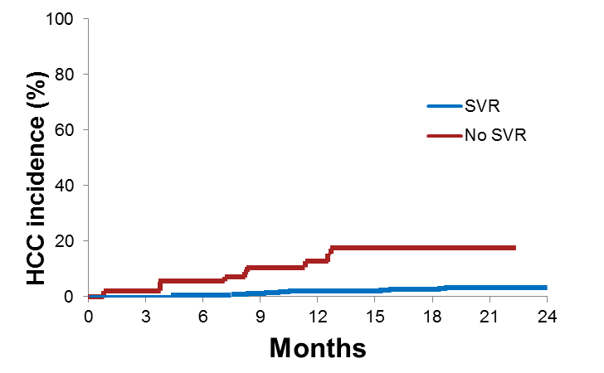
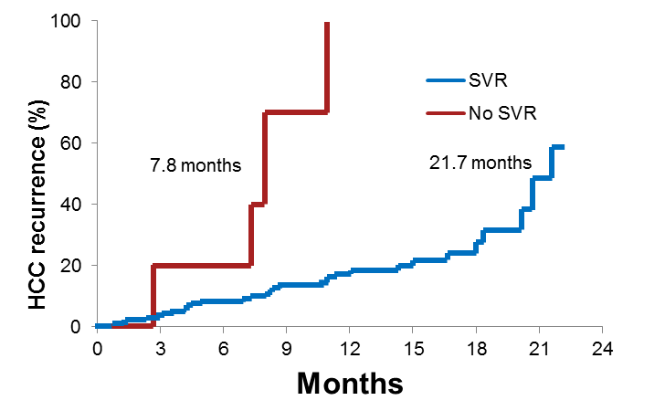
SVR as a Predictor of De Novo and Recurrent HCC in HCV Patients
Multicenter, prospective cohort of 1927 HCV-infected cirrhotic patients from Italy
De Novo HCC
HCC Recurrence
1766 patients no previous history of HCC;
50 patients developed HCC (50/1766 – 2.8%);
Average annual incidence of 2.4%
161 patients with previously treated
HCC; 38 patients developed HCC;
average annual incidence of 24.8%
p<0.0001
p<0.0001
HCC Recurrence (%)
HCC Incidence (%)
SVR with DAA regimens is associated with a significant reduction of
incidence and recurrence of HCC
Lleo, EASL 2018, SAT-PS-154

Slide 12
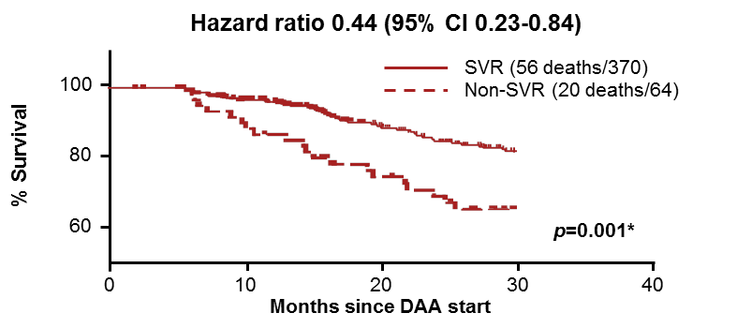
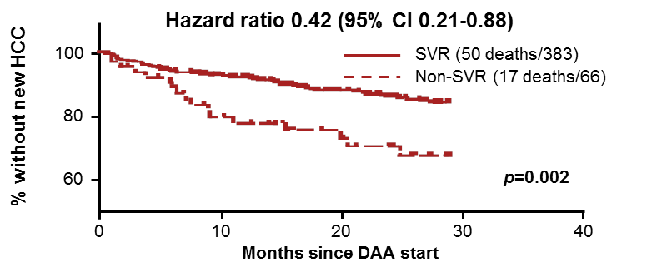
Long-Term Real-Life Follow-Up of Patients with Chronic HCV and Decompensated Cirrhosis After DAAs
NHS England Expanded Access Program (EAP)
Outcomes in 449 patients with decompensated cirrhosis treated with LDV/SOF or SOF+DCV±RBV
Transplant-Free Survival
Demographics
 | N=449
Male, % | 74
Median age, years | 54 (28-79)
MELD, mean | 12 (7-32)
Achieved SVR, n | 383
Treatment failures, n | 66
Median f/u, weeks | 136 (24-174)
De Novo HCC Development
SVR in decompensated patients is associated with improved transplant-free survival and reduced risk of HCC
Cheung, EASL 2018, LBP-009

Slide 13
Fernandez Alvarez P, EASL 2021, Poster PO-578
Notes:
321 patients
68.8% male, median age 57, median follow up 52 months (41-63)
44 patients developed liver related events: 32 with portal hypertension decompensation
12 patients developed HCC (3.7%); 22 patients died
Patients who developed HCC were older, had cirrhosis, GT3, and diabetes

Slide 14
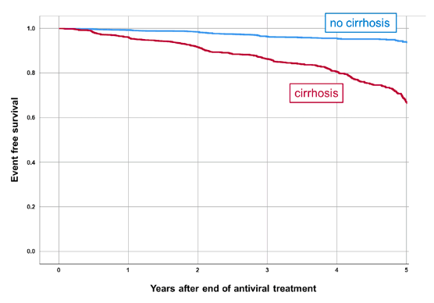
Long-Term Event-free Survival of Patients with SVR
Results:
Overall SVR:
95% (9,951/10,448) ITT
97% (9,824/10,157) PP
181 patients died
415 patients (5.7%) had liver related clinical events (liver transplantation, HCC, hepatic decompensation, or increase in MELD by > 3 points
Risk of de novo HCC 0.6%/yr
In pts with cirrhosis: 1.2% in yr 1-2, then 0.8% from yr 3-7
Wedemeyer, H et al. Persistent long-term risk of liver related complications in HCV patients after antiviral therapy- Data from the German Hepatitis C-Registry. EASL June 23-26 2021.
Notes:
About 1/3 (32%) of patients had liver cirrhosis at baseline
26% (2,712/10,448) had a follow up of at least 3 years
2,359 got ribavirin, 8,089 did not

Slide 15
Key Points
Successful treatment of HCV associated with lower incidence of diabetes as compared to patients with untreated HCV
Rates of HCC, decompensation, and death due to liver disease are decreased in patients with F2 or F3 who achieve SVR
Rates of de novo HCC reduced in patients after SVR
In patients with HCC who achieve SVR, HCC recurrence is reduced
Long-term liver disease complications reduced after SVR, especially among patients without cirrhosis
Patients with advanced fibrosis/cirrhosis need
Follow-up and management for their liver disease
On-going HCC surveillance every 6 months indefinitely

Slide 16
References
Butt AA, Yan P, Aslam S, Shaikh OS, Abou-Samra AB. Hepatitis C Virus (HCV) Treatment With Directly Acting Agents Reduces the Risk of Incident Diabetes: Results From Electronically Retrieved Cohort of HCV Infected Veterans (ERCHIVES). Clin Infect Dis. 2020 Mar 3;70(6):1153-1160.
Mangia A, et al. Long-term follow-up of patients with chronic HCV infection and compensated or decompensated cirrhosis following treatment with sofosbuvir-based regimens. 53rd EASL; Paris, France; April 11-15, 2018. Abstract GS-018.
Lleo A, et al. SVR is the strongest predictor of occurrence and recurrence of hepatocellular carcinoma in HCV cirrhotic patients after treatment with DAAs: a prospective multi-centric Italian study. 53rd EASL; Paris, France; April 11-15, 2018. Abstract PS-154.
Cheung M, et al. LBP-009 Long-term real-life follow-up of patients with chronic hepatitis C virus and decompensated cirrhosis after direct acting antivirals – what is the clinical benefit of antiviral treatment? Journal of Hepatology 68;s109-s110.
Wedemeyer, H et al. Persistent long-term risk of liver related complications in HCV patients after antiviral therapy- Data from the German Hepatitis C-Registry. EASL June 23-26, 2021. PO-52.
Fernandez Alvarez, P et al. Long-term follow up in patients with hepatitis C virus treated with direct-acting-antiviral agents. EASL June 23-26, 2021. PO-578.

Slide 17
Resources
National Clinician Consultation Center http://nccc.ucsf.edu/
HIV Management
Perinatal HIV
HIV PrEP
HIV PEP line
HCV Management
Substance Use Management
Present case on ECHO http://echo.unm.edu hivecho@salud.unm.edu
AETC National HIV Curriculum https://aidsetc.org/nhc
Hepatitis C Online https://www.hepatitisc.uw.edu/
AETC National Coordinating Resource Center https://targethiv.org/library/aetc-national-coordinating-resource-center-0
Additional trainings scaetcecho@salud.unm.edu
www.scaetc.org
Notes:
Find additional TeleECHO sessions in your area: https://echo.unm.edu/locations-2/echo-hubs-superhubs-united-states/
https://hsc.unm.edu/echo/get-involved/join-an-echo/
IDEA Platform: Infectious Diseases Education & Assessment. https://idea.medicine.uw.edu/
AETC National HIV Curriculum: 6 core modules for self study; regularly updated; CME, CNE
Hepatitis C Online Curriculum: https://www.hepatitisc.uw.edu/
Hepatitis B Online Curriculum: https://www.hepatitisb.uw.edu/
National STD Curriculum: https://www.std.uw.edu/

