Slide 1
Project ECHO® - UNM
Indian Country HIV TeleECHO
Addressing Pandemic Mental Health Crisis in the HIV Clinic
8/11/21
Jasen Christensen, DO
Associate Professor
Department of Psychiatry and Behavioral Sciences
University of New Mexico School of Medicine
Notes:
Version_ 08 2021

Slide 2
Conflict of Interest Disclosure Statement
Speaker has nothing to disclose.
This presentation was reviewed by UNMHSC and SCAETC faculty to ensure it meets Continuing Education guidelines.
This project is supported by the Health Resources and Services Administration (HRSA) of the U.S. Department of Health and Human Services (HHS). Under grant number U1OHA33225 (South Central AIDS Education and Training Center). It was awarded to the University of New Mexico. No percentage of this project was financed with non-governmental sources. This information or content and conclusions are those of the authors and should not be construed as the official position or policy of, nor should any endorsements be inferred by HRSA, HHS, or the U.S. Government.

Slide 3
Learning Objectives
Identify a resource for suicide screening.
Describe data supporting safety planning.
Discuss recent data regarding suicide rates.

Slide 4
Suicide Rates Have Remained Stable
Studies are showing overall suicide rates to be remaining stable:
Massachusetts March-May 2020
Foust J, et al. Suicide Deaths During the COVID-19 Stay-at-Home Advisory in Massachusetts, March to May 2020. JAMA, 2021;4(1)
21 Countries April-July 2020
Pirkis J, et al. Suicide trends in the early months of the COVID-19 pandemic: an interrupted time-series analysis of preliminary data from 21 countries. The Lancet, July 2021;9(1):579-588.
Reference 14 font

Slide 5
Suicides Dropped in 2020
Suicide rate declined by ~ 6% from 2019 to 2020 ¹
2019: 47,511
2020: 44,834
Suicide experts have observed that rates tend to decrease following communal trauma:
Possibly reflecting social cohesion / shared suffering ²
Ahmad F, et al. The Leading Causes of Death for the US in 2020. JAMA, March 31,2021.
Moran M. Suicides Drop During Past Year of Pandemic, Study Finds. Psychiatric News. June 2021;56(6).

Slide 6
Reporting on suicidal behavior and COVID-19 Need for caution
“News reporting on suicidal behavior can influence suicide and self-harm in the general population.”
“Sensational media coverage of the negative effects resulting from the pandemic, especially when focused on suicidal behavior, could increase the risk of imitation and contribute to normalizing suicidal behavior as a common and acceptable way to cope with difficulties related to the crisis.”
Hawton K, et al. Reporting on suicidal behavior and COVID-19 - need for caution.
The Lancet Psychiatry, January 2021;8(1):15-17

Slide 7
BH crises have increased among adolescents
Mental Health-related emergency department (ED) visits among adolescents (age 12-17yo) increased by 31% in 2020 vs 2019
ED visits for suspected suicide attempts among boys Feb-March 2021 were 3.7% higher than same period 2019
ED visits for suspected suicide attempts among girls Feb-March 2021 were 50.6% higher than same period 2019
Yard et al. Emergency Department Visits for Suspected Suicide Attempts Among Persons Aged 12-25 Years Before and During the COVID-19 Pandemic - United States, January 2019-May 2021. CDC Morbidity and Mortality Weekly Report. June 18,2021 70(24);888-894.

Slide 8
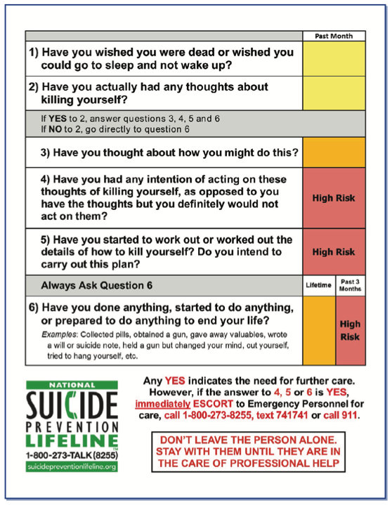
Columbia Suicide Severity Rating Scale
https://cssrs.columbia.edu/wp-content/uploads/C-SSRS-Brochure-for-First-Responders-1.pdf

Slide 9
Safety Planning
Step 1: Warning signs that a crisis may be developing:
1: __________________________________
2: __________________________________
3: __________________________________
Step 2: Internal Coping strategies - things that can be done to take one’s mind
off problems without contacting another person:
1: __________________________________
2: __________________________________
3: __________________________________
Step 3: People and social settings that can provide distraction:
1: Name__________________________________ # _________________
2: Name__________________________________ # _________________
3: Place _______________________ 4: Place ______________________
Step 4: People I can contact for help:
1: Name__________________________________ # _________________
2: Name__________________________________ # _________________
1: Name__________________________________ # _________________

Slide 10
Safety Planning
Step 5: Professionals or agencies I can contact for help
1: Clinician__________________________________ # _________________
2: Clinician__________________________________ # _________________
3: Local Urgent Care Service ______________________________________
Address ____________________________________________________
Phone _____________
4: Suicide Prevention Lifeline Phone: 1-800-273-TALK (8255)
Step 6: Safety of the home
1: __________________________________
2: __________________________________
The one thing that is most important to me and worth living for
_____________________________________________________
Stanley B et al. Comparison of the Safety Planning Intervention With Follow-up vs. Usual Care of Suicidal Patients Treated in
The Emergency Department. JAMA Psychiatry. 2018:75(9):894-900.

Slide 11
Evidence for Safety Planning
9 Emergency Departments (5 intervention sites, 4 control sites)
Cohort comparison design with 6-month FU
Patients enrolled if presented to ED with suicide-related concern
1186 in intervention group, 454 in comparison group
Intervention was Safety Plan + 2 telephone follow-ups to inquire about risk, review/revise the Safety Plan and support engagement
Intervention cohort had 45% fewer suicidal behaviors at 6 months (p=0.03)
And double the odds (OR: 2.06, p=0.001) of attending at least 1 outpatient mental health visit
Stanley B et al. Comparison of the Safety Planning Intervention With Follow-up vs. Usual Care of Suicidal Patients Treated in
The Emergency Department. JAMA Psychiatry. 2018:75(9):894-900.

Slide 12
No-Harm contracts
Avoid such contracts
There is no evidence to support their use
They create a false sense of security

Slide 13
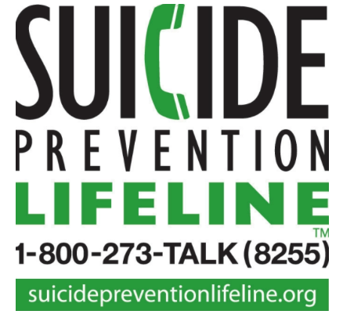
Psychiatric Crisis Resources
SAFE-T: 5-step suicide assessment
https://store.samhsa.gov/product/SAFE-T-Pocket-Card-Suicide-Assessment-Five-Step-Evaluation-and-Triage-for-Clinicians/sma09-4432
Columbia Severity Rating Scale
https://cssrs.columbia.edu/wp-content/uploads/C-SSRS-Brochure-for-First-Responders-1.pdf
Stanley/Brown Patient Safety Plan
https://suicidepreventionlifeline.org/wp-content/uploads/2016/08/Brown_StanleySafetyPlanTemplate.pdf

Slide 14
Resources
National Clinician Consultation Center http://nccc.ucsf.edu/
HIV Management
Perinatal HIV
HIV PrEP
HIV PEP line
HCV Management
Substance Use Management
Present case on ECHO http://echo.unm.edu hivecho@salud.unm.edu
AETC National HIV Curriculum https://aidsetc.org/nhc
AETC National Coordinating Resource Center https://targethiv.org/library/aetc-national-coordinating-resource-center-0
Additional trainings scaetcecho@salud.unm.edu
www.scaetc.org
Notes:
Find additional TeleECHO sessions in your area: https://echo.unm.edu/locations-2/echo-hubs-superhubs-united-states/
https://hsc.unm.edu/echo/get-involved/join-an-echo/
IDEA Platform: Infectious Diseases Education & Assessment. https://idea.medicine.uw.edu/
AETC National HIV Curriculum: 6 core modules for self study; regularly updated; CME, CNE
Hepatitis C Online Curriculum: https://www.hepatitisc.uw.edu/
Hepatitis B Online Curriculum: https://www.hepatitisb.uw.edu/
National STD Curriculum: https://www.std.uw.edu/

