Slide 1
Project ECHO® - UNM
Indian Country HIV TeleECHO
Screening & Management of Anal Dysplasia in the HIV Clinic
9/8/2021
Michelle Iandiorio, MD
Clinical Director, SCAETC
Professor, Dept of IM, Div of ID, UNMHSC
Notes:
Version_ 09 2021

Slide 2
Conflict of Interest Disclosure Statement
Speaker has nothing to disclose.
This presentation was reviewed by UNMHSC and SCAETC faculty to ensure it meets Continuing Education guidelines.
This project is supported by the Health Resources and Services Administration (HRSA) of the U.S. Department of Health and Human Services (HHS). Under grant number U1OHA33225 (South Central AIDS Education and Training Center). It was awarded to the University of New Mexico. No percentage of this project was financed with non-governmental sources. This information or content and conclusions are those of the authors and should not be construed as the official position or policy of, nor should any endorsements be inferred by HRSA, HHS, or the U.S. Government.

Slide 3
Learning Objectives
Recognize that people with HIV (PWH) are at considerably higher risk for anal dysplasia and cancer.
List anal cancer screening methods recommended for PWH.
Identify recommended follow-up for those with abnormal screening anal cytology.

Slide 4
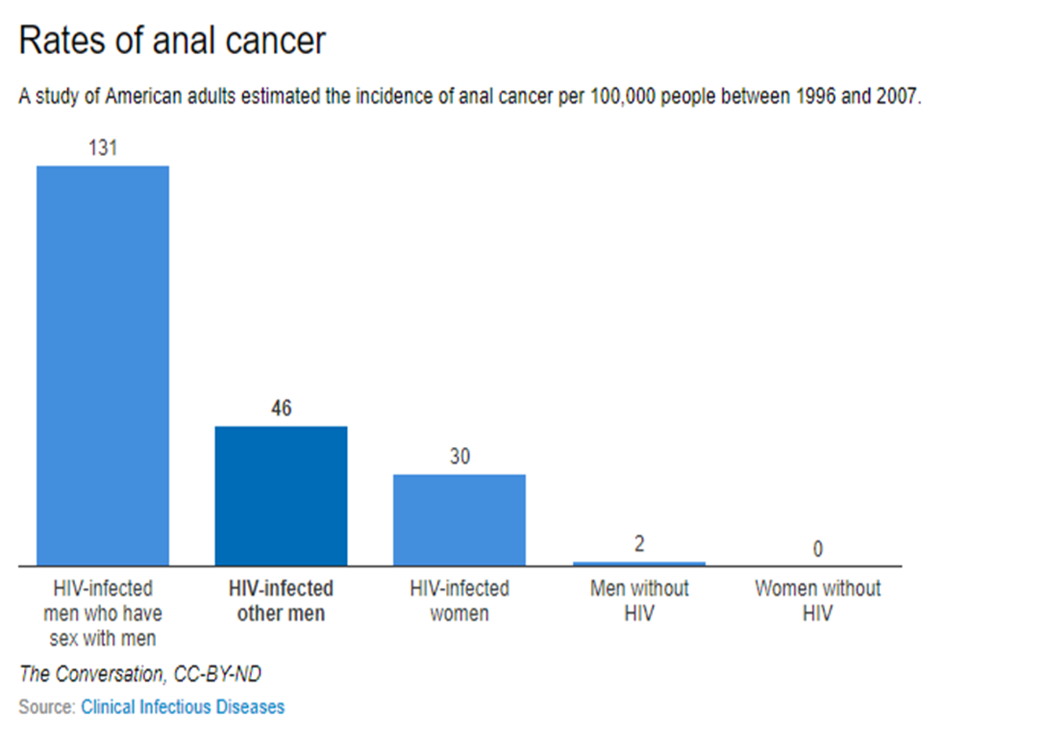
Anal Cancer
8,300 in the U.S.
Many fold (37-100) increase among people with HIV
Very high morbidity, quality of life issues
https://www.cdc.gov/cancer/dcpc/data/
https://theconversation.com/how-the-anal-cancer-epidemic-in-gay-and-bi-hiv-positive-men-can-be-prevented-80358
Notes:
A study of American adults estimated the incidence of anal cancer per 100,000 people between 1996 and 2007.

Slide 5
Anal Cancer Risk Factors
High risk human papilloma virus (HPV) infection
Smoking
Compromised immune function (including HIV), autoimmune, transplant
Multiple sex partners
Anal warts
Chronic inflammation
Previous history of dysplasia (anal or cervical)
Silverberg, M et al. Risk of anal cancer in HIV-infected and HIV-uninfected individuals in North America. CID. 2012;54(7):1026-1034.
Notes:
Palefsky, JM. et al, Obstet Gynecol Clin N Arm, 2009;36: 187-200. Blomberg, M et al, JID, 2012, May 15; 205: 1544-53. https://www.cdc.gov/cancer/cervical/basic_info/risk_factors.htm Cervical: 5+ years birth control pills, 3+ children

Slide 6
Few at Risk are Receiving Anal Cancer Screening
U.S. MSM with HIV rates as much as 37-fold higher than the general population
One in 10 MSM in care for HIV are screened for anal cancer
Healthcare disparities in accessing screening
Less common in blacks , those with less than high school education, those followed by smaller medical practices
Freedman, M. Prevalence of Anal Pap testing Among Men in HIV Medical Care who Have Sex with Men, United States, 2009-2012. ID Week, October 27, 2016, New Orleans.
MSM = men who have sex with men
Notes:
Freedman, M. Prevalence of Anal Pap testing Among Men in HIV Medical Care who Have Sex with Men, United States, 2009-2012. ID Week, October 27, 2016, New Orleans.
Compared with white men, non-Hispanic blacks had a significantly lower pap testing rate (7% versus 13%
A total of 8514 men were classified as MSM and had both interview and medical record data. An estimated 11% (95% confidence interval [CI] 9-13) of HIV-infected of MSM overall received anal pap testing in the 12 months before interview.....lower in men with less than a high school education....
Men seen in a medical practice with more than 400 patients had a higher testing rate (14%) than those seen in practices with 50 to 400 patients (9%, P = 0.1) or fewer than 50 patients (4%, P < 0.0001).

Slide 7
Human Papilloma Virus (HPV)
Most common sexually transmitted infection: 75-80% of people exposed
Most immunocompetent people clear HPV infection but if it persists, it can lead to dysplasia/cancer
HIV: Less clearance, multiple strains of HPV, accelerated progression to dysplasia
Women:
HIV neg: 40% anal HPV, 43% cervical HPV
PWH: 76% anal HPV, 43% cervical HPV
Men:
HIV neg: 60% anal HPV
PWH: nearly all with history of receptive anal sex
Hariri, S et al. JID 2011. 204(4):566-73. Konopnicki, D et al. JID 2013, doi:10.1093/infdis/jit090.
X-Wu Sun, et al. NEJM 1997, 337:1343-9. www.cancer.gov/cancertopics/factsheet/risk/hpv
Notes:
Additional optional reference: Chin-Hong & Palefsky, 2005.
HIV+ MSM: Higher burden of HPV infection, Multiple HPV subtypes, More likely to develop Anal Intraepithelial Neoplasia (AIN) than HIV negative
Relationship between decreased immune function and higher rates of anal and cervical HPV infection
Not any direct effect of HIV, rather, related to immune dysfunction
Double-stranded DNA virus that replicates in the nucleus of squamous epithelial cells, thus its link with cervical, anogenital, and oral sites. Single layer of flat cells with rapid diffusion.
Hundreds of papillomavirus types are capable of infecting humans.
Most cases of anal cancer are linked to infection by HPV-16, which is closely associated with cervical cancer. The infection is initiated by an opening in the skin, allowing virus entry and access to binding sites.
Once the virus binds, it is brought into (endocytosed) into the host cell. Replication of the virus is closely associated with the differentiation state of the host squamous epithelial cell.
https://www.cdc.gov/hpv/hcp/
https://www.uptodate.com/contents/virology-of-human-papillomavirus-infections-and-the-link-to-cancer
http://microbiollogy.blogspot.com/2013/05/virology_8.html

Slide 8
HPV and Immunosuppression
Inverse relationship between measures of immunity and HPV for HIV-infected women
As CD4 cell count drops (and viral load increases), prevalence of HPV infection increase
Studies show a higher rate of oncogenic HPV infections in women with lower CD4 cell counts
Role of antiretroviral (ARV) therapy, immune reconstitution, and HPV… Jury still out
ARV therapy (so far) has not been shown to prevent progression of dysplasia
Notes:
Speaker notes:
High viral loads and low CD4 cell counts among women with HIV have been associated with HPV infection in multiple studies.
Immune reconstitution with ARV therapy has not been shown in studies to lower rates of HPV progression to cancer unlike other conditions and diseases associated with the later stages of HIV infection.

Slide 9
Anal Cancer Screening in HIV
No national guidelines
Annual digital anal rectal exam (DARE) recommended (BIII)
Anal cytology only IF high-resolution anoscopy (HRA) available
If ASCUS or greater, HRA indicated (BIII)
https://aidsinfo.nih.gov/contentfiles/lvguidelines/glchunk/glchunk_343.pdf
r
Notes:
https://aidsinfo.nih.gov/contentfiles/lvguidelines/glchunk/glchunk_343.pdf
11/2018 “AIN are recognized through visual inspection, including HRA and bx as needed. A DRE to feel for masses should be performed as part of routine evaluation.
2/2016 “Anal cytology screening should not be done without the availability of referral for HRA.
Berry, et al. Anogenital neoplasia and HIV. HIV InSite. Nov 1998. Some experts recommend annual anal cytology for those at risk.
Aberg, JA, et al. CID 2013. MSM, women with hx receptive anal intercourse or abn cervical pap, and all HIV with genital warts should have anal ap.
At THS, The current guidelines for patient’s living with HIV is to screen for anal dysplasia with an annual digital anorectal screen (dare) for all patients ≥35 years old and those <35 with symptoms of anal cancer. This is done with an Anal Papanicolaou with cytology. A baseline test should be obtained, and if normal be performed annually thereafter.

Slide 10
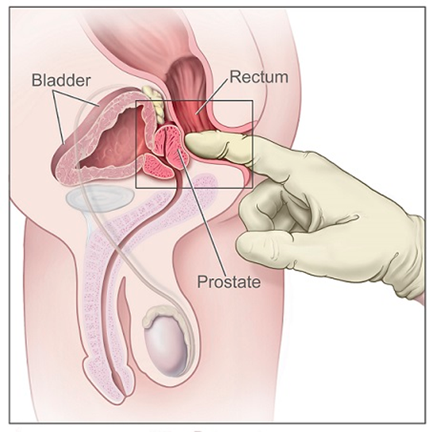
Anal Cancer Screening
Perianal & anal exam
Important in men & women
Visualize external lesions
Masses may be palpated by DRE
Symptom review
Anal bleeding
Anal itching, pain
Anal discharge
Narrowing of stool
Mass in anus
Image from www.hpvvaccination.com
Notes:
Cervical cancer often has no signs or symptoms. In advanced disease, may cause bleeding or discharge

Slide 11
HPV Infection & Detection by Anal Cytology
Men and women with HIV are at higher risk of developing squamous cell cancer of the anus (especially MSM)
It is possible that screening HIV-infected patients with anal Pap smears will decrease the morbidity and mortality associated with anal cancers and dysplasia
Evidence in support of performing routine anal Pap smears not available…yet, but some guidelines recommend anal Pap tests at baseline and annually for:
MSM
Any patient with history of anogenital warts
Women with abnormal cervical or vulvar histology
Notes:
Speakers Notes
Inform participants that although the discussion in this training is about screening for cervical cancer, the idea of conducting anal Pap smears for HIV-infected patients has recently gained momentum.
Anal and cervical cancers in HIV-infected patients
Anal and cervical cancers are associated with high-risk types of HPV infection.
The rates of anal cancer among MSM are comparable to the incidence of cervical cancer in women before the introduction of routine Pap smears (35/100,000) (Chaio et al., 2006).
The rates of anal cancer among HIV-infected MSM are about double what they are for non-HIV infected men.
Anal Pap smears are about as accurate in detecting pre-cancerous cells as cervical Pap smear.
Anal Pap smears involve inserting a swab blindly into the canal and fixing for cytological examination. Anal cytology is defined by the Bethesda system as well and abnormal results are evaluated by high-resolution anoscopy and biopsy to produce a diagnosis.
Recommendations on the utility of anal Pap smears
Literature on the utility of anal Pap smears for HIV-infected individuals is limited due to the lack of published randomized clinical trials data looking at anal Pap smears.
Stay tuned to developments and changes as data becomes available on whether performing anal Pap smears should be a part of routine healthcare for our HIV-infected patients.
As of 2007, the New York State AIDS Institute recommends that providers conduct anal Pap smears for MSM, any patient with anogenital warts, and women with a history of cervical or vulvar histological abnormality.
If providers want to consider anal Pap smears, they should be sure to coordinate follow-up with a practice that is capable or conducting high-resolution anoscopy.

Slide 12
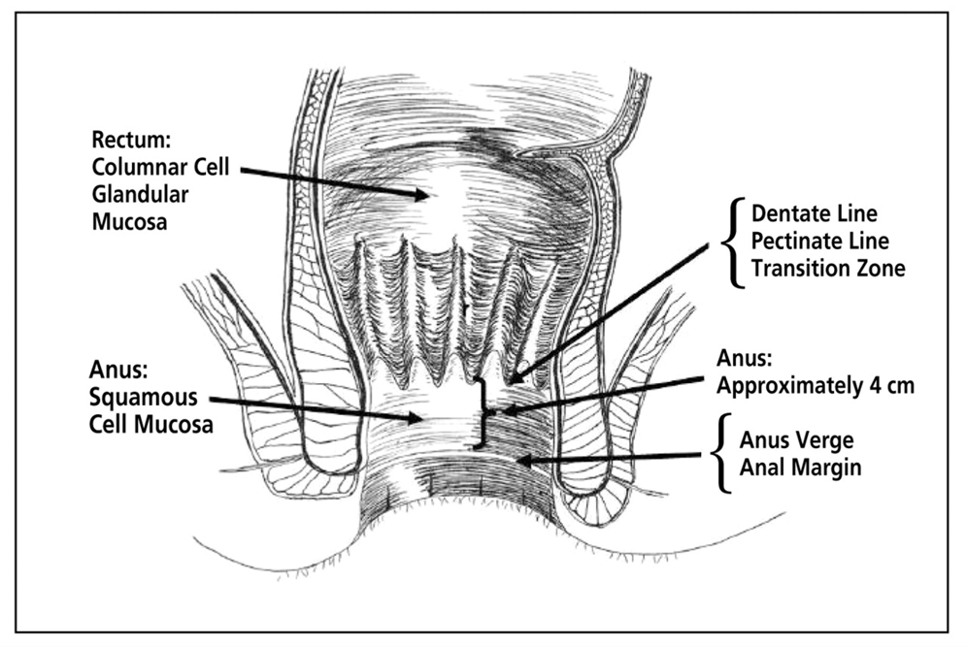
J Am Osteopath Assoc. 2011;111(3_suppl_2):S35-S43.
Notes:
The anal canal is approximately 4 cm long from the anal verge (margin) to the transitional zone. The dentate line (also called the pectinate line) is located at the proximal end of the anus. The flat squamous cells of the anal canal end here. The transitional (transition, transformation) zone has been considered synonymous with the dentate line owing to their proximity, but the transitional zone is actually just proximal to the dentate line, is considered part of the anus, and contains cube-shaped cells called transitional cells. It is the junction between rectal columnar epithelium and anal squamous epithelium, similar to the cervical transitional zone. Above the transitional zone is the rectum with its columnar epithelium. Adapted from Netter. ⁵

Slide 13
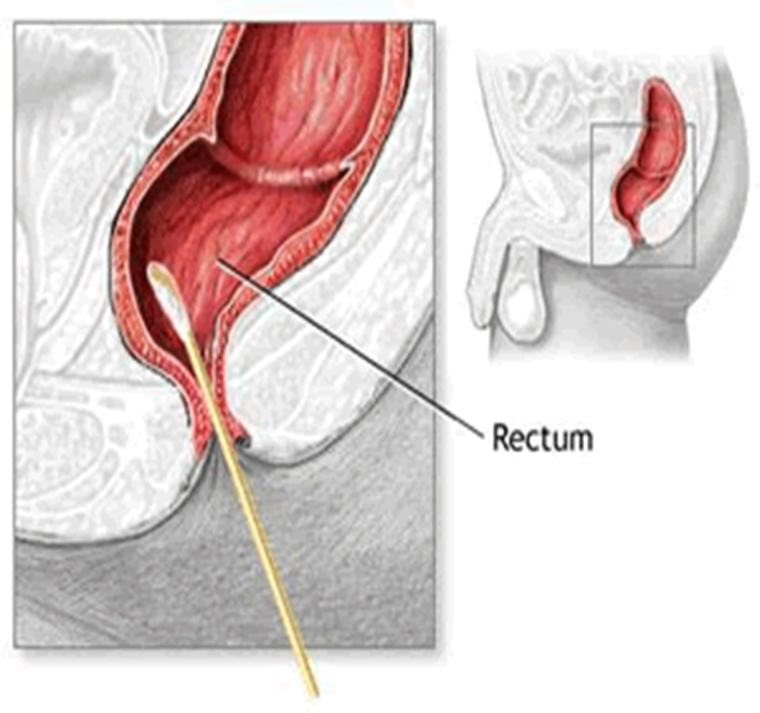
Anal PAP Smear/Cytology
Blind-sample swab
Moistened Dacron swab
Insert swab 2-3 inches into anal canal
Gentle pressure in 360 degrees while withdrawing over 30 seconds
Notes:
Blind swab (unlike cervical swab which is visualized during speculum exam)
Goal: sample at dentate line, where rectal mucosa and squamous mucosa meet
Wenoah Veikley,, ACRN: “Longer than you or patient are comfortable with”
An anal Papanicolaou is a simple test which detects abnormal cells which that may be a possible precursor of anal cancer, and can determine need for referral for HRA and further intervention
The anal pap can be done by a clinician, or by the patient via self collection.
Studies have shown that anal self-sampling and accuracy was similar to that of clinician sampled specimens.

Slide 14
Anal Cytology Nomenclature
Normal (negative for intraepithelial lesion or malignancy)
LSIL (low-grade squamous intraepithelial lesion) or AIN (anal intraepithelial neoplasia grade 1)
HSIL (high-grade squamous intraepithelial lesion) or AIN2, 3 (anal intraepithelial neoplasia grade 2,3)
ASCUS (atypical squamous cells of undetermined significance)
ASC-H (atypical squamous cells, cannot rule out a high-grade lesion)

Slide 15
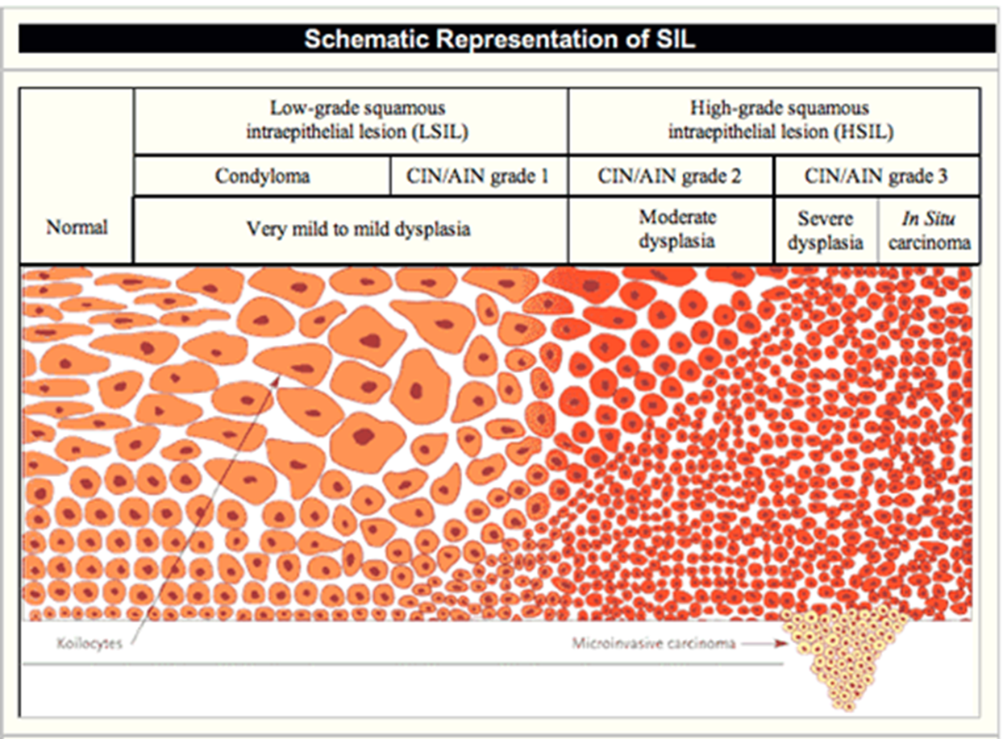
Cytology
Image from Id.medicine.ucsf.edu
Notes:
Squamous cell abnormalities
Atypical squamous cells
Atypical squamous cells of undetermined significance (ASC-US)
Atypical squamous cells – cannot exclude HSIL (ASC-H)
Low grade squamous intraepithelial lesion (LGSIL or LSIL)
HPV/mild dysplasia/CIN 1
High grade squamous intraepithelial lesion (HGSIL or HSIL)
CIS, CIN 2, CIN 3; invasiveness
Superficially invasive squamous cell carcinoma (SISCCA)

Slide 16
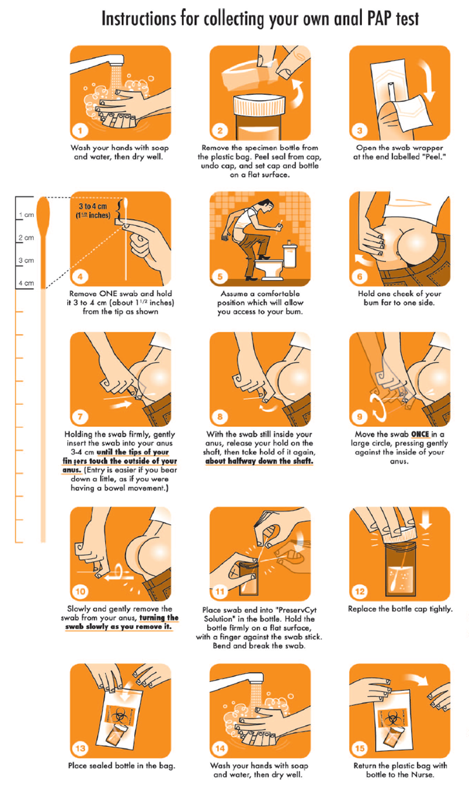
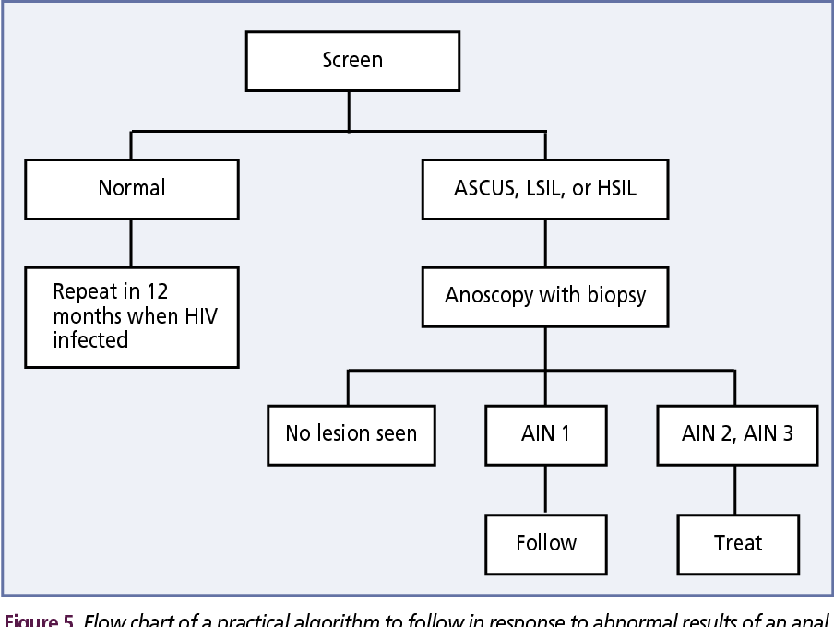
Anal PAP
Illustration taken from Luc Latulippe Copyright 2005.
J Am Osteopath Assoc. 2011;111(3_suppl_2):S35-S43.
Notes:
https://www.ihs.gov/sites/hivaids/themes/responsive2017/display_objects/documents/ihshivguidelinesadultadolescent.pdf

Slide 17
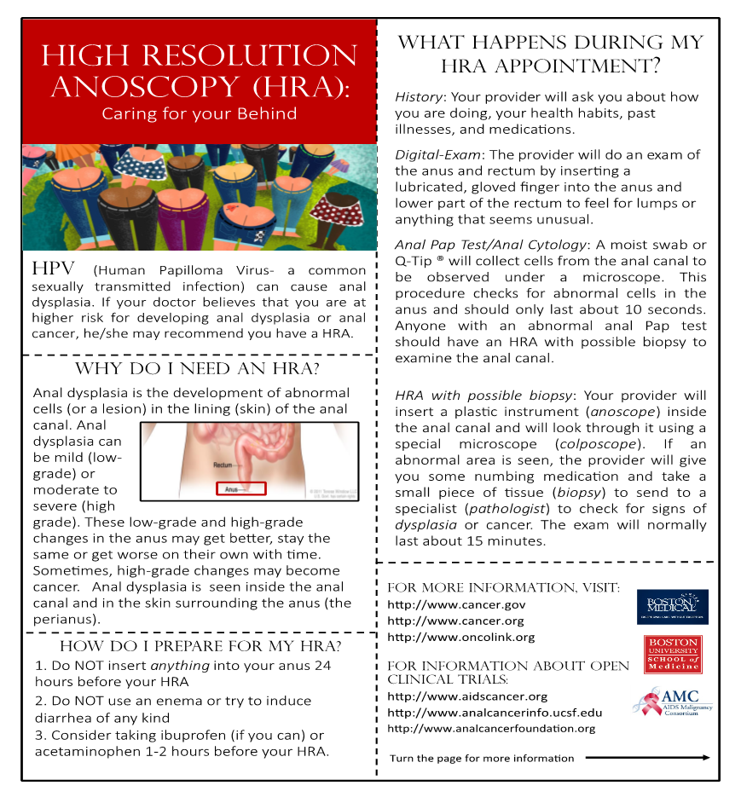

Slide 18
References
https://www.hivguidelines.org/hiv-care/anal-dysplasia-cancer/
Introduction of human papillomavirus vaccination programmes: Updated systematic review and meta-analysis. Lancet 2019; 394(10197):497-509
Abramowitz L, Benabderrahmane D, Ravaud P, et al. Anal squamous intraepithelial lesions and condyloma in HIV-infected heterosexual men, homosexual men and women: prevalence and associated factors. AIDS 2007;21(11):1457-1465
Tamelet C, Ravaux I, Dhiver C, et al. Feasibility and Acceptability of Anal Self-Sampling for Human Papillomavirus Screening in HIV-Infected Patients. Intervirology 2016;59:118-122.
Cranston RD, Darragh TM, Holly EA, Jay N, Berry JM, Da Costa M, Efird JT, Palefsky JM: Self-collected versus clinician-collected anal cytology specimens to diagnose anal intraepithelial neoplasia in HIV-positive men. J Acquir Immune Defic Syndr 2004;36:915-920.
Rosenberg JG, Dodge B, Van der Pol B, Reece M, Herbenick D, Fortenberry JD: Reactions to self-sampling for ano-rectal sexually transmitted infections among men who have sex with men: a qualitative study. Arch Sex Behav 2011;40:281-288.
Bénard É, Pérez N, Brisson M; HPV Vaccination Impact Study Group. Population-level impact and herd effects following the introduction of HPV vaccination programmes: updated systematic review and meta-analysis. Lancet. 2019;394(10197):497-509.
http://www.idsociety.org/Guidelines/Patient_Care/IDSA_Practice_Guidelines/Infections_By_Organism-28143/HIV/AIDS/Primary_Care_Management_of_HIV-Infected_Patients/
Guidelines for the Prevention & Treatment of Opportunistic Infections in HIV-infected Adults & Adolescents. https://aidsinfo.nih.gov/guidelines/html/4/adult-and-adolescent-opportunistic-infection/0
https://www.ihs.gov/sites/hivaids/themes/responsive2017/display_objects/documents/ihshivguidelinesadultadolescent.pdf

Slide 19
Resources
National Clinician Consultation Center http://nccc.ucsf.edu/
HIV Management
Perinatal HIV
HIV PrEP
HIV PEP line
HCV Management
Substance Use Management
Present case on ECHO http://echo.unm.edu hivecho@salud.unm.edu
AETC National HIV Curriculum https://aidsetc.org/nhc
AETC National Coordinating Resource Center https://targethiv.org/library/aetc-national-coordinating-resource-center-0
Additional trainings scaetcecho@salud.unm.edu
www.scaetc.org
Notes:
Find additional TeleECHO sessions in your area: https://echo.unm.edu/locations-2/echo-hubs-superhubs-united-states/
https://hsc.unm.edu/echo/get-involved/join-an-echo/
IDEA Platform: Infectious Diseases Education & Assessment. https://idea.medicine.uw.edu/
AETC National HIV Curriculum: 6 core modules for self study; regularly updated; CME, CNE
Hepatitis C Online Curriculum: https://www.hepatitisc.uw.edu/
Hepatitis B Online Curriculum: https://www.hepatitisb.uw.edu/
National STD Curriculum: https://www.std.uw.edu/

