Slide 1
The Psychological Implications of COVID-19 on People of Color with HIV/AIDS Cynthia J. Raines, PhD, MS October 13, 2021

Slide 2
Disclosures
“This program is supported by the Health Resources and Services Administration (HRSA) of the U.S. Department of Health and Human Services (HHS) as part of an award totaling $3,845,677 with zero percentage financed with nongovernmental sources. The contents are those of the author(s) and do not necessarily represent the official views of, nor an endorsement, by HRSA, HHS or the U.S. Government.”

Slide 3
Training Objectives
1)Describe the mental, emotional, and behavioral impact of
COVID-19 on people of color with HIV/AIDS.
2) Discuss how the pandemic exposed racial and ethnic
disparities in accessing behavioral health care.
3) Discuss strategies we can use to help our patients
discuss, identify, and effectively manage their mental
health during the pandemic and beyond.

Slide 5
Profound destabilization of life as we knew it in 2020..
Financial Strain
Persistent Worry
Job Changes
Anxiety
Education
Trauma
Loss of Travel
Separation from family
Social Isolation
Collective Loss
Chronic Stress

Slide 6
Adaptability:
The ability to be creative and flexible in the face of new situations
The ability to adjust to new or altered conditions
The ability to change in order to become successful
Humans have the capacity to adapt naturally to changing environments.

Slide 7
This Photo by Unknown Author is licensed under CC BY-NC
This Photo by Unknown Author is licensed under CC BY-SA
Notes:
Many of us re-adjusting to the return activities, e.g. sports, weddings, celebrations, religious activities, and concerts.

Slide 8
Notes:
Some continue to struggle with stress, anxiety, depression, social isolation.

Slide 9
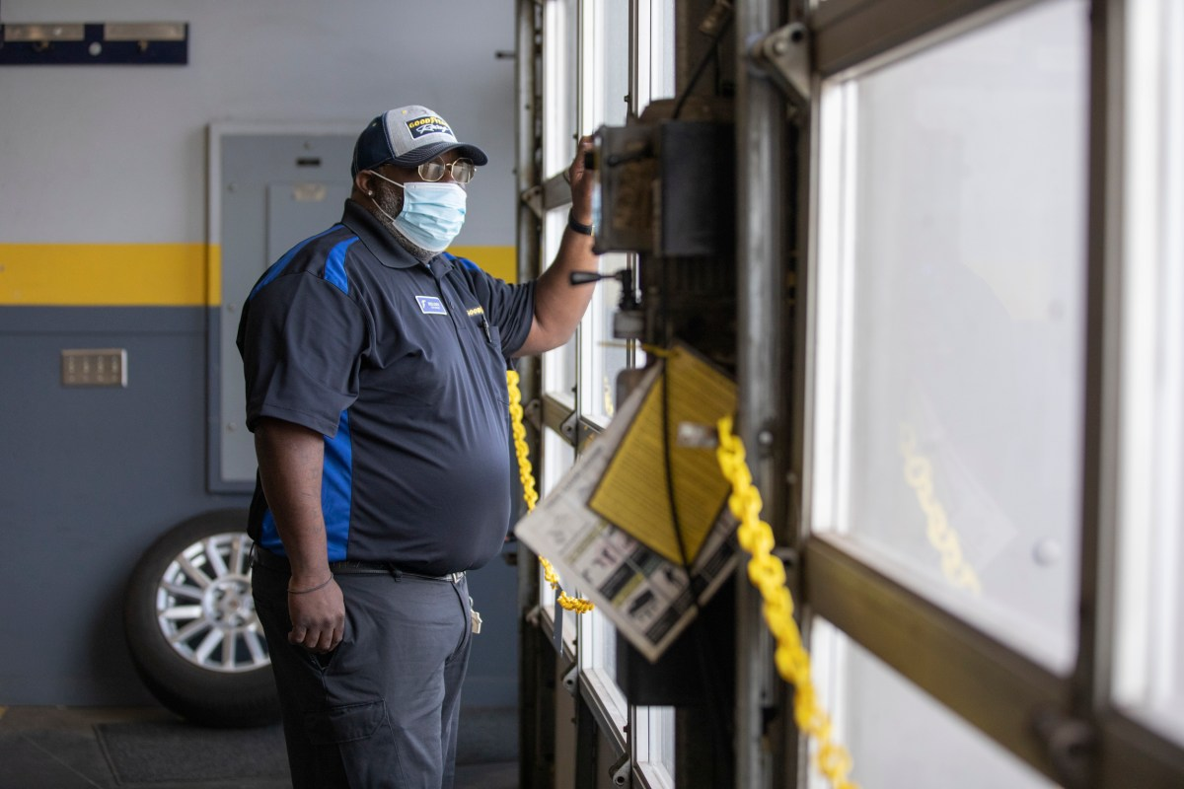
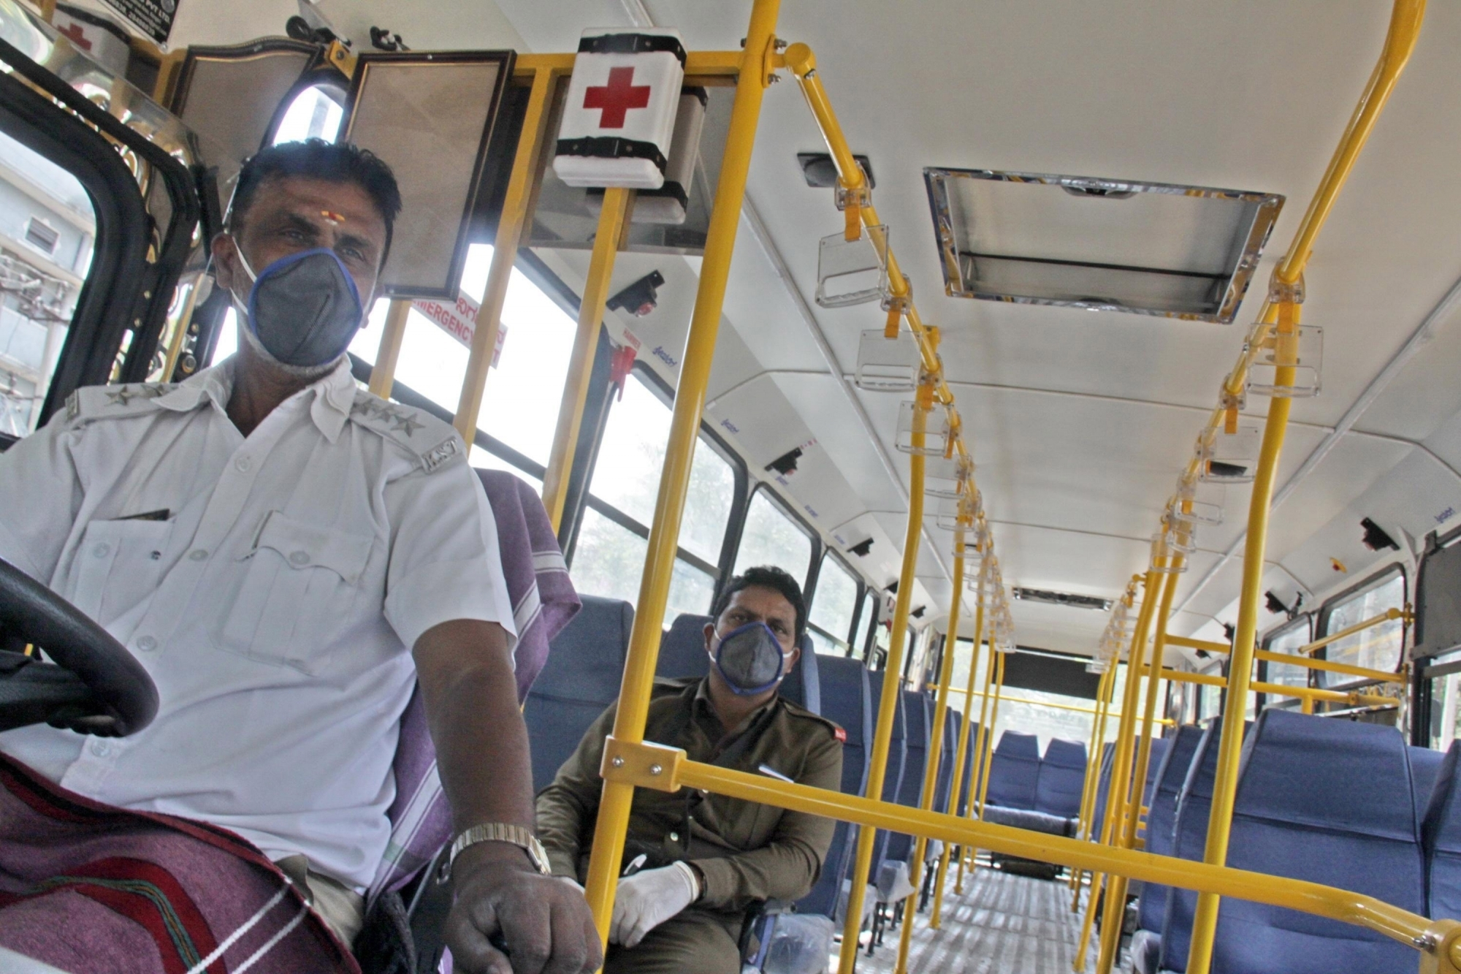
Impact on People of Color…..

Slide 10
As of April 15, 2020, case data from CDC show that in COVID-19 cases where race was specified, Blacks, who comprise 12.1% of the total U.S. population (U.S. Census Bureau, 2020), make up 30% of COVID-19 cases Kaiser Family Foundation, 2020; Health Affairs, 2020).
Latinos, who make up 18% of the population (U.S. Census Bureau, 2020), account for 17% of COVID-19 cases.

Slide 11
People of Color are:
At an increased risk for serious illness if they contract COVID-19 due to higher rates of underlying health conditions, such as diabetes, asthma, hypertension, and obesity compared to Whites; (Kaiser Family Foundation, 2020; Health Affairs, 2020).
More likely to be uninsured and to lack a usual source of care which is an impediment to accessing COVID-19 testing and treatment services.
More likely to work in the service industries such as restaurants, retail, and hospitality that are particularly at risk for loss of income during the pandemic.

Slide 12
People of Color are:
More likely to live in housing situations, such as multigenerational families or low-income and public housing that make it difficult to social distance or self-isolate.
Often working in jobs that are not amenable to teleworking and use public transportation that puts them at risk for exposure to COVID-19 (Kaiser Family Foundation, 2020; Health Affairs, 2020).

Slide 13
Access to Behavioral Health
The COVID-19 pandemic has spotlighted racial and ethnic disparities in access to behavioral health care.
Black and Latino communities are continuing to deal with the opioid epidemic while now in the midst of the COVID-19 pandemic.
Blacks and Latinos have substantially lower access to mental health and substance-use treatment services (National Survey on Drug Use and Health, 2020).
Blacks and Latinos have less access to needed treatment, often terminate treatment prematurely, and experience less culturally responsive care.

Slide 14
Special Consideration: People with HIV
In comparison with the general population, people living with HIV (PWH) are more likely to experience depression, anxiety, suicidality, and substance abuse (Chibanda et al. 2016; Hughes, 2016).
Depression and Dysthymia are common mental health conditions faced by PWH (National Mental Health Institute, 2021).
Mental health problems in PWH have a negative influence on HIV treatment adherence (Chander, Himelhoch, and Moore, 2006).

Slide 15
Patients living with HIV show more feelings of anger, guilt, and experience more suicide ideations (Schade, van Grootheest, Smit, 2013).
PWH suffer more from shame, stigma, and discrimination, which can also cause mental health problems (Whetten, Whetten, Whetten, Murphy-McMillan, 2008).

Slide 16
Risk Factors among PWH (National Institute for Mental Health, 2021)
Trouble accessing mental health services.
Experiencing a loss of social support, resulting in isolation.
Having to tell others about an HIV diagnosis.
Managing HIV medicines and medical treatment.
Dealing with loss, including the loss of relationships or the death of loved ones.
Facing stigma and discrimination associated with HIV/AIDS.
Notes:
Nation Institute for Mental Health

Slide 17
Impact of COVID 19 on the mental health of PWH
Increased feelings of isolation and loneliness due to social distancing and quarantine protocols (Barbera, Kamis, Rowan, Davis, Shehata, Carlson, 2021).
Increased worry about finances, physical health, and mental health (Weerasuria, Ko, Ehm, et al, 2021).
Study of 703 PWH participants:
61% increased depressed symptoms
50% increased anxiety
39% increased insomnia
(Sun, Chen, Brown, Operario, 2020).

Slide 18
Helping our patients
Skill building and Accessing Resources are key!
Brain
Thoughts, mindset, interpretations, self-talk, out-look
Body
Physiological sensations
Emotional experiences/feelings
Behavior
Actions, performance, behavioral responses

Slide 19
Six Strategies for Mental Wellness
Strategy # 1 Challenge negative self talk (Brain)
Strategy # 2 Help clients reduce worry (Brain)
Strategy # 3 Eat, Sleep, Move, Spirituality (ESMS) (Body)
Strategy # 4 Breathwork (Body)
Strategy # 5 Learn stress competencies (Behavior)
Strategy # 6 Improve Depression Through Connection (Behavior)

Slide 20
Challenge Negative Self Talk
Important to catch worry and negative “looping” ASAP.
The goal is to disrupt the habit of negative thinking with greater awareness.
Teach productive responses to anxious or depressive thinking, e.g. “where’s the evidence that this is true”.

Slide 21
Reduce Worry
Worry is common with anxiety, depression, and grief.
Important to teach the difference between productive and unproductive worry.
Reduce the habit of generalized unproductive worry vs. individual worries.
Increase awareness and challenge of unproductive worry.
In-session practice
Wishing well vs. worrying

Slide 22
Eating, Sleeping, Moving, & Spirituality
Physical health is the foundation for mental health.
Exercise decreases the impact of stress (Ratey, 2009).
Limit caffeine, alcohol, tobacco, and sugar (CATS) (Wehrenberg, 2008).
Improve spirit/soul through prayer, meditation, chanting, and/or mindfulness.

Slide 23
Breathwork
Breath improves vagal tone which stimulates the peripheral nervous system.
Various types of breathing exercise can induce a calm, relaxed mind (Brown, 2012).
“Take 10” exercises-releases nitric oxide.

Slide 24
Stress Competencies (Wehrenberg, 2008)
1. Eliminate the stressor or demand.
2. Manage the stressor through better organization of time and environment.
3. Improve internal resources with self care, rest, productive self-talk.
4. Activate external resources for support, e.g. ask for help.
5. Practice radical acceptance.

Slide 25
Improve Depression with Connection (Hari, 2018)
Help clients restore lost connections:
Disconnection from meaningful work
Disconnection from people
Disconnection from meaningful values
Disconnection from nature
Disconnection from hope

Slide 26
National Suicide Prevention
1-800-273-Talk (8255)
Suicide Text Number
Text CONNECT TO
741741

Slide 27
Remember!!!
As Helping Professionals we must strive to address our own physical, psychological, and emotional needs first before helping others!

Slide 28
References
Barbera, L. K., Kamis, K., Rowan, S. E., Davis, A., Shehata, S., Carlson, J., Johnson, S & Erlandson, K. (2021) HIV and COVID-19: review of clinical course and outcomes, HIV Research & Clinical Practice, 22:4, 102-118, DOI: 10.1080/25787489.2021.1975608.
Brown, R., Gerbarg, P. & Muskin, P. (2012). How to use herbs, nutrients and yoga in mental health care. W.W. Norton.
Chander, G., Himelhoch, S., & Moore, R.D. (2006). Substance abuse and psychiatric disorders in HIV-positive patients: epidemiology and impact on antiretroviral therapy. Drugs, 66, 769–789.
Chibanda, D. , Cowan, F., Gobsom, L., Weiss, H. A., & Lund, S. (2016). Prevalence and correlates of probably common mental disorders in a population with high prevalence of HIV in Zimbabwe. BMC Psychiatry, 16, 55.
Hari, J. (2018). Lost connections: Uncovering the real causes of depression a the unexpected solutions. Bloomsbury.
Health Affairs. (2020, March 2020). Health Justice Strategies To Combat COVID-19: Protecting Vulnerable Communities During A Pandemic. https://www.healthaffairs.org/do/10.1377/hblog20200319.757883/full/.
Huges, E., Bassi, S., Gilbody, S., Bland, M., & Martin, F. (2016). Prevalence of HIV, hepatitis B, and hepatitis C in people with severe mental illness: A systematic review and meta-analysis. Lancet Psychiatry, 3, 40-48.

Slide 29
References
Kaiser Family Foundation. (2020, April 9). Communities of Color at Higher Risk for Health and Economic Challenges due to COVID-19. https://www.kff.org/coronavirus-covid-19/issue-brief/communities-of-color-at-higher-risk-for-health-and-economic-challenges-due-to-covid-19.
National Institute of Mental Health. (2021, March 17). HIV/AIDS and Mental Health. https://www.nimh.nih.gov/health/topics/hiv-aids/index.shtml.
National Survey on Drug Use and Health. (2020, September). www.samhsa.gov.
Ratey, J. (2009). Spark: The Revolutionary New Science of Exercise and the Brain. Little Brown.
Sun, S., Hou, J., Chen, Y., Lu, Y., Brown, L., & Operario, D. Challenges to HIV care and psychological health during the COVID-19 pandemic among people living with HIV in China. AIDS Behav. 2020;24(10):2764–2765.
Schade, A., van Grootheest, G., & Smit, J. H. (2013). HIV-infected mental health patients: characteristics and comparison with HIV-infected patients from the general population and non-infected mental health patients. BMC Psychiatry, 13, 13-35.
Wehrenberg, M. (2010). The ten best-ever anxiety management techniques. W.W. Norton.
Whetten, K.., Reif, S., Whetten, R., & Murphy-McMillan, K. (2008). Trauma, Mental Health, Distrust, and Stigma Among HIV-Positive Persons: Implications for Effective Care. Psychosom Med, 70, 531–538.
Weerasuria, M., Ko,C., Ehm, A., et al. The impact of the COVID-19 pandemic on people living with HIV in Victoria, Australia. AIDS Res Hum Retroviruses. 2021;37(4):322–328.

Slide 30
Contact Information
Dr. Cynthia J. Raines
Pavilion Counseling Services
(973) 731-1428
pavilioncounseling@gmail.com

