Slide 1
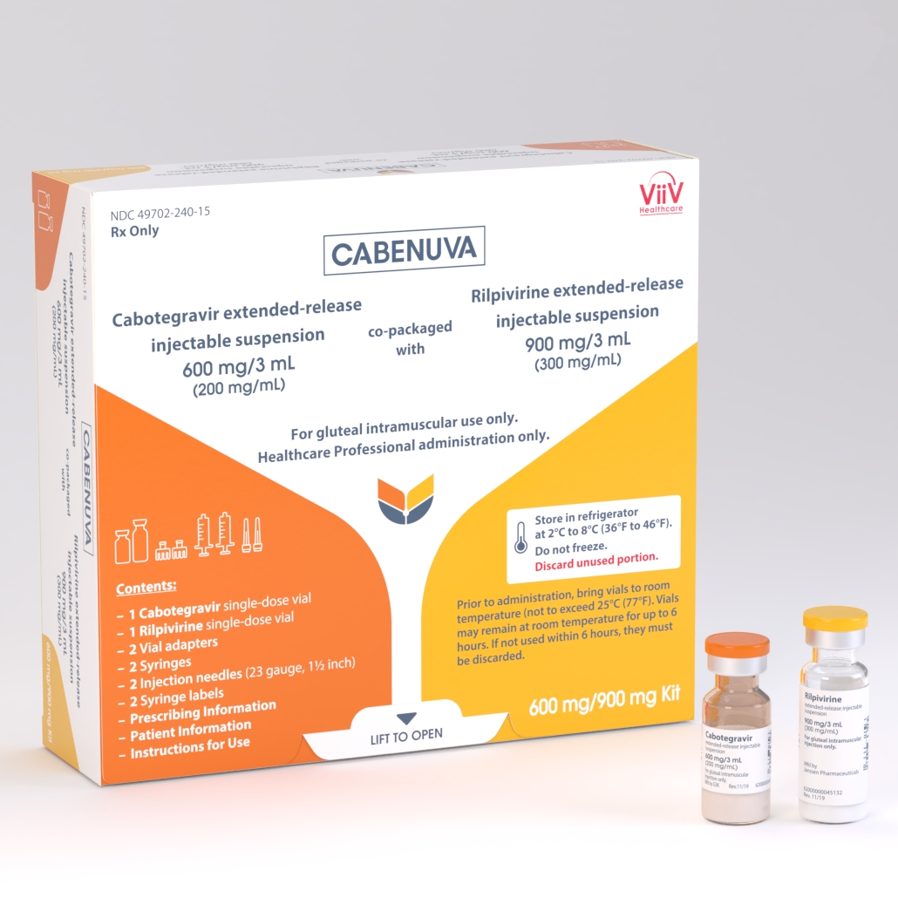
Injectable HIV Therapy
Larry York, PharmD, BCIDP, BCPS, AAHIVP
Slides created by and adapted from Kendra O’Connor

Slide 2
Disclaimer
“This presentation is supported by the Health Resources and Services Administration (HRSA) of the U.S. Department of Health and Human Services (HHS) as part of an award totaling $3,278,366. The contents are those of the author(s) and do not necessarily represent the official views of, nor an endorsement, by HRSA, HHS or the U.S. Government.”
The views and opinions expressed in this presentation are not necessarily those of the Pacific AIDS Education and Training Centers (PAETC), the Regents of the University of California or its San Francisco campus (UCSF or collectively, University) nor of our funder the Health Resources and Services Administration (HRSA). Neither PAETC, University, HRSA nor any of their officers, board members, agents, employees, students or volunteers make any warranty, express or implied, including the warranties of merchantability and fitness for a particular purpose; nor assume any legal liability or responsibility for the accuracy, completeness or usefulness of information [,apparatus, product] or process assessed or described; nor represent that its use would not infringe privately owned rights.

Slide 3
Injectable CAB/RPV
Consists of:
Cabotegravir extended-release injectable suspension
Integrase inhibitor (INSTI)
White to light pink color
Rilpivirine extended-release injectable suspension
Non-nucleoside reverse transcriptase inhibitor (NNRTI)
White to off-white color
For intramuscular (IM) use
FDA approved January 21st, 2021

Slide 4
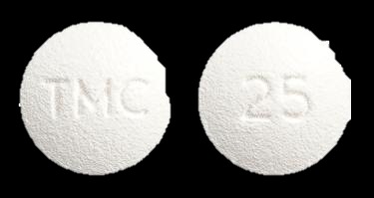
Rilpivirine (Edurant)
Key component in Complera, Odefsey, Juluca
Significant issues with acid-suppressing medications
Lacks significant potency and high barrier to resistance
Must be taken with a full meal (390+ kcals)

Slide 5
Cabotegravir (Vocabria)
Brand new agent
Structurally analogous to dolutegravir
Fair barrier against HIV resistance but < DTG, BIC
Adverse effects appear similar to those of dolutegravir

Slide 6
Indications and Usage
A complete regimen for the treatment of HIV-1 infection in adults
Indicated to replace the current antiretroviral (ARV) regimen in those who are virologically suppressed (HIV RNA less than 50 copies/mL) on a stable ARV regimen
Only for patients with no history of treatment failure and with no known or suspected resistance to either cabotegravir or rilpivirine
Cabenuva does not treat Hepatitis B
Notes:
Had to be on uninterrupted current regimen (either initial or second ARV regimen) for at least 6 months prior to screening for ATLAS trial. Any prior switch, defined as a change of a single drug or multiple drugs simultaneously, must have occurred due to tolerability/safety, access to medications, or convenience/simplification, and must NOT have been done for treatment failure (HIV-1 RNA >400 c/mL).
In FLAIR trial, study participants who were suppressed (HIV-1 RIN <50 c/mL) after 20 weeks on Triumeq (ABC/DTG/3TC) were eligible to be randomized into the Cabenuva oral lead-on and injection phases.
Did they require a genotype? Doesn’t seem like they required an initial genotype in any of the studies. It only states in the exclusion criteria that if they has a known genotype with resistance they were not included (or the investigators were able to retest it) and that they did genotypes on participants who met confirmed virological withdrawal criteria to see if they had resistance.

Slide 7
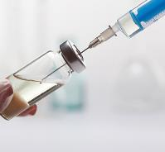
Dosage and Administration
Prior to starting injectable CAB/RPV:
Oral (PO) cabotegravir and rilpivirine should be used for ~1 month (at least 28 days) to assess the tolerability of both medications
Cabotegravir 30 mg PO once daily + Rilpivirine 25 mg PO once daily with a meal
Injectable CAB/RPV is for IM gluteal injection only
Cabotegravir and rilpivirine are administered as two different injections at separate gluteal injection sites (on opposite sides or 2 cm apart) during the same visit
Recommended dosing schedule:
Start CAB/RPV injections on the last day of oral therapy
First dose: cabotegravir 600 mg & rilpivirine 900 mg
Continue with monthly IM injections
Following doses: cabotegravir 400 mg & rilpivirine 600 mg

Slide 8
Cabenuva Dosing Schedule

Slide 9
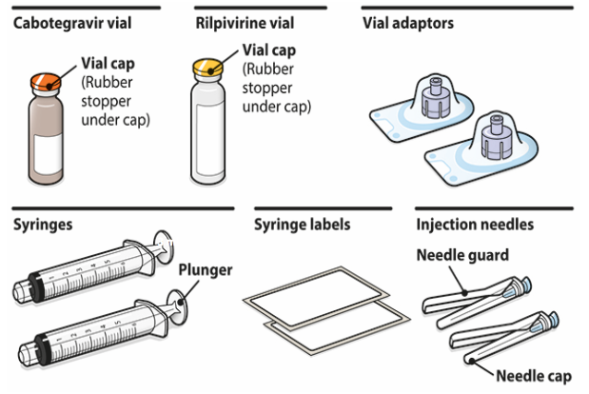
Cabenuva Kits

Slide 10
Administration Instructions
CAB/RPV should be removed from the refrigerator at least 15 minutes prior to preparing the injections to allow the medications to come to room temperature
The vials may remain in the carton at room temperature for up to 6 hours
Once the suspensions have been drawn into syringes, they should be administered as soon as possible, but may remain in the syringes for up to 2 hours
Consider the BMI of the patient to ensure that the needle length is sufficient to reach the gluteus muscle

Slide 11
Adherence
CAB/RPV must be administered by a healthcare professional
Patient must agree to required monthly injection dosing schedule
Patients should be counseled on the importance of adherence to scheduled dosing visits to help maintain viral suppression and avoid potential development of resistance with missed doses
CAB/RPV may be given up to 7 days before or after the date the patient is scheduled to receive monthly injections
Notes:
Discuss that in the naïve patient trial 98% of injections were given within appropriate time frame in ATLAS and FLAIR

Slide 12
Missed Injections
Patients who miss a scheduled injection by more than 7 days (and oral therapy has not been taken in the interim) should be clinically reassessed to ensure resumption of therapy remains appropriate
Planned missed injections:
If a patient plans to miss a scheduled injection visit by more than 7 days, daily oral therapy may be taken to replace up to 2 consecutive monthly injection visits
The oral dosing is the same as during the trial period prior to starting CAB/RPV.
The first dose of oral therapy should be taken ~1 month after the last injection dose and continued until the day injection dosing is restarted
If injections are restarted, the higher (loading dose) must be given again

Slide 13
Contraindications
Patients who do NOT qualify for CAB/RPV :
Anyone who has had a previous allergic (hypersensitivity) reaction to either cabotegravir or rilpivirine
Anyone taking other medications that interact with either cabotegravir or rilpivirine to cause significant decreases in the plasma concentrations of them
This may result in loss of virologic response

Slide 14
Warnings and Precautions
Allergic (hypersensitivity) reactions have been reported with rilpivirine
Discontinue CAB/RPV immediately if signs or symptoms of allergic reactions develop (including, but not limited to, severe rash, or rash accompanied by fever, discomfort, fatigue, muscle or joint aches, oral blisters or lesions, pink eye, facial swelling, &/or difficulty breathing)
Serious post-injection reactions with rilpivirine were reported
These include: difficulty breathing, agitation, abdominal cramping, flushing, sweating, oral numbness, & changes in BP within minutes after receiving the injection
Monitor (for ~10 minutes) and treat if needed (typically began to resolve within a few minutes after the injection)
These events have been associated with unintentional (partial) IV administration

Slide 15
Warnings and Precautions for Hepatotoxicity and Depressive Disorders
Hepatotoxicity (liver toxicity) has been reported with CAB/RPV use
Monitoring of liver chemistries is recommended
Discontinue CAB/RPV if hepatotoxicity is suspected
Patients with underlying liver disease or marked elevations in AST/ALT prior to treatment may be at increased risk for worsening or development of AST/ALT elevations
Depressive disorders have been reported with CAB/RPV
Immediate medical evaluation is recommended for depressive symptoms (including depressed mood, depression, major depression, mood altered, mood swings, unease/general dissatisfaction with life, negative thoughts, suicidal ideation or attempt)
Notes:
Depression much less likely than with efavirenz (Atripla)

Slide 16
Warnings and Precautions for Residual Concentrations
Residual concentrations of cabotegravir and rilpivirine may remain in the systemic circulation of patients for up to 12 months or longer
It is essential to initiate an alternative, fully suppressive ARV regimen no later than 1 month after the final injection of Cabenuva to avoid potential resistance to these ARVs
If virologic failure is suspected, an alternate regimen should be prescribed as soon as possible
Notes:
Potential concerns:
ADEs
Pregnancy

Slide 17
Adverse Reactions
The most common side effects observed in at least 2% of patients who received CAB/RPV were:
Injection site reactions
Fever (pyrexia)
Tiredness (fatigue)
Headache
Muscle pain
Nausea
Sleep disorders
Dizziness
Rash
Notes:
Most side effects were mild and did not frequently lead to discontinuation (3-5%)

Slide 18
Adverse Reactions Continued
Less common side effects observed in less than 2% of patients who received CAB/RPV were:
Abdominal pain
Inflammation/irritation of the stomach lining
Indigestion
Vomiting
Diarrhea
Gas
Hepatotoxicity
Weight increase
Anxiety (including irritability)
Depression
Abnormal dreams
Allergic reactions
Notes:
These are uncommon events that occurred

Slide 19
Drug Interactions
Because CAB/RPV is a complete HIV treatment regimen, administration with other HIV medications is not recommended
CAB/RPV has potential interactions with certain seizure medications, behavioral health medications, tuberculosis medications, and some common over the counter/prescription medications
CAB/RPV is not expected to interact with common hormone therapies
Pharmacist can review for drug interactions
Notes:
Most gender affirming hormone therapies and birth control are not known to interact
Drugs that induce UGT1A1 or cytochrome P450 CYP3A4 may decrease the plasma concentrations of cabotegravir and/or rilpivirine
These medications include:
Anticonvulsants: carbamazepine, oxcarbazepine, phenobarbital, phenytoin
Antimycobacterials: rifabutin, rifampin, rifapentine
Glucocorticoid (systemic): dexamethasone (more than a single-dose treatment)
Herbal product/OTC supplement: St John’s wort (Hypericum perforatum)

Slide 20
Use in Specific Populations
Pregnancy:
There are insufficient human data on the use of CAB/RPV during pregnancy to adequately assess a drug-associated risk of birth defects and miscarriage
Lactation:
Breastfeeding is not recommended due to the potential for HIV-1 transmission
Kidney & Liver Impairment:
Mild or moderate: No dose adjustments necessary
Severe: Increased monitoring for ADEs is recommended (kidney) & unknown (liver)
Hepatitis B Co-infection:
Cabenuva is not indicated for the treatment of Hepatitis B
Hepatitis B status must be confirmed if switching to Cabenuva from a regimen that treats Hepatitis B

Slide 21
Potential Advantages/Disadvantages
Potential Advantages | Potential Disadvantages/Barriers
Greater convenience for individuals concerned about taking daily pills Option for those with difficulty swallowing or absorbing pills Potential for less stigma – having to think about HIV treatment only 12 times a year and not having pill bottles that could reveal status to others Patients enrolled in studies reported high satisfaction with Cabenuva | Regimens cannot be self-administered and require monthly injections Medication leaves the body slowly (can be present for 12+ months) Potential for resistance to important medication classes with missed doses Inability to quickly remove drug if side effects occur (hopefully most side effects identified during oral phase) Drug interactions (cannot quickly adjust regimen) Fear of needles

Slide 22
PrEP Ongoing Research
Trial HPTN 077 results reveal that long acting injectable cabotegravir (CAB LA) in HIV uninfected individuals:
Cabotegravir was not associated with weight gain in HIV negative individuals
Cabotegravir does not seem to have clinically significant interactions with hormonal contraception
The half-life is more prolonged in females compared to males, and longer for those with higher Body Mass Index (BMI)
Trial HPTN 083 results reveal that long acting injectable cabotegravir (CAB LA) every 8 weeks as PrEP is highly effective in preventing HIV acquisition in cisgender men who have sex with men and in transgender women who have sex with men
Trial HPTN 084 results reveal that long-acting injectable cabotegravir (CAB LA) every 8 weeks as PrEP is highly effective in preventing HIV acquisition in cisgender women
In both trials, CAB LA was found to be statistically superior in preventing HIV infection in comparison to daily oral Truvada (TDF+FTC) for PrEP

Slide 23
PrEP Ongoing Research Continued
In November 2020, the FDA granted breakthrough therapy designation to a CAB LA injection for PrEP
This designation reduces hurdles in submitting the drug application and expedites FDA review
The status is granted for drugs that address serious medical conditions and may provide a substantial improvement over currently available products
This is clearly the case in the PrEP arena, where TAF/FTC and TDF/FTC are currently the only approved options
The FDA’s breakthrough designation was based on results from the HIV Prevention Trials Network (HPTN) 083 and 084 clinical trials
Notes:
It hasn’t been submitted for approval yet, so we don’t know when it will be approved
It is being said that they are hoping to submit for approval in the first half of 2021

Slide 24
PEP Ongoing Research
There are currently no ongoing studies regarding the use of CAB/RPV or cabotegravir LA for PEP
A potential reason for the lack of these studies is that a ~1 month (at least 28 days) regimen of oral therapy is required prior to starting LA injection therapy
Current PEP regimens consist of 28 days of therapy

Slide 25
Other Alternatives to Daily Dosing on the Horizon
Early trials are ongoing for:
Every other month administration of CAB/RPV
Other injectable therapies that can be administered every other month or even less frequently
Weekly or monthly oral options
Long-acting medications delivered via implant (similar to Nexplanon contraceptive)

Slide 26
References
https://www.accessdata.fda.gov/drugsatfda_docs/label/2021/212888s000lbl.pdf
https://clinicalinfo.hiv.gov/en/drugs/cabotegravir/patient#:~:text=An%20application%20for%20marketing%20approval,an%20oral%20formulation%20of%20cabotegravir.
https://www.clinicaltrials.gov/ct2/show/study/NCT02951052
https://clinicaltrials.gov/ct2/show/NCT02938520
https://www.clinicaltrials.gov/ct2/show/NCT03635788
https://www.hptn.org/research/studies/hptn077
https://www.hptn.org/research/studies/hptn083
https://www.hptn.org/research/studies/hptn084
https://www.who.int/news/item/09-11-2020-trial-results-reveal-that-long-acting-injectable-cabotegravir-as-prep-is-highly-effective-in-preventing-hiv-acquisition-in-women
https://www.thebodypro.com/article/europe-approval-long-acting-hiv-treatment-cabotegravir-rilpivirine-cabenuva
Notes:
Cite both Cabenuva studies

Slide 27
Questions?

