Slide 1

Disclaimer
“This presentation is supported by the Health Resources and Services Administration (HRSA) of the U.S. Department of Health and Human Services (HHS) as part of an award totaling $3,278,366. The contents are those of the author(s) and do not necessarily represent the official views of, nor an endorsement, by HRSA, HHS or the U.S. Government.”
The views and opinions expressed in this presentation are not necessarily those of the Pacific AIDS Education and Training Centers (PAETC), the Regents of the University of California or its San Francisco campus (UCSF or collectively, University) nor of our funder the Health Resources and Services Administration (HRSA). Neither PAETC, University, HRSA nor any of their officers, board members, agents, employees, students or volunteers make any warranty, express or implied, including the warranties of merchantability and fitness for a particular purpose; nor assume any legal liability or responsibility for the accuracy, completeness or usefulness of information [,apparatus, product] or process assessed or described; nor represent that its use would not infringe privately owned rights.

Slide 2
Before we begin. . .
Link to CDC Website to Watch Thu's Personal TB Story
Notes:
Video for

Slide 3

Latent TB Infection (LTBI): Updates for AZ Community Health Centers
Cherie Stafford, RN, MSN/MPH
TB Nurse Coordinator
Arizona Department of Health Services
April 13, 2021

Slide 4
Polling slide: Have you known anyone who was ill due to TB? (choose all that apply)
Family member
My friend or coworker
My patient
No one that I know personally

Slide 5

Objectives
Review latest statewide TB data
Know where to find the latest updates on LTBI testing and treatment
  With a special focus on HIV
Apply 2021’s Clinical Recommendations on LTBI Testing and Treatment to community health settings
Discuss how to address current challenges in testing and treatment, such as drug shortages & impurities, and the COVID vaccine
Notes:
Anything taken directly from a source should have a hyperlink to that source (or citation with previous hyperlink)

Slide 6
Polling slide: What is TB? (choose all that apply)
TB = Tuberculosis
An ancient disease caused by mycobacteria
An airborne disease
A disease found in cows
A curable disease
A preventable disease

Slide 7
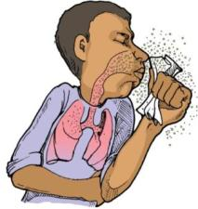
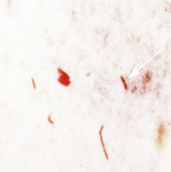
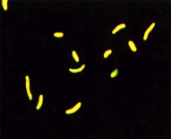
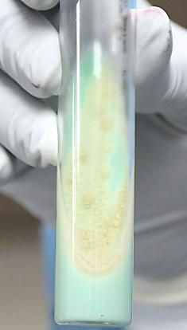
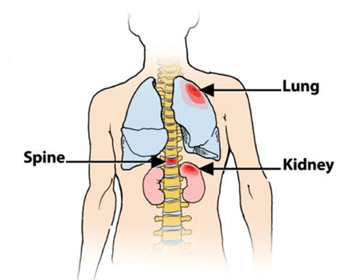
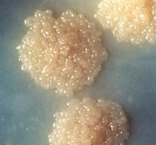
TB = Tuberculosis
Mycobacterium Tuberculosis Complex
(MTB)

Slide 8
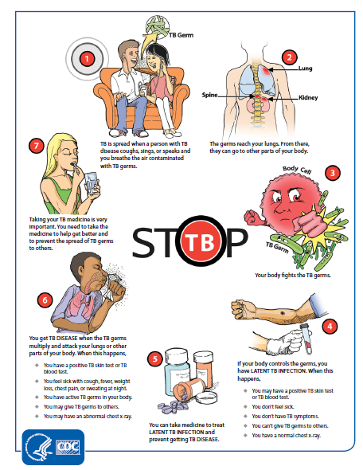
Factors that Increase Risk of Spreading TB
TB disease of the lungs or larynx
Poor cough hygiene
Aerosolizing procedure at site of disease
Higher burden of disease (smear positive sputum smears)
Cavitary disease
Early diagnosis with treatment can Stop TB from spreading to others

Slide 9
TB is Preventable
Community Health Centers are important partners for diagnosing and treating Latent TB Infection (LTBI)
Someone with LTBI is not sick and cannot spread TB to others
Targeted testing followed by treatment of LTBI can prevent someone from developing TB disease and passing it onto friends and family (and coworkers and patients!)

Slide 10
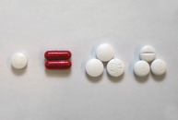
TB is Curable
If you think someone needs treatment for TB disease, regardless of site of disease, report it to your local health department (LHD)
Case management is key to ensure completion of treatment

Slide 11


2 Steps to Prevent
M. bovis (cow TB)
Test cows for TB
Pasteurization
Keep your family safe:
Make sure your Queso Fresco is Pasteurized!

Slide 12
Polling slide: Which do you think it closest to the US 2020 TB case rate?
52.6 per 100,000
10.4 per 100,000
2.2 per 100,000
10 per 1,000,000
1 per 1,000,000
Notes:
10.4 the peak in the early 1990’s. 52.6 the official rate in 1953. if under 1 case/million, then reach goal of elimination.

Slide 13
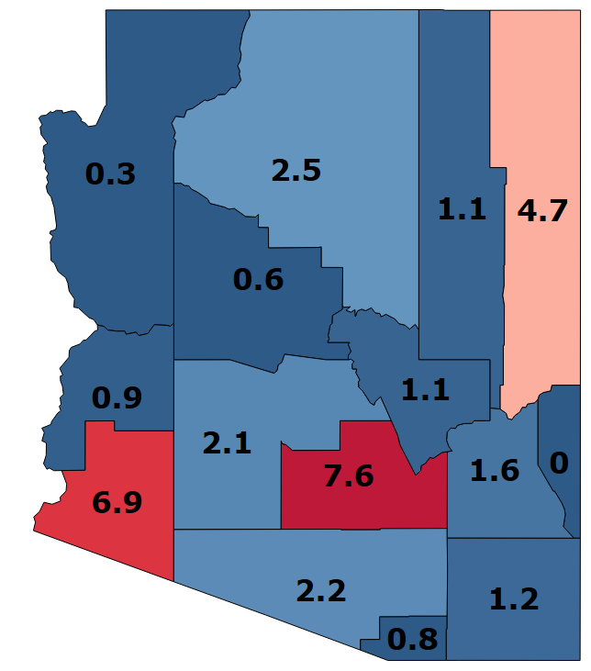
TB diagnosis decreased in the US in 2020
Hx 5-yr [2016-2020]
Rate/100,000
There were 7,163 reported TB cases in the US, for an incidence rate of 2.2 per 100,000. This was a 20% decrease from 2.7 in 2019.
ADHS data is available on our website
LTBI is not reportable (except in children 5 years of age and younger) in AZ

Slide 14
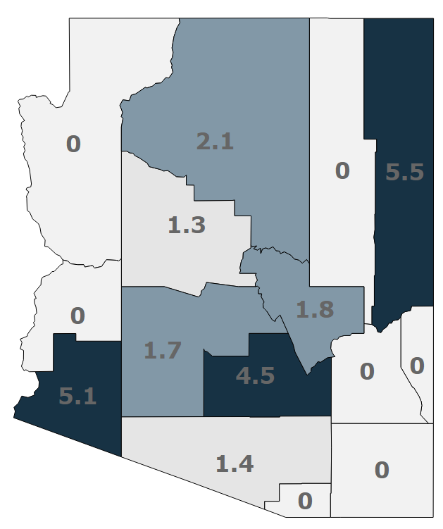
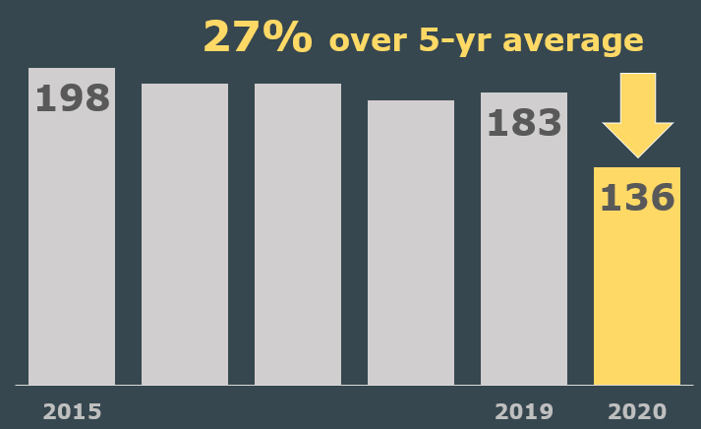
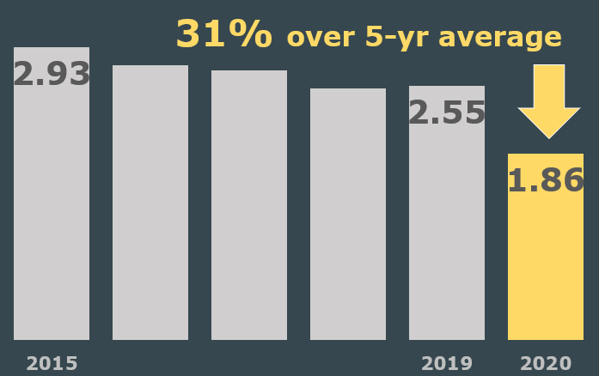

AZ experienced a 27% decrease in reported TB numbers, with a 31% decrease in case rate (per 100,000)
Notes:
Slide 12

Slide 15
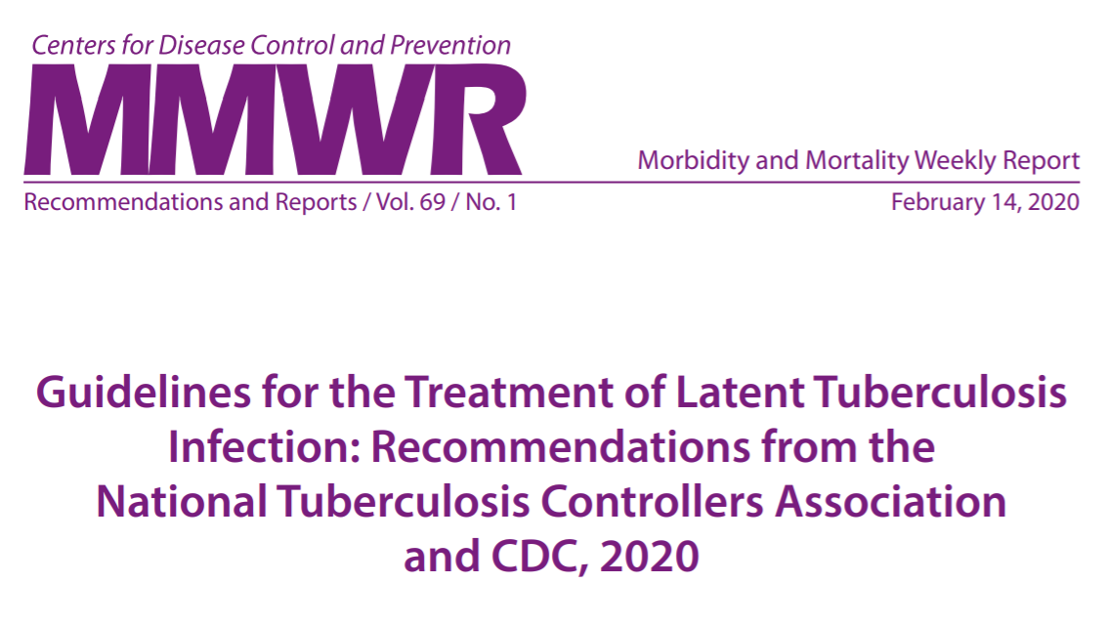
2020 LTBI Treatment Guidelines

Slide 16
Polling question: Which is the preferred regimen for treatment of LTBI?
Isoniazid 300 mg every day for 9 months (9H)
Rifampin 600 mg every day for 4 months (4R)
Isoniazid 900 mg and Rifapentine 900 mg once a week for twelve weeks (3HP)
It depends upon patient preference and potential drug interactions

Slide 17
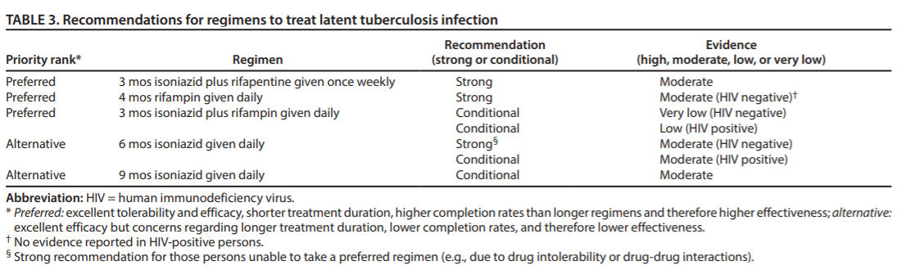
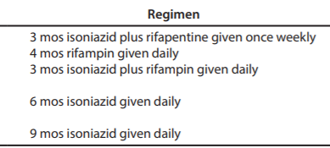
Recommendations for Regimens to Treat Latent TB Infection

Slide 18
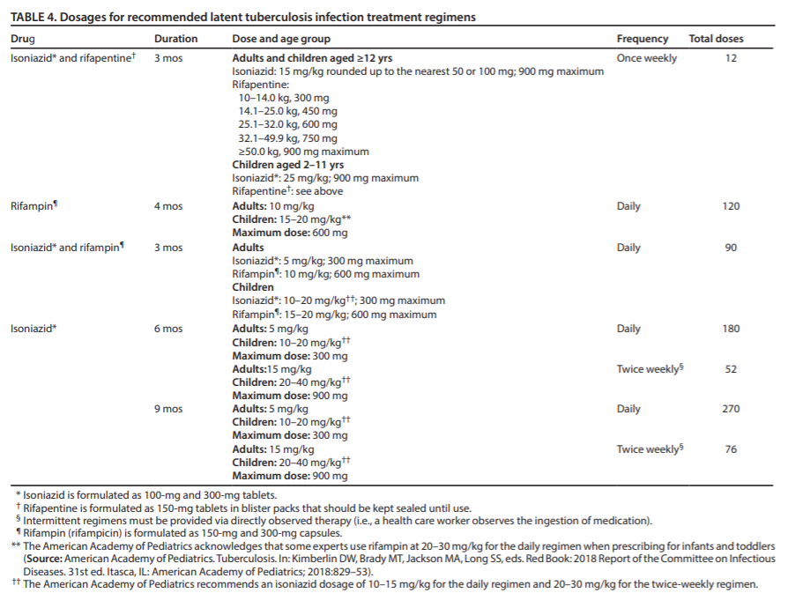
Dosages for Recommended Latent TB Infection Treatment Regimens

Slide 19
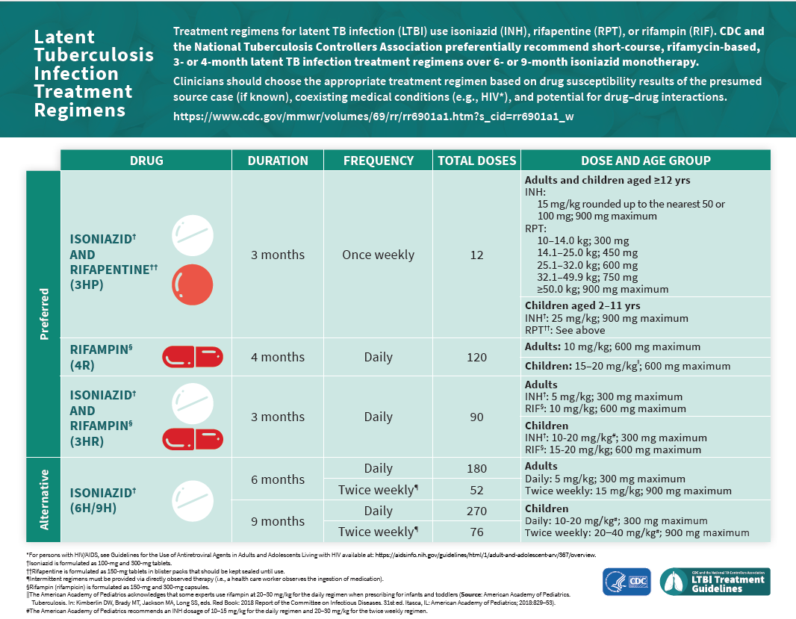
Latent Tuberculosis Infection Treatment Regimens

Slide 20
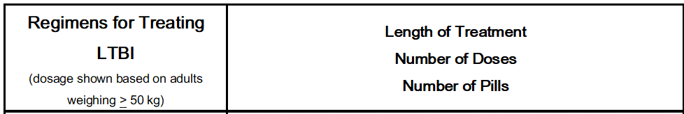
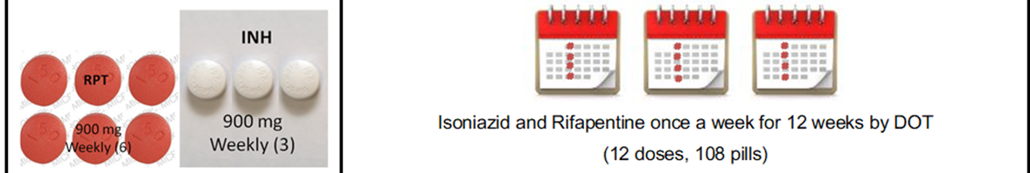

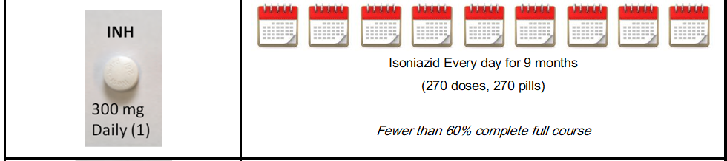
Regimens for Treating LTBI
Notes:
Visualization of number of pills

Slide 21
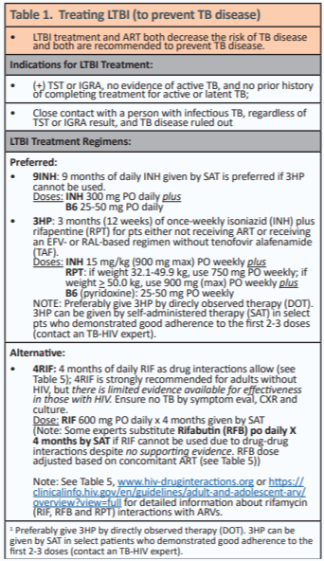
LTBI Treatment
& HIV
3HP preferred, if not contraindicated by drug interactions
9INH if 3HP cannot be used
Include B6 25-50 mg with INH containing regimens
Resource is updated twice a year

Slide 22
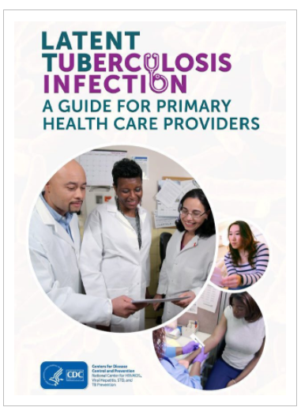
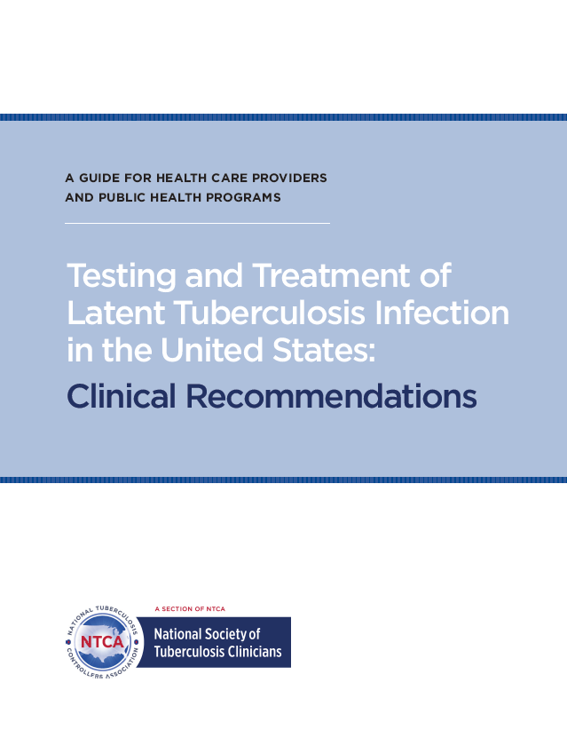
Updated Practical Resources

Slide 23

Free CE available through CDC

Slide 24
Polling question: Should everyone be tested for LTBI?
Yes
No
I don’t know

Slide 25

Targeted Testing
TB Risk Assessment
Screening Questionnaire

Slide 26
Tuberculosis Risk Assessment
Example is for asymptomatic adults.
Re-testing should only be performed in persons who previously tested negative and who have new risk factors since the last assessment.
For patients with TB symptoms or abnormal chest x-ray consistent with active TB disease → Evaluate for active TB disease.
Do not start treatment for LTBI until active TB has been ruled out.
Please note: A negative tuberculin skin test or interferon gamma release assay does not rule out active TB disease.

Slide 27
Adult Screening for LTBI testing:
□ Travel or residence in a country with an elevated TB rate > 1 month Includes countries other than the United States, Canada, Australia, New Zealand, western or northern European countries
□ Medical conditions increasing risk for progression to TB disease Radiographic evidence of prior healed TB, low body weight (10% below ideal), silicosis, diabetes mellitus, chronic renal failure or on hemodialysis, gastrectomy, jejunoileal bypass, solid organ transplant, head and neck cancer
□ Immunosuppression, current or planned HIV infection, injection drug use, organ transplant recipient, treated with TNF-alpha antagonist (e.g., infliximab, etanercept, others), steroids (equivalent of prednisone > 15 mg/day for > 1 month) or other immunosuppressive medication
□ Close contact to someone with infectious TB disease

Slide 28
Should they be tested for LTBI?
Yes, No, Maybe?
Dialysis patient who is being worked up for a kidney transplant.
A US born male who served in the Navy, with deployments in Asia (including the Philippines).
A health care worker whose baseline QFT was negative two years ago. Last summer she spent three months in Peru visiting family.
A patient comes in saying that his mom called saying that his uncle has TB.

Slide 29
How about a patient recently diagnosed with HIV?
Test for LTBI at diagnosis
Repeat if there are ongoing risks for exposure
Repeat once CD4 >200
If there is an exposure to potentially infectious TB, coordinate with the local health department for testing, reporting, and to see if window prophylaxis is needed.
If test is positive for LTBI, rule out TB disease before starting preventative treatment

Slide 30
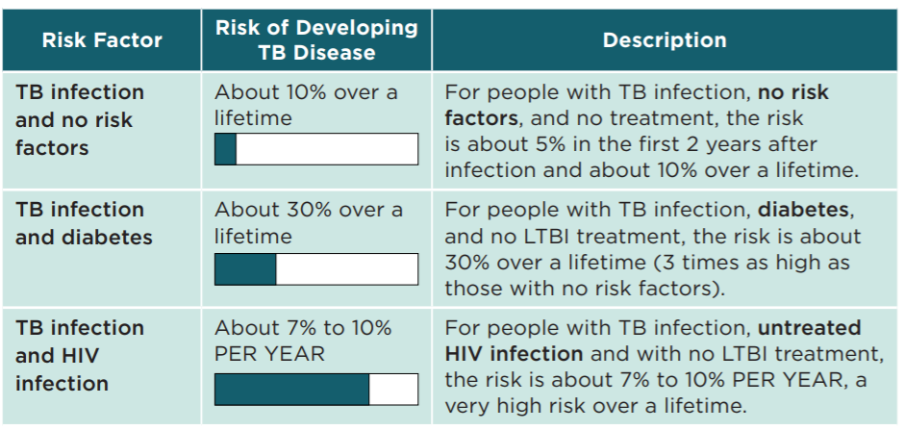
Risk of Disease Progression
https://www.cdc.gov/tb/education/corecurr/index.htm
Notes:
updated source document

Slide 31
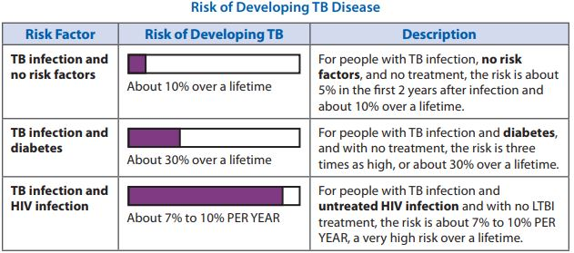
Risk of Disease Progression

Slide 32
Polling question: Which of the following do you use in your practice to test for TB Infection? (all the apply)
TST
QFT
T-spot
I don’t know

Slide 33
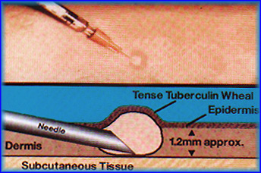
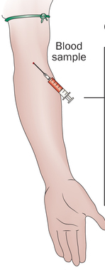
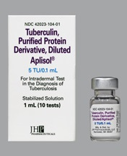
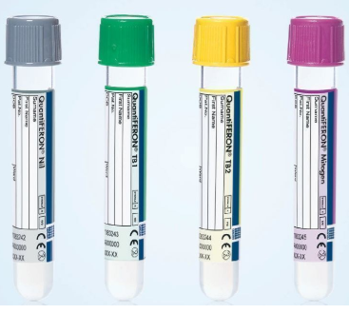
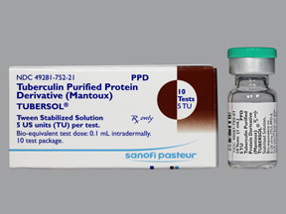
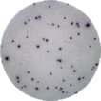
The Options
IGRA
TST
T Spot
QFT

Slide 34
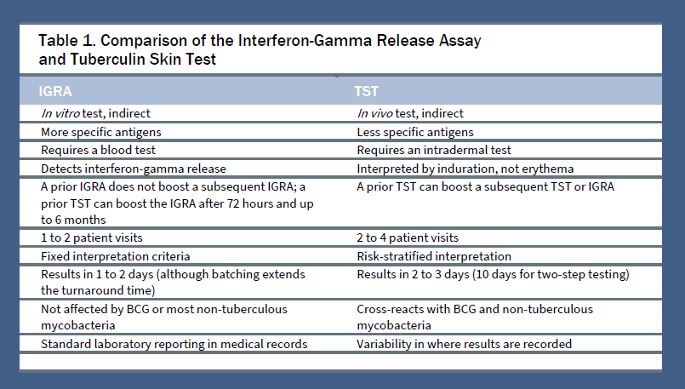
Which to choose?
Logistics Cost
Patient & Provider preference
Section 1 : Testing and Treatment of Latent Tuberculosis Infection in the United States NSTC/NTCA Clinical Recommendations | February 2021
Notes:
If I can see chat: what are some reasons for preferring IGRA’s? How about the TST?

Slide 35
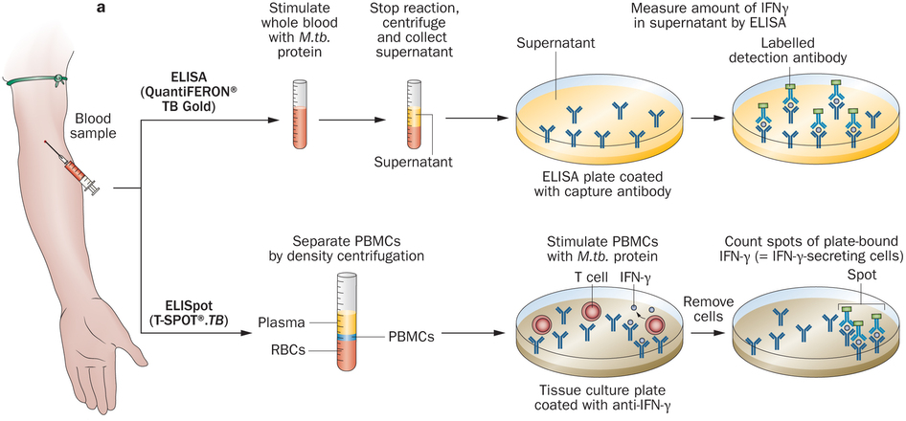
Differences Between QFT and T-Spot
 | QFT | T-Spot
Initial process | Process whole blood within 16 hours | Process peripheral blood mononuclear cells within 8 hours (30 if T-Cell Xtend)
MTB Antigen | Single mixture of synthetic peptides representing ESAT-6, CFP-10, & TB7.7 | Separate mixtures of synthetic peptides representing ESAT-6 & CFP-10
Measurement | IFN-g concentration | Number of IFN-g producing cells (spots)
Possible results | Positive, negative, indeterminate | Positive, negative, indeterminate, borderline
Link to CDC website for TB testing fact sheets

Slide 36
IGRA Results:
What does it mean?
Negative = Negative TST
Positive = Positive TST
Indeterminate = Test failure.
  - Readminister. It may be due to lab error or patient anergy.

Slide 37
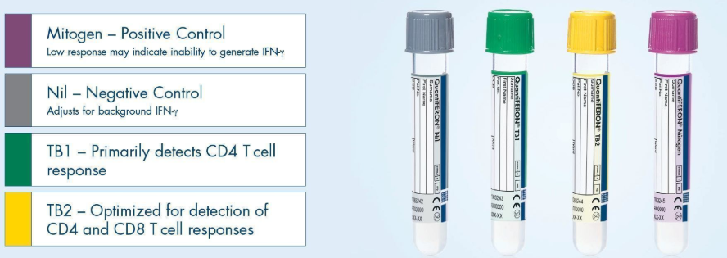
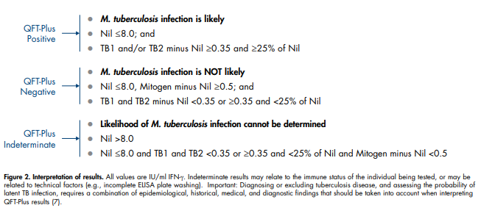
How to Interpret QFT-Plus Results
Lack of immune response?
Control Failure?
The current cut off is 0.35
Borderline results may account for conversions/reversions
Link to QuantiFERON-TB Gold Plus Marketing Pamphlet

Slide 38
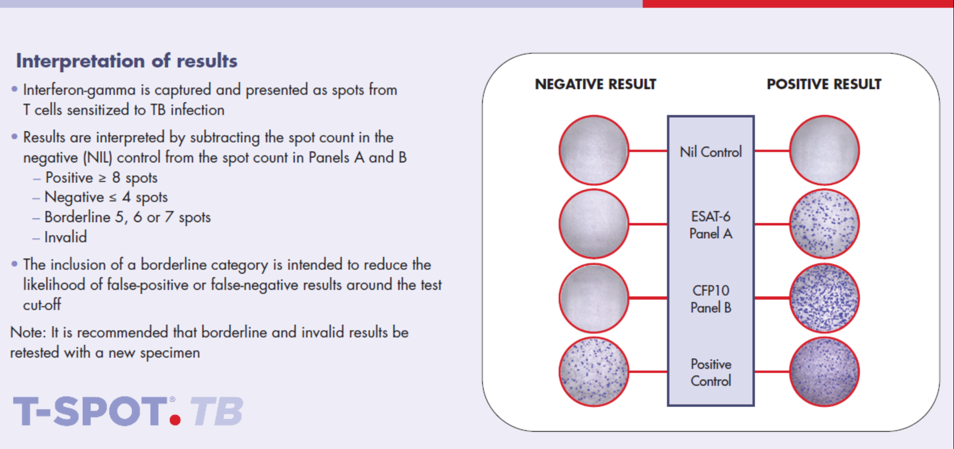
How to Interpret T-Spot Results

Slide 39

If Invalid, is it due to Nil or Positive Control?
Invalid?
Control Failure?
Lack of immune response?

Slide 40
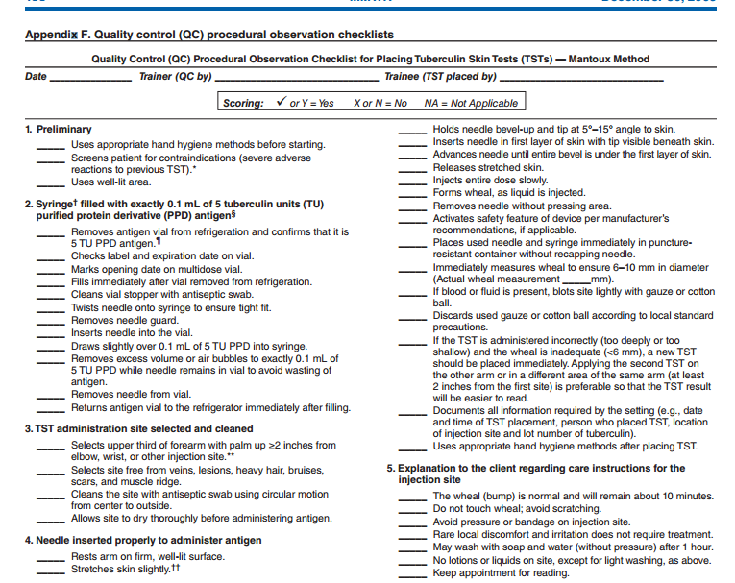
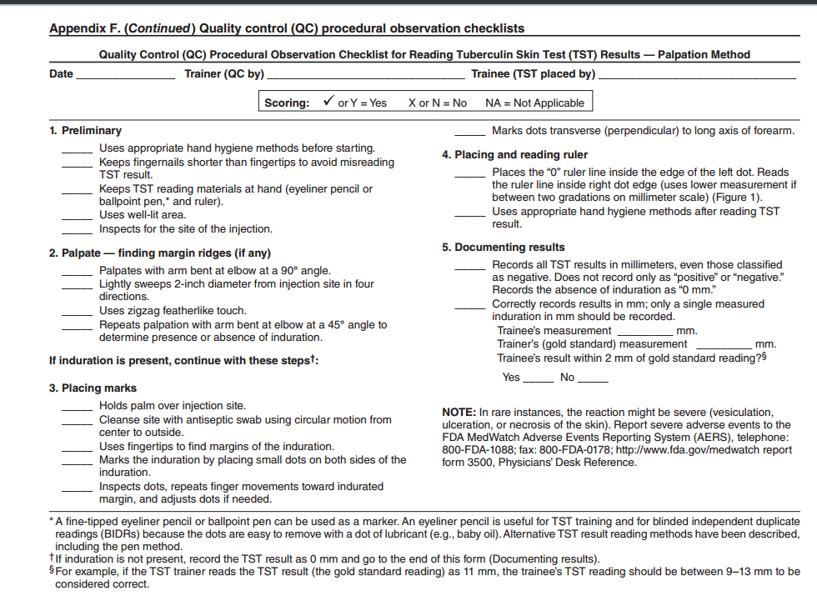
TST Quality Assurance
CDC’s MMWR: Guidelines for Preventing the Transmission of Mycobacterium tuberculosis in Health Care Settings, 2005. Appendix F: Link to CDC Guidance on MMWR

Slide 41
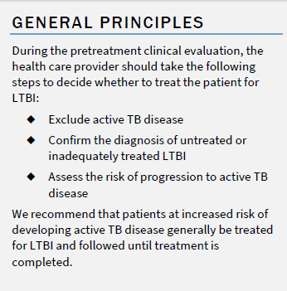
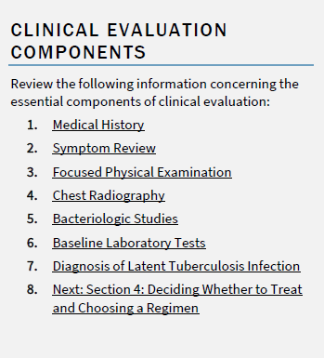
It’s positive. . .what’s next?
If needed
Section 3: Testing and Treatment of Latent Tuberculosis Infection in the United States
NSTC/NTCA Clinical Recommendations | February 2021

Slide 42
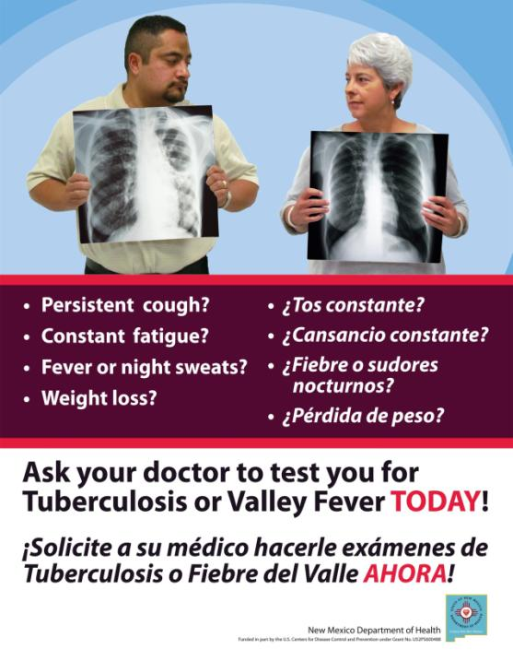
Flyer for New Mexico Department of Health

Slide 43
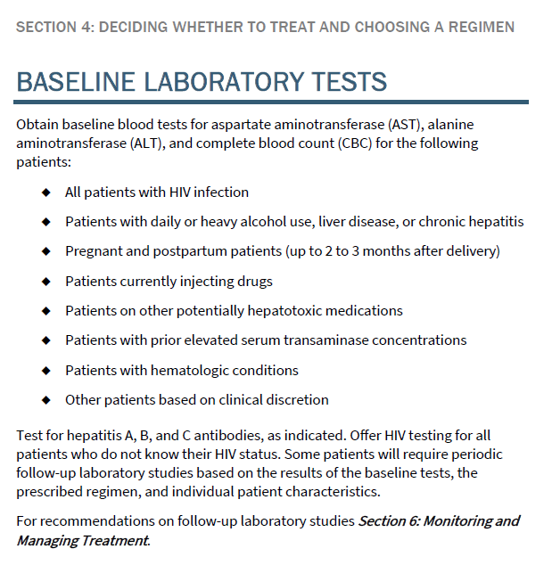
HIV Test?
Hepatitis screen?

Slide 44
Baseline lab tests (ALT/AST, CBC)
Not routinely indicated unless:
  Pregnant or postpartum (within 3 months post delivery)
  Daily or heavy alcohol use (monitor closely)
  Liver disease, hepatitis, or history of elevated liver enzymes
  All patients with HIV infection
  Current IV drug use
  Taking other hepatotoxic medications
Repeat at least monthly if abnormal.
Monitor all patients for symptoms of possible hepatotoxicity and test if symptoms develop.
Hold TB meds if ALT/AST >3 times normal with symptoms, or >5 times normal without symptoms

Slide 45
Who would benefit from taking Vitamin B6 with INH?
People at risk for neuropathy such as:
  Pregnant/Postpartum/breastfeeding women
  Diabetics
  People living with HIV
  People with heavy alcohol use
  Malnutrition (or diets without milk/meat)
  Chronic renal failure
  Exclusively breastfeed infants (reportable! consult with TB expert)
25 to 50 mg every day (or 50 mg once a week for 3HP)
Note: cumulative high doses (100 to 200 mg a day) can cause toxicity that manifests as neuropathy

Slide 46
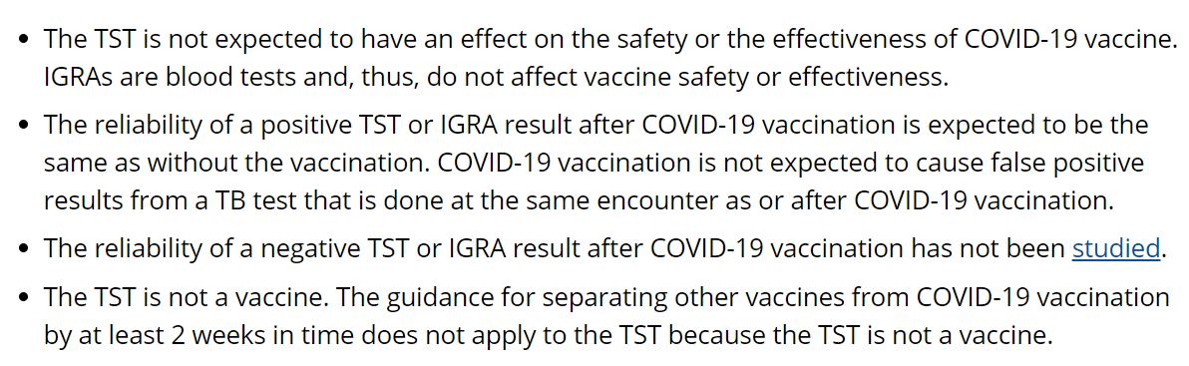
Current Events:
COVID-19 Vaccine & TB Tests
(TST/IGRA)
Per CDC:

Slide 47
Current Events:
COVID-19 Vaccine & TB Tests (TST/IGRA)
COVID-19 vaccines should not be delayed due to testing for LTBI.
Timing recommendation:
  TST or IGRA before the COVID vaccine (can be at same encounter)
Options for recently vaccinated people:
  Wait 4 weeks after second shot OR
  Can perform TST/IGRA, with plans to repeat in future (at least 4 weeks after second shot) if negative.

Slide 48
Current Events: Health Care Worker TB Screening Requirements
Arizona Administrative Code:
R9-10-113 pg 26 & 27
CDC Updates (2019)
Applies to health care facilities licensed by the state of Arizona
Refers to CDC’s 2005 MMWR
Updated every 5 years (last in 2018/19). Request for early update has been made.
Companion Document (2020) provides guidance on how to implement
Caveat for medium risk health care facilities in AZ: annual testing still required based on AAC
Most facilities are low risk in AZ (Appendix B)

Slide 49
What would implementation of new guideline look like?
Baseline Screening of all Health Care Personnel (see Appendix 2 on who is Health Care Personnel) with Appendix 3 (or similar document)
Baseline Testing of all Health Care Personnel (if they do not have a documented history of TB infection or disease) with blood test or TST. Note that TST should be a two-step in circumstances following Box 1 of the 2005 MMWR.
Encourage LTBI treatment. For untreated LTBI, Appendix 4. They will then be screened annually (Appendix 7).
Annual TB Education. (see Appendix 6).
Annual Facility Risk Assessment (Appendix B of 2005 MMWR. See Appendix 1 for suggested amendments to wording.)
If there are any TB exposures in the facility, coordination and sharing of contact investigation data with local health department.
DRAFT

Slide 50

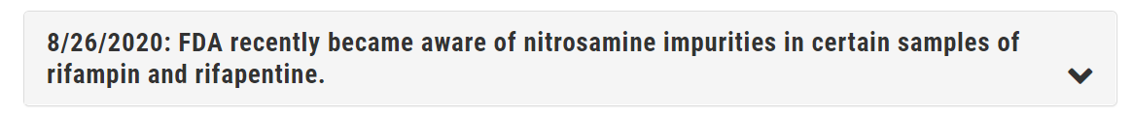
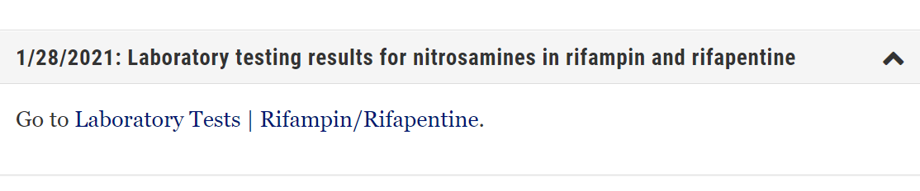
Current Events: Drug Impurities

Slide 51
Current Events: Drug Impurities
Nitrosamines detected in Rifampin and Rifapentine are not among the 7 known carcinogens. Neither are recalled. More details here.
  None were found in Rifabutin
No recommended changes in treating LTBI or TB disease
Updates, such as useful patient education or health care worker FAQs will be posted to our webpage: www.azdhs.gov/tb
Notes:
Updated resource

Slide 52
Current Events: Drug shortages
Check with your pharmacy to make sure Rifapentine is available for the full course of treatment.
If not available, there are other treatment options.
If treatment is delayed, will it be a missed opportunity?
  Highest risk of developing TB disease is in the first 2 years after infection
  Immunosuppression increases risk
  Will this delay other medical services?

Slide 53
Reporting TB in AZ
LTBI is reportable in children 5 years of age and younger
TB disease is reportable to the local health authority. Rule of thumb: if you are thinking they need treatment for TB disease, contact the local TB program.
Who is your local health authority? Your county health department or if the patient lives on tribal lands, the tribal health department.

Slide 54


Where do I Report TB in AZ?
Link to ADHS Communicable Disease Reporting for Healthcare Providers

Slide 55

LTBI: Targeted Testing Project
With the exception of children 5 and under, and contacts to potentially infectious TB, LTBI is not required reporting.
ADHS is looking to expand voluntary reporting for targeted testing. If your health center is interested in participating, contact us at tb@azdhs.gov

Slide 56
LTBI or TB?
Question 1
Latent TB Infection
Tuberculosis (TB)
May feel sick and may have symptoms such as a cough, fever, and/or weight loss

Slide 57
LTBI or TB?
Question 2
Latent TB Infection
Tuberculosis (TB)
Treatment option: 12 weeks of once a week Rifapentine/INH (3HP)

Slide 58
LTBI or TB?
Question 3
Latent TB Infection
Tuberculosis (TB)
Sputum may be AFB smear positive

Slide 59
LTBI or TB?
Question 4
Latent TB Infection
Tuberculosis (TB)
Collected specimens may culture out MTB

Slide 60
LTBI or TB?
Question 5
Latent TB Infection
Tuberculosis (TB)
Cannot spread TB bacteria to others

Slide 61
LTBI or TB?
Question 6
Latent TB Infection
Tuberculosis (TB)
Treatment option: 4 months Rifampin daily

Slide 62
LTBI or TB?
Question 7
Latent TB Infection
Tuberculosis (TB)
May require respiratory isolation precautions

Slide 63
LTBI or TB?
Question 8
Latent TB Infection
Tuberculosis (TB)
Never treat with a single drug. Standard treatment starts with four drug therapy: (RIPE).

Slide 64
LTBI or TB?
Question 9
Latent TB Infection
Tuberculosis (TB)
Reportable disease (regardless of age or site of disease)

Slide 65
LTBI or TB?
Question 10
Latent TB Infection
Tuberculosis (TB)
Is not currently sick. Can be treated to prevent future illness

Slide 66
Review: LTBI or TB?
Latent TB Infection
Tuberculosis (TB)
May feel sick and may have symptoms such as a cough, fever, and/or weight loss
Sputum may be AFB smear positive
Collected specimens may culture out MTB
May require respiratory isolation precautions
Never treat with a single drug. Standard treatment starts with four drug therapy: (RIPE).
Reportable disease (regardless of age or site of disease)
Cannot spread TB bacteria to others
Is not currently sick. Can be treated to prevent future illness
Treatment option: 12 weeks of once a week Rifapentine/INH (3HP)
Treatment option: 4 months Rifampin daily

Slide 67
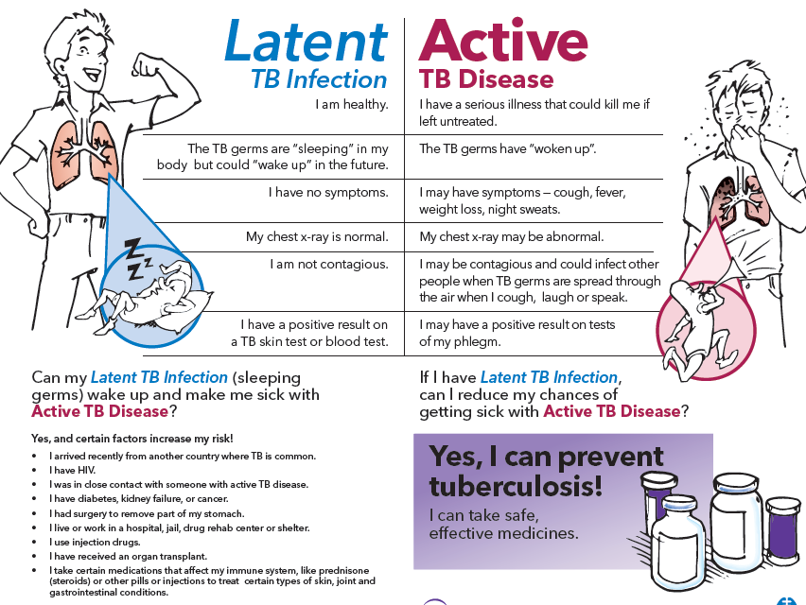
Review: Difference Between LTBI and Active TB?

Slide 68
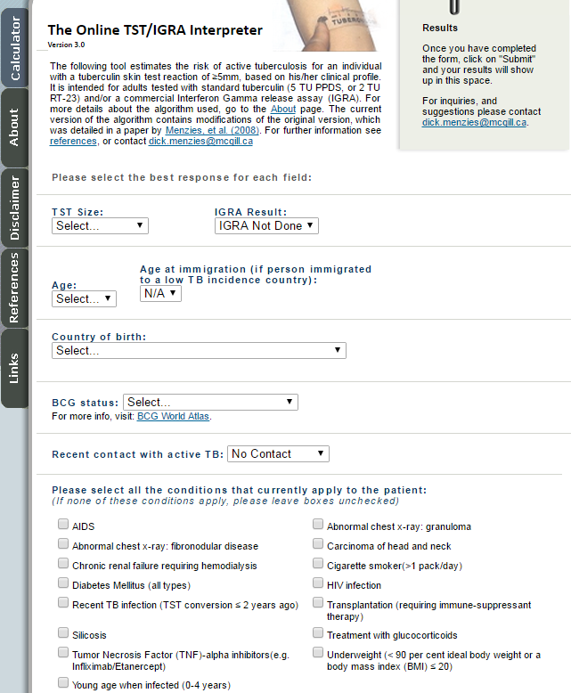
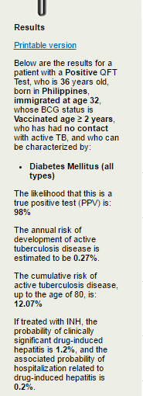
Online Active TB Risk Tool
Link to Online TST/IGRA Interpreter Tool

Slide 69
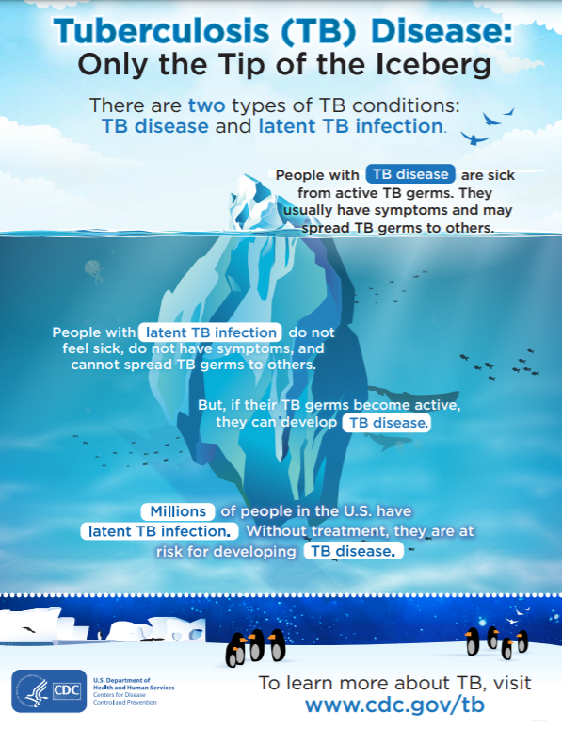
Thank you for helping to eliminating TB in our lifetime!
Any Questions?

Slide 70
Resources For Health Care Workers
LTBI Screening, Diagnosis, Treatment: Video http://globaltb.njms.rutgers.edu/products/ltbimultimedia.htm
Latent Tuberculosis Infection: A Guide for Primary Health Care Providers. http://www.cdc.gov/tb/publications/LTBI/default.htm
Poster summarizing TST: http://www.cdc.gov/tb/publications/Posters/images/Mantoux_wallchart.PDF
Training for Staff on TST’s video: http://www2c.cdc.gov/podcasts/player.asp?f=3739
Guide: http://www.cdc.gov/tb/education/Mantoux/guide.htm

Slide 71
Patient Education
The TB cycle: http://www.cdc.gov/tb/publications/Posters/stoptb.htm
Latent Infection handout: https://sntc.medicine.ufl.edu/Files/Products/UFTB%20English%20Flyer.pdf
Handout In Spanish: https://sntc.medicine.ufl.edu/Files/Products/0UFTB%20Spanish%20Flyer.pdf
Video in English: http://www.youtube.com/watch?v=1wqy4LxcAmU&feature=youtu.be
Video in Spanish: http://www.youtube.com/watch?v=iQzq5S9ZsOM

