Slide 1
STIs on the Rise
Becca Scranton, MPH STD Control Program Manager
Arizona Department of Health Services
Notes:
Good morning. Before we get into the clinical DGI presentation, I will provide a quick surveillance update for STIs in Arizona.

Slide 2
Disclaimer
“This presentation is supported by the Health Resources and Services Administration (HRSA) of the U.S. Department of Health and Human Services (HHS) as part of an award totaling $3,278,366. The contents are those of the author(s) and do not necessarily represent the official views of, nor an endorsement, by HRSA, HHS or the U.S. Government.”
The views and opinions expressed in this presentation are not necessarily those of the Pacific AIDS Education and Training Centers (PAETC), the Regents of the University of California or its San Francisco campus (UCSF or collectively, University) nor of our funder the Health Resources and Services Administration (HRSA). Neither PAETC, University, HRSA nor any of their officers, board members, agents, employees, students or volunteers make any warranty, express or implied, including the warranties of merchantability and fitness for a particular purpose; nor assume any legal liability or responsibility for the accuracy, completeness or usefulness of information [,apparatus, product] or process assessed or described; nor represent that its use would not infringe privately owned rights.

Slide 3
By the end of this presentation, you will be able to:
Explain trends in Arizona’s STI rates in recent years
Interpret statewide STI surveillance data
Discuss challenges with STI testing and reporting

Slide 4
Key trends
STIs have been rising since 2000
The rise in syphilis is more recent (2014)
Notes:
STIs have been rising in Arizona for well over a decade. The overall count is heavily influenced by what has been happening with chlamydia since that is the most common reportable STI that we surveil. The increases in gonorrhea and syphilis began in 2014 and we have observed a much shaper rate of increase in syphilis as compared to STIs overall.

Slide 5
60% of STIs occur in persons <25
Cases
Age
Chlamydia | Gonorrhea | Syphilis
Notes:
One of the key disparities we see in STIs, are the disproportionate rates by age. Not only do 60% of infections occur in persons under the age of 25, and when we plot case counts by age, we see that there is a really share peak in case counts for chlamydia and gonorrhea around the age of 20. Ensuring equitable access to screening and treatment for youth and young adults is incredibly important since this is where we see the majority of our disease burden and young persons can face unique barriers in accessing care.

Slide 6
Proportion of STI disparities by race/ethnicity
Proportion of Case Counts
| Race/ethnicity is missing in 32% of reported cases
Notes:
We also see disparities by race ethnicity. In Arizona, the majority of reported cases of STIs occur in Hispanic and non-Hispanic white persons.

Slide 7
Rate of STI disparities by race/ethnicity
Proportion of Case Counts
Rate per 100,000
Black/African American
Hispanic
Non-Hispanic White
| Race/ethnicity is missing in 32% of reported cases
Notes:
However when look at rates, the picture changes and the highest rates of STIs occur in Black/African Americans and American Indians. Our data relies heavily on provider reporting and about a third of our overall cases are missing race/ethnicity data. However, even when we look at syphilis which has 4% missingness, these trends persist.

Slide 8
2020 STI testing* dropped compared to 2019
| *Only a portion of testing funded by ADHS
2019 | 2020
Notes:
The question I get asked most these days is how has COVID impacted STIs are rates of STIs decreasing due to stay at home orders? COVID is still ongoing, so it will be a while before I can fully answer that question, but what I can tell you is that we did observe a drop in STI testing and delayed case reporting starting in roughly April. Keep in mind the testing we fund primarily occurs in County clinics, who have been heavily involved in responding to COVID. Although the drops in STI testing were in our county clinics, we suspect declines in testing were fairly widespread.

Slide 9
2020 STD Lab Reporting Volume
3500
|---March 22 ---------------Aug 29---|
Week
ELR | Paper
Notes:
We also observed a drop in lab reports between March and August which reflects the declines in testing occurring in our county clinics.

Slide 10
Gonorrhea and early syphilis continue to increase.
2019 2020*
Gonorrhea
+6%
Early Syphilis
+2%
| *As of 3/8/2021
Notes:
And although our screening is down, both gonorrhea and early syphilis continue to rise in spite of decreased testing and delayed reporting.

Slide 11
Preliminary DGI Analysis in AZ
Inclusion Criteria: DGI tx and/or suspicious* site
*Suspicious sites include abscess, blood, wound, ulcer, ear, joint
Notes:
In 2019 the was a cluster of DGI in Michigan. It prompted us to look at expanding DGI surveillance capacity in Arizona. DGI surveillance is one of the many projects that was postponed due to COVID last year but we are in the process of revisiting this work. DGI is estimated to occur in .5 to 3% of cases so for 2019 we would expect to see between 76 – 457 cases in Arizona, so these estimates do seem reasonable, however there are a lot of limitations.
DGI-Cefotaxime 1 gm IV/8 Hours + Azithromycin 1 gm Orally for 1 Dose
DGI-Ceftizoxime 1 gm IV/8 Hours + Azithromycin 1 gm Orally for 1 Dose
DGI-Ceftriaxone 1 gm IM or IV/24 Hours+Azithromycin 1 gm for 1 Dose
DGI-Ceftriaxone 1-2 gm IV/12-24 Hours+Azithromycin 1 gm for 1 Dose
We did see an increase in possible DGI cases starting in 2017, which reflects are overall upward trend of gonorrhea. However we suspect that this is not a true reflection of DGI burden in Arizona
Limitations:
Data entry errors
Under reporting
Limited options for specimen site (recently expanded)
Do not currently investigate cases to validate that they are truly DGI

Slide 12
Next steps
Notes:
Retrospective analysis (2017 – 2019)
Scale up active surveillance through coding and automation

Slide 13
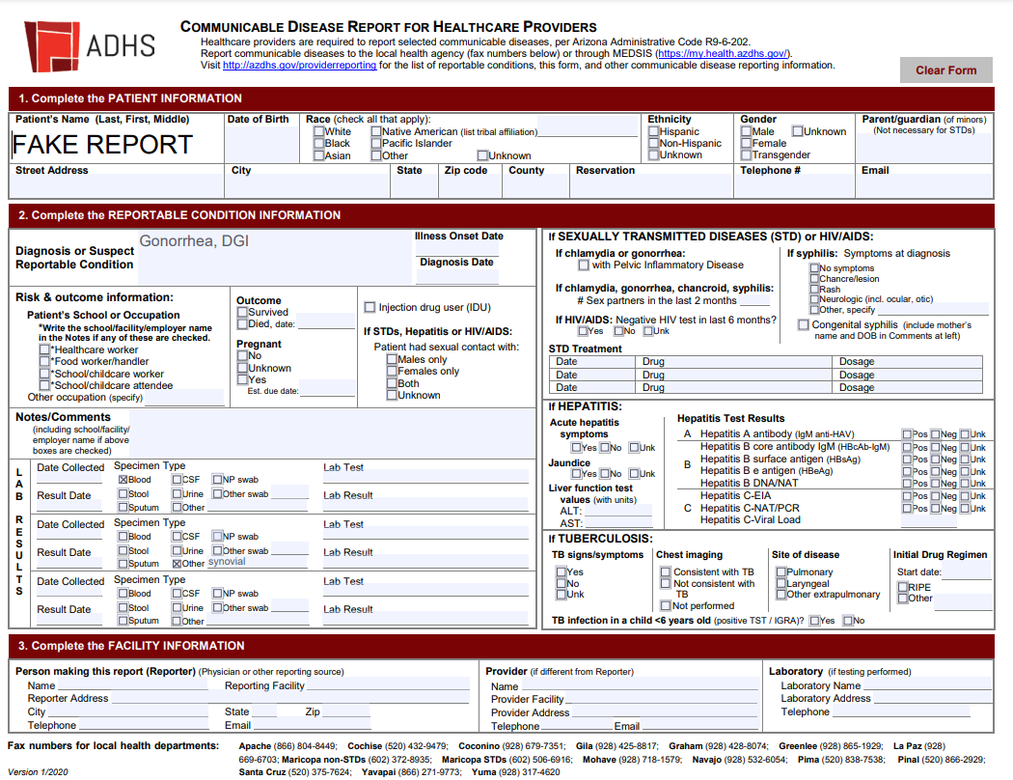
Suspect DGI?

Slide 14
Suspect DGI? You can report!
c
c
Notes:
These options are also available in MEDSIS (same thing, you may have to select ‘other’ for certain sites0

Slide 15
Areas of the CDR that could indicate DGI
Notes:
The specimen type list is not comprehensive, so if you get someone who is reactive at the synovial site or in a wound, you would have to select other and write in the site, as shown here.

Slide 16
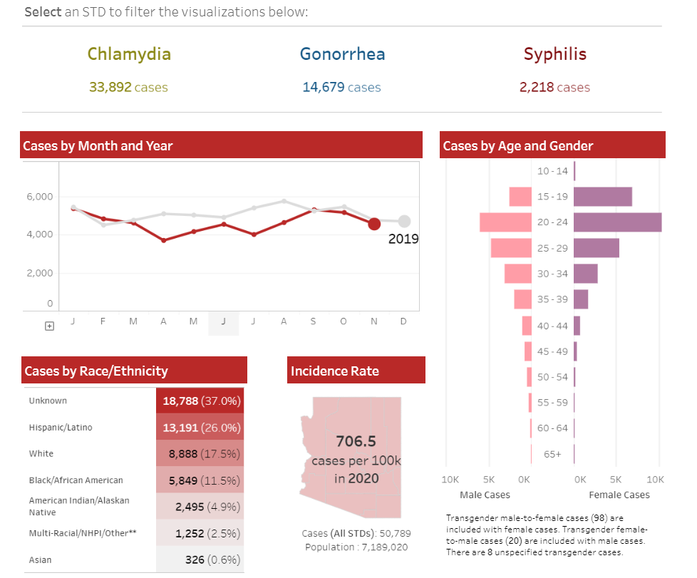
New data dashboard azdhs.gov/std
Notes:
If you’d like more data, check out our new data dashboard. You can filter data by disease, county, and year. There’s a 3-4 month lag and it’s updated monthly. We’re currently showing December 2020 preliminary data.

Slide 17
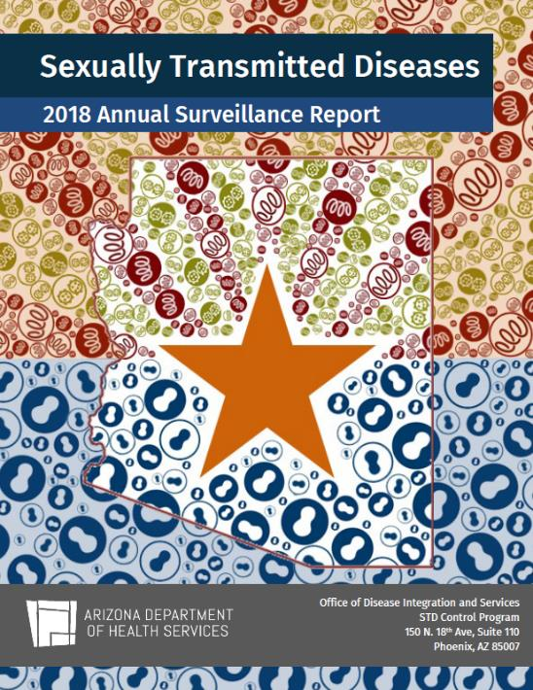
Want to learn more?
azdhs.gov/std
std@azdhs.gov
Check out the IDAZ App!
Report at azdhs.gov/reporting!
Becca Scranton
STD Control Program Manager
Rebecca.Scranton@azdhs.gov
602-364-4761
Notes:
You can also reach out to me directly if you have any questions or want to connect.

