Slide 1


Updates to PrEP 2022
Following CDC Release of PrEP Guidelines 2021

Slide 2
MATEC Statement on Equity and Inclusion
MATEC has a strong commitment to fair, respectful and unbiased representation of humankind. We strive to be anti-racist, gender affirming and honor all people in an authentic way. This is our goal in all of our work, including this presentation.
Our commitment to you is that we take this stance seriously and invite you to do the same. We ask that if you find something offensive, off-putting, or inaccurate to please let us know.
We continue to grow and evolve and welcome you on our journey.

Slide 3

Land Acknowledgement
Wayne State University rests on Waawiyaataanong, also referred to as Detroit, the ancestral and contemporary homeland of the Three Fires Confederacy. These sovereign lands were granted by the Ojibwe, Odawa, Potawatomi, and Wyandot nations, in 1807, through the Treaty of Detroit. Wayne State University affirms Indigenous sovereignty and honors all tribes with a connection to Detroit. With our Native neighbors, WSU can advance educational equity and promote a better future for the earth and all people.

Slide 4
Disclaimer
This program is supported by the Health Resources and Services Administration (HRSA) of the U.S. Department of Health and Human Services (HHS) as part of an award totaling $4,198,345 with zero percentage financed with nongovernmental sources. The contents are those of the author(s) and do not necessarily represent the official views of, nor an endorsement, by HRSA, HHS or the U.S. Government.
Funding for the AIDS Research and Education Center in the School of Medicine at Wayne State University is provided in part by Michigan Department of Health and Human Services (MDHHS) Division of Communicable Diseases.

Slide 5

MATEC Michigan
The Michigan site of the Midwest AIDS Education and Training Center (MATEC) is located in Detroit at Wayne State University School of Medicine, Division of Infectious Diseases.
MATEC Michigan’s mission is to increase the number of health care professionals who provide excellent quality HIV care and prevention services to our state’s underserved and vulnerable populations.

Slide 6
Disclosure
No one with the ability to control content of this activity has a relevant financial relationship to disclose with an ineligible company.
None of the planners or speakers for this educational activity have relevant financial relationships to disclose with ineligible companies whose primary business is producing, marketing, selling, re-selling, or distributing healthcare products used by or on patients

Slide 7
Continuing Medical Education
The Wayne State University School of Medicine is accredited by the Accreditation Council for Continuing Medical Education to provide continuing medical education for physicians.
The Wayne State University School of Medicine designates this live activity for a maximum of 2.5 AMA PRA Category 1 Credit(s)™. Physicians should claim only the credit commensurate with the extent of their participation in the activity.

Slide 8
Continuing Nursing Education
Detroit Medical Center is approved as a provider of nursing continuing professional development by Ohio Nurses Association, an accredited approver by the American Nurses Credentialing Center’s Commission on Accreditation. (OBN-001-91)
Detroit Medical Center designates this live activity for ___ Contact Hours.
Criteria for awarding contact hours requires attendance for the entire session.

Slide 9
Program Evaluation
Upon program completion, you will be asked to complete a short evaluation.
All responses are carefully read and are crucial for continued program improvement.
Thank you for joining us today

Slide 10
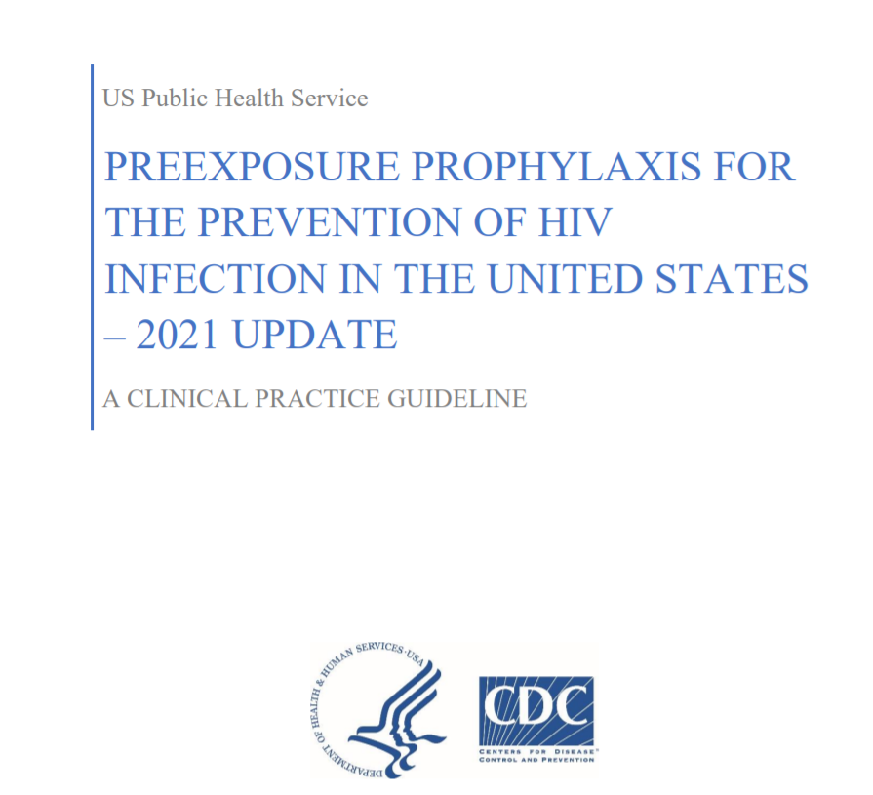
Updates to PrEP guidelines
In December 2021, new guidelines from the CDC were issued for PrEP with significant changes to 2017 guidelines
Shortly after, injectable PrEP was approved (Dec 20, 2021) by FDA
Multiple updates and changes to guidelines

Slide 11
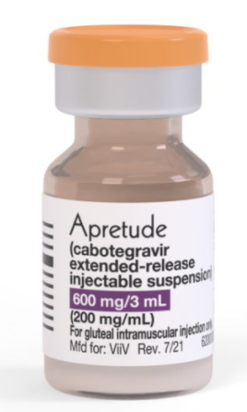
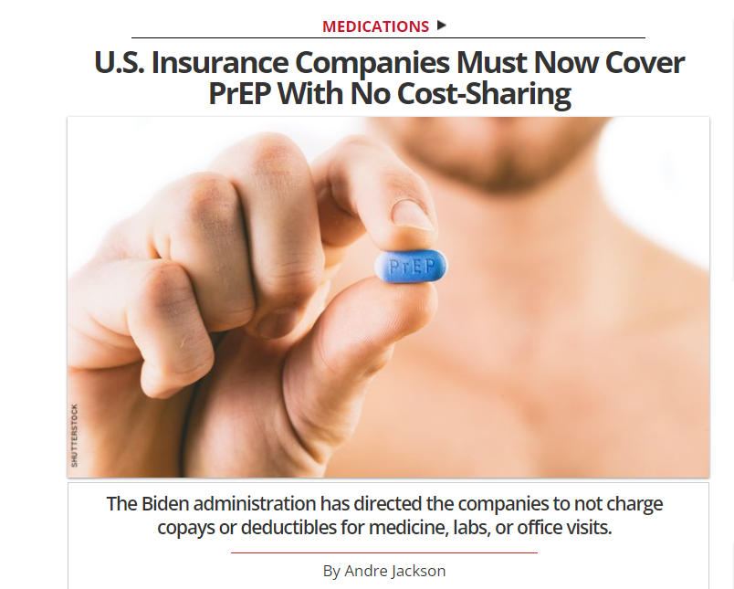
PrEP timeline (2017 -2022)
USPSTF issues Grade A recommendation to offer PrEP for persons at high risk
(June 2019)
CAB PrEP (Apretude) FDA approved as long acting injectable PrEP (Dec 2021)
2017
2018
2019
2020
2021
HR 3815 Bill introduced to increase access to PrEP
(July 2019)
CDC issues revised PrEP guidelines issued
(Dec 2021)
F/TAF (Descovy) approved as oral PreP
(Oct 2019)
PrEP guidelines from CDC issued
(2017)

Slide 12
Changes to 2021 guidelines highlighted in this presentation
Added F/TAF (Descovy)
Changed recommendations to oral PrEP lab monitoring
Added info on Same Day PrEP
Added info on “2-1-1” / On Demand PrEP
Recognized PrEP and telehealth workflows
Injectable PrEP

Slide 13
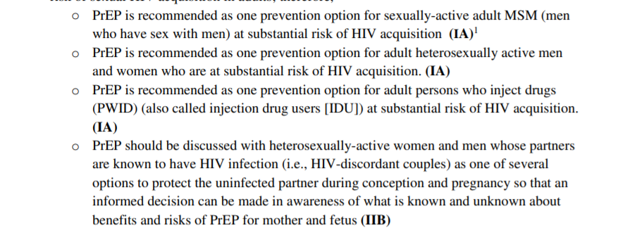
Stronger in recommendation for PrEP
2017
2021
All sexually active adults and adolescents should be informed about PrEP for prevention of HIV acquisition
In 2020, about 25% of the 1.2 million people for whom P is recommended were prescribed it, compared to only about 3% in 2015
In 2020, about 25% of the 1.2 million people for whom PrEP is recommended were prescribed it, compared to only about 3% in 2015

Slide 14
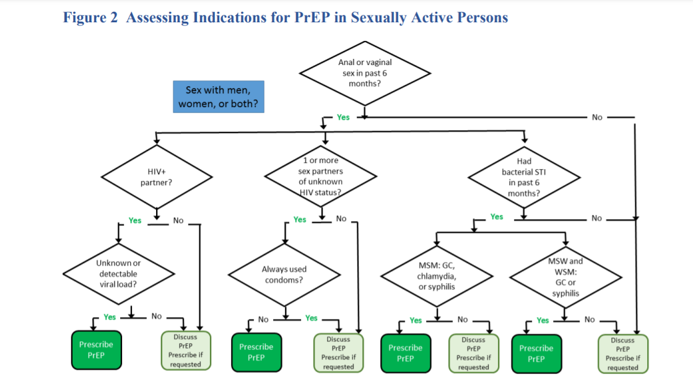
Assessing Risk of Sexual HIV Acquisition

Slide 15
Changes to 2021 guidelines highlighted in this presentation
Updates on F/TAF (Descovy)
Oral PrEP lab monitoring
Same Day PrEP
“2-1-1” / On Demand PrEP
PrEP and telehealth
Injectable PrEP

Slide 16
Information on F/TAF (Descovy)
New guidelines provide information about F/TAF (Descovy) as an oral PrEP option
In 2019, the FDA approved F/TAF as PrEP for sexually active men and transgender women and updated guideline adds F/TAF as a PrEP option for these groups. F/TAF is not recommended for people assigned female sex at birth who could get HIV through receptive vaginal sex.
Lab monitoring for F/TAF has been updated in guidelines
    Recommend checking lipids at baseline and 12 months after initiative F/TAF, and monitoring weight
    In previous guidelines, it was recommended to check eCrCl every 6 months, and this has been relaxed

Slide 17
Changes to 2021 guidelines highlighted in this presentation
Updates on F/TAF (Descovy)
Oral PrEP lab monitoring
Same Day PrEP
“2-1-1” / On Demand PrEP
PrEP and telehealth
Injectable PrEP

Slide 18
Changes to Lab monitoring for Oral PreP
Significant changes to HIV testing, including much more frequent use of HIV RNA testing
Changed monitoring of kidney function
    Assess creatinine clearance once every 12 months for patients under age 50 or patients whose estimated creatinine clearance was greater than 90 mL/min when they started oral PrEP
    For all other patients, assess creatinine clearance every 6 months.
For patients taking F/TAF,-- Each year, measure patients’ triglyceride and cholesterol levels and their weight.
Guidelines highlight that DEXA scans, liver function tests, U/A and LFTs and hematologic assays are not indicated for the routine care of all persons prescribed daily oral PrEP

Slide 19
Changes in HIV testing for PrEP
The updated guideline includes two testing algorithms:
For patients starting or restarting PrEP after a long stop (no oral PrEP in past 3 months, no injectable PrEP in past 1 year), test using an HIV antigen/antibody test (laboratory-based is preferred).
If nonreactive test and no HIV exposure-prone event in prior 4 weeks → can prescribe PrEP
Recommend if using rapid antigen/antibody test to also send to laboratory even if nonreactive in office
If patient has had HIV exposure prone event in prior 4 weeks, also send for quant or qualitative HIV-1 RNA assay.
If a patient has a negative antigen/antibody test and an undetectable HIV-1 RNA test confirming the patient does not have HIV, continue prescribing PrEP
If a patient has a positive antigen/antibody test and a detectable HIV-1 RNA test → link to care
For patients who are taking or have recently taken PrEP test using an HIV antibody/antigen assay AND a qualitative or quantitative HIV-1 RNA assay
  Includes patient who have taken oral PrEP in the last 3 months
  Includes patient who had a CAB PrEP injection in past 12 months
Means you are running an HIV-1 RNA every three months for these patients continually until they discontinue PrEP

Slide 20
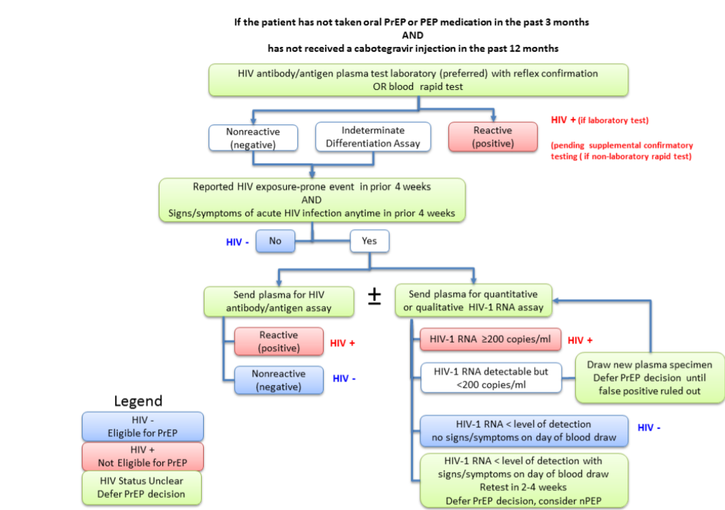
Determining HIV status for PrEP for patients not recently on oral PrEP

Slide 21
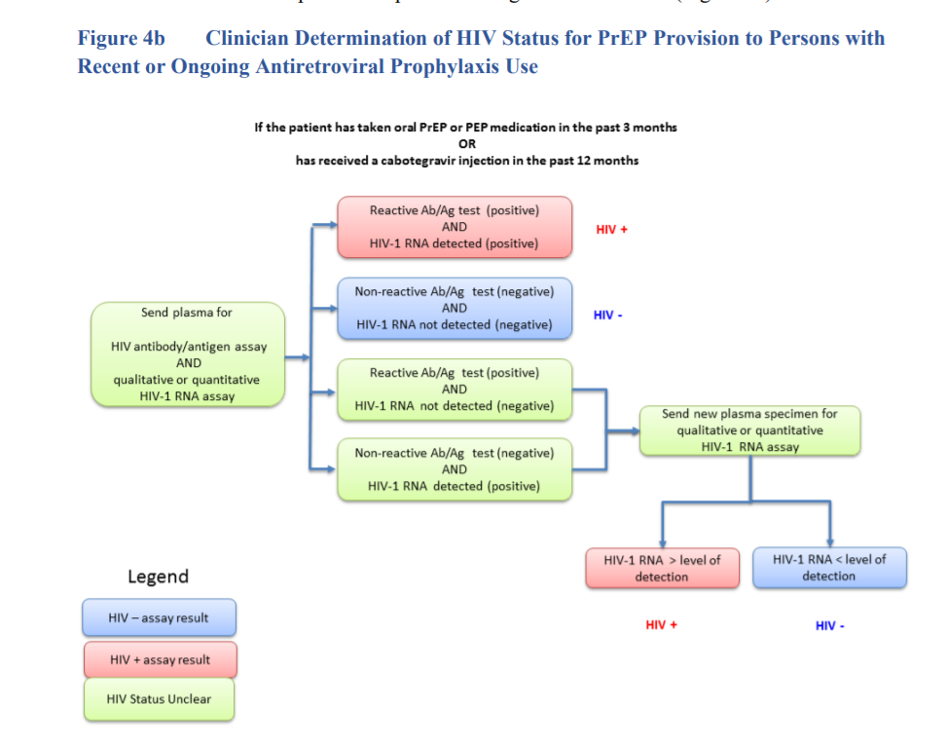
Determining HIV status for persons with recent oral or injectable PrEP use
Why did they add HIV-1 RNA?
HIV tests in persons who acquire HIV while taking PrEP differs from performance in persons not exposed to ARV
Delays from 34-62d in HIV Ag/Ab production, but HIV RNA was seen earlier

Slide 22
Oral PrEP associated Labs
Oral PrEP Follow-Up
Timing of Oral PrEP Associated Labs
Test | Screening/Baseline (if never on PrEP, or not on oral PrEP in past 3 months or IM PrEP in past 12mos) | Screening/baseline if has been on oral PreP in past three months or IM PreP in past 12 months | Q 3 month visit | Q 6 months | Q 12 months | When stopping PrEP
HIV Ag/Ab | X | X | X |  |  | X*
HIV-1 RNA |  | X | X
eCrCl | X |  |  | If age ≥50 or eCrCl <90 at PrEP intiiation | If age <50 or eCrCl <90 at PrEP initiation | X
Syphilis | X | X | MSM/TGW | X |  | MSM/TGW
Gonorrhea | X | X | MSM/TGW | X |  | MSM/TGW
Chlamydia | X | X | MSM/TGW | X |  | MSM/TGW
Lipid panel (F/TAF) | X | X | MSM/TGW | X | X
Hep B serology (HbsAg, HBsAb, HB total core Ab) | X | X
Hep C serology | X |  |  |  | MSM, TGW, PWID
Note RNA frequency
Note lipid monitoring
Note no u/a
Adapted from 2021 CDC PrEP guidelines

Slide 23
Changes to 2021 guidelines highlighted in this presentation
Updates on F/TAF (Descovy)
Oral PrEP lab monitoring
Same Day PrEP
“2-1-1” / On Demand PrEP
PrEP and telehealth
Injectable PrEP

Slide 24
Same Day PrEP
Offer same-day PrEP to patients when appropriate. The updated guideline offers steps to safely prescribe PrEP to patients on the same day as their first evaluation
Safely initiating PrEP requires determination of HIV status and assessment of renal function.
Safely shortening the time to initiation of PrEP may be useful for some patients
  E.g. some patients may have time or work constraints that impose a significant burden to return to the clinic a week or two after evaluation for a prescription visit OR
  Other patients report risk behaviors that put them at substantial risk of acquiring HIV infection in the time between visits for evaluation and PrEP prescription.

Slide 25
Same day PrEP considerations
To offer same day PrEP clinic must be able to:
Conduct point of care HIV testing, ideally with an antigen/antibody fingerstick or other blood test where same day results can be obtained*
    Oral fluid HIV testing should not be used
Draw blood for laboratory creatinine and HIV testing when same day HIV and creatinine test results are not available
    Where available, a point of care blood creatinine test may be used
Offer information on insurance or co-pay assistance
Provide rapid follow-up contact for patients whose laboratory test results indicate HIV infection or renal dysfunction
Provide scheduled follow-up tests and appointments
Be able to dispense or prescribe oral PrEP medication, or administer a gluteal intramuscular injection of CAB
Ideally, would collect specimens for other STI testing
*Where same-day results can be obtained, laboratory-based antigen/antibody test or an HIV-1 RNA test can be used (and is preferred)

Slide 26

Same day PrEP – who is this not appropriate for?
Patients who express ambivalence about starting PrEP
Patients for whom blood cannot be drawn for laboratory testing
Patients with s/s and sexual history indicating possible acute HIV infection
Patients with history of renal disease or associated conditions (e.g., hypertension, diabetes)
Patients without insurance or a means to pay when picking up the prescribed medication that day
May not be appropriate but use judgement:
Patients who do not have a confirmed means of contact should laboratory test indicate a need to discontinue PrEP (e.g., HIV infection, unanticipated renal dysfunction)
Patients with a very recent possible HIV exposure but no signs and symptoms of acute infection (should be evaluated for nPEP before PrEP)
Patients who may not be easily contacted for return appointments
Patients with mental health conditions that are severe enough to interfere with understanding of PrEP requirements (adherence, follow-up visits)

Slide 27
Changes to 2021 guidelines highlighted in this presentation
Updates on F/TAF (Descovy)
Oral PrEP lab monitoring
Same Day PrEP
“2-1-1” / On Demand PrEP
PrEP and telehealth
Injectable PrEP

Slide 28
2-1-1
Also called event-driven, intermittent, or “on-demand” and is a non-daily PrEP regimen that times oral F/TDF doses in relation to sexual events
The guidelines now provides information on how to correctly use off-label 2-1-1 dosing for oral PrEP. This information may benefit gay, bisexual, and other men who have sex with men who choose to use 2-1-1 dosing. This approach is not approved by the FDA and is not recommended by CDC.
IPERGAY155 and the subsequent Prévenir open label study in Paris have demonstrated the HIV prevention efficacy of 2-1-1 dosing only with F/TDF and only for MSM

Slide 29
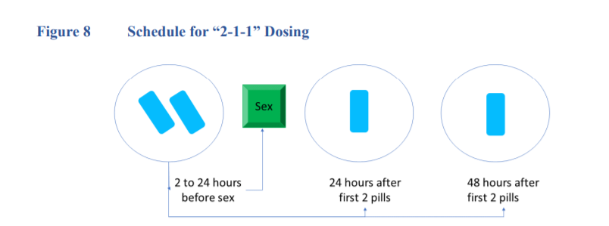
More on 2-1-1
Based on trial experience, MSM prescribed the 2-1-1 regimen should be instructed to take F/TDF as follows:
  2 pills in the 2-24 hours before sex (closer to 24 hours preferred)
  1 pill 24 hours after the initial two-pill dose
  1 pill 48 hours after the initial two-pill dose

Slide 30
More on 2-1-1
Based on the timing of subsequent sexual events, MSM should be instructed to take additional doses as follows:
    If sex occurs on the consecutive day after completing the 2-1-1 doses, take 1 pill per day until 48 hours after the last sexual event.
    If a gap of <7 days occurs between the last pill and the next sexual event, resume 1 pill daily.
    If a gap of >/= 7 days occurs between the last pill and the next sexual event, start again with 2 pills

Slide 31
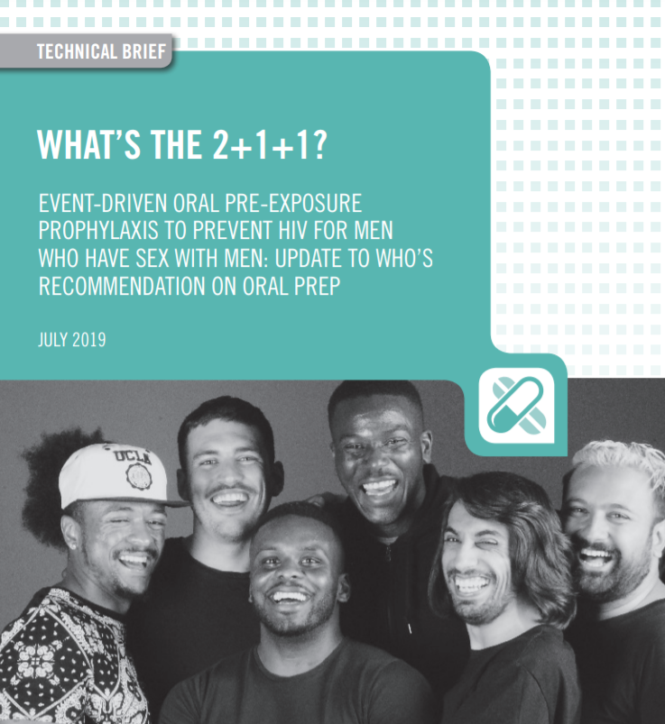
2-1-1 additional considerations
Some clinicians may choose to prescribe F/TDF off-label using “2-1-1” dosing for adult MSM who request non-daily dosing and who:
    have sex infrequently (e.g., less often than once a week) and
    can anticipate sex (or delay sex) to permit the doses at least 2 hours prior to sex
Clinicians who elect to provide the 2-1-1 regimen – should give no more than 30 pills without follow-up and documentation of another negative HIV test
    Patients having sex less than once weekly will have sufficient medication to cover up to 7 intermittent sexual events.

Slide 32
2-1-1 – who it is not for
2-1-1 dosing should not be prescribed:
    For populations other than adult MSM because it has been studied only in adult MSM
    For MSM who it is anticipated will have difficulty adhering to a complex dosing regimen (e.g., adolescents, patient with an active substance use disorder)
    With F/TAF because its use for pericoital dosing has not been studied; or
    For MSM with active hepatitis B infection because of the danger of hepatic flares with episodic F/TDF exposure.

Slide 33
Changes to 2021 guidelines highlighted in this presentation
Updates on F/TAF (Descovy)
Oral PrEP lab monitoring
Same Day PrEP
“2-1-1” / On Demand PrEP
PrEP and telehealth
Injectable PrEP

Slide 34

PrEP and telehealth considerations
Conduct PrEP screening, initiation, or follow-up visits by phone or online
Obtain specimens for HIV, STI, or other PrEP-related laboratory tests by:
    Laboratory visits for specimen collection only
    Order home specimen collection kits for specified tests
    For HIV testing, only if a patient has no possible access to a lab (in-person or by mail), clinicians can provide an oral swab-based self-test that the patient can conduct and report the result to the clinician (e.g., photo of the test result).
When HIV-negative status is confirmed, provide a prescription for a 90-day supply of PrEP medication (rather than a 30-day supply with two refills) to minimize trips to the pharmacy and to facilitate PrEP adherence.

Slide 35
Changes to 2021 guidelines highlighted in this presentation
Updates on F/TAF (Descovy)
Oral PrEP lab monitoring
Same Day PrEP
“2-1-1” / On Demand PrEP
PrEP and telehealth
Injectable PrEP

Slide 36
Injectable PrEP trials
Safety and efficacy of LA-CAB to reduce the risk of acquiring HIV were evaluated in two randomized, double-blind trials that compared LA-CAB to F/TDF
HPTN 083 included 4,566 HIV-uninfected MSM and transgender women who have sex with men
    Incidence of HIV infections occurred in 52 participants
      13 in the cabotegravir group (incidence 0.41 per 100 person years)
      39 in the TDF-FTC group (incidence 1.22 per 100 person years)
HPTN 084 included 3,224 uninfected cisgender women in SSA at risk of acquiring HIV
    Incidence of HIV infections occurred in 38 participants
      4 in the cabotegravir group (incidence 0.21%)
      34 in the TDF-FTC group (incidence 1.79%)
    CAB-LA was superior to daily oral TDF-FTC in prevention of HIV infection among MSM and transgender women (HPTN 083) and in cisgender women (HPTN 084)
https://www.fda.gov/news-events/press-announcements/fda-approves-first-injectable-treatment-hiv-pre-exposure-prevention; adapted from presentation by Dr. Shira Heisler

Slide 37
Cabotegravir For PreP
  Apretude (Cabotegravir extended-release injectable suspension) for use in at-risk adults and adolescents weight at least 35 kg (77 lbs) for pre-exposure prophylaxis (PrEP) to reduce the risk of sexually acquired HIV
    CDC guidelines state not for <18years old
  600 mg (3 mL) of cabotegravir injected into gluteal muscle (gluteus medius or gluteus maximus)
  Given first as 2 initiation injections administered 1 month apart, and then every 2 months thereafter
      2-inch needle for IM injections for patients with BMI of 30 or greater
      1.5-inch needle for IM injections for for patients with a BMI < 30
  30 mg daily oral cabotegravir is optional for a 4-week lead-in prior to injections
    In the clinical trial of CAB injections for PrEP, patients were provided oral CAB 30 mg tablets daily for 5 weeks prior to receiving the 1st injections
    No safety concerns identified in oral lead-in phase, thus it is not required
    It may be optional for patients who are especially worried about side effects

Slide 38
Advantages to Cabotegravir PrEP
Can be used in patients with renal disease
For patients who have difficulty with adherence to oral PrEP and prefer injections every 2 months

Slide 39
Disadvantages to Cabotegravir PrEP
Injection site reactions
Long tail – needs consideration when stopping/discontinuing LA-CAB
Person has to come into office
Side effects occurring more frequently in participants who received LA-CAB compared to participants who received F/TDF in both HPTN 083 and HPTN 084 trials included: injection site reactions, headache, pyrexia (fever), fatigue, back pain, myalgia and rash

Slide 40
Cautions with CAB Injections
Do NOT administer or prescribe other antiretroviral medical in combination with CAB for PrEP
Do NOT administer CAB injections at any site other than gluteal muscle because the pharmacokinetics of drug absorption with injection at pother sites is unknown
Do NOT dispense CAB injections for use by patients for home administration (unless and until self-administration is FDA approved)
Do NOT prescribe ongoing daily oral CAB (other than for lead-in prior initiating or restarting injections)

Slide 41
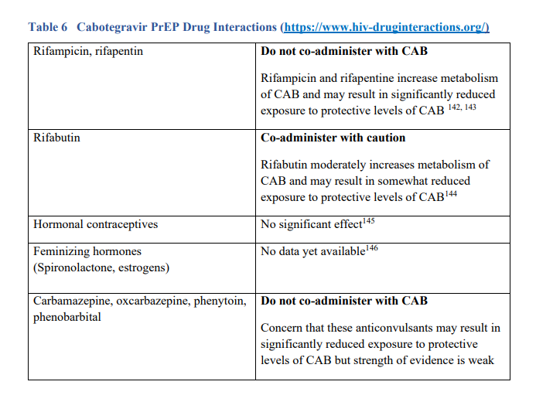
Cabotegravir PrEP Drug Interactions

Slide 42
Cabotegravir Initial PrEP Visit
Must ensure that patient doesn’t have acute or chronic HIV infections
    Because of the long duration of drug exposure or “long tail” following injection of CAB, exclusion of acute HIV is necessary with the most sensitive test, an HIV-1 RNA Assay
    If you wish to provide injection at the first PrEP evaluation visit based on rapid HIV Ag/Ab test, blood should always be drawn for laboratory confirmatory testing that includes HIV RNA assay
Patients who have been taking daily oral PrEP can initiate CAB injections as soon as HIV-1 RNA results confirm they remain HIV negative
All CAB PrEP patients should have baseline STI testing
Labs NOT Indicated:
    Creatinine, estimated creatinine clearance
    Hepatitis B serology
    Lipid panels
    Liver Functions Tests

Slide 43
Other lab monitoring changes injectable PrEP
Because the FDA approved CAB for PrEP in 2021, the updated CDC guidelines includes a new section that details the ongoing assessments and follow-up schedule for patients taking CAB.
Regular kidney, triglyceride, or cholesterol assessments are not needed for patients taking CAB as they are for patients taking oral PrEP.
The follow-up schedule for recommended assessments is different for CAB users:
  HIV testing every 2 months (at each injection visit)
  STI testing every 4 months (at every other injection visit)

Slide 44
Clinical Follow-Up and Monitoring for Cabotegravir PrEP Patients
Injectable PrEP Follow-Up
Timing of CAB PrEP Associated Labs
Test | Screening/Baseline | 1 month visit | Q2 months | Q4 months | Q6 months | Q12 months | When stopping CAB
HIV Ag/Ab | X | X | X | X | X | X | X
HIV-1 RNA | X | X | X | X | X | X | X
Syphilis | X |  |  | MSM/TGW^ | Heterosexually active women & men only | X | MSM/TGW
Gonorrhea | X |  |  | MSM/TGW | Heterosexually active women & men only | X | MSM/TGW
Chlamydia | X |  |  | MSM/TGW | Heterosexually active women & men only | Heterosexually active women & men only | MSM/TGW
Hep C serology | X |  |  |  | MSM, TGW, PWID

Slide 45
Discontinuing or Restarting CAB PrEP
CAB level slowly wane over many months after injections are discontinued
At some point during this “tail” phase, CAB levels will fall bellow a protective threshold and persist for some time at non-protective levels, exposing the patient to the risk of HIV acquisition
    These lower level of CAB may confer resistance to CAB or other INSTI medications
    Patients discontinuing CAB injections who may be at ongoing risk of sexual and injection HIV exposure should be provided with another highly effective HIV prevention method during the months following their last injection.

Slide 46
Clinical guidance for discontinuing LA-CAB
When helping patients discontinue CAB PrEP safely, clinicians should:
    Re-educate patients about the “tail” and the risks during declining CAB levels
    Assess ongoing risk/indications
    Educate about nPeP
    Continue follow up visit quarterly for 12 months
    Conduct HIV-1 RNA tests at each quarterly follow-up visits after discontinuing CAB injections
    Can begin F/TDF or F/TAF within 8 weeks after last injection
    CAB injections can be restarted at any point after determining negative HIV status with HIV-1 RNA testing

Slide 47
Time to Protection with CAB PrEP
No data yet available from clinical trials in men or women to estimate the time from initiation of CAB injections to maximal protection against HIV acquisition

Slide 48
Cabotegravir for PrEP and Pregnancy
CAB for PrEP may be initiated or continued in women who may be pregnant while receiving injections when it is determined that the anticipated benefits outweigh the risks
  Published data on cabotegravir-exposed pregnancies among women without HIV are sparse with only 4 pregnancies documented in HPTN 077
  The known increased risk of HIV acquisition during pregnancy and subsequent risk of HIV transmission to the infant during pregnancy and breastfeeding exceed any theoretical risk to maternal or infant health yet identified or observed in cabotegravir PrEP trials or in pregnancies occurring during treatment trials with cabotegravir-containing regiments

Slide 49
Coverage for Cabotegravir
Due to just recently being FDA approved, we are still doing our research
  Medicaid?
  Private?
  Prior authorization?
  Medication assistance program?

Slide 50
Reference pages
Specific pages with updates useful in clinic:
Page 15 – Table 1a: Summary of Clinician Guidance for Daily Oral PrEP Use
Page 16 -17 – Table 1b: Summary of Clinician Guidance for Cabotegravir Injection PrEP Use
Page 23 – Figure 2 Assessing Indications for PrEP in Sexually Active Persons
Page 27 – Figure 3 Assessing Indications for PrEP in Persons Who Inject Drugs
Page 30 – Figure 4a Clinician Determination of HIV Status for PrEP Provision to Persons without Recent Antiretroviral Prophylaxis Use
Page 31 – Figure 4b Clinician Determination of HIV Status for PrEP Provision to Persons with Recent or Ongoing Antiretroviral Prophylaxis Use
Page 35 – Same Day PrEP Guidance
Page 40 – PrEP Telehealth Guidance & Medication Adherence Counseling
Page 43 – Follow up Care & Monitoring Guidance
Page 47 – Prescribing Cabotegravir Injection Guidance
Page 55 – Event Driven PrEP
Page 64 – Primary Care Considerations around PrEP
Page 65 – Financial / Billing Issues
From Sara Olson, Midwest MATEC

Slide 51
References
Clinicians’ Quick Guide: Preexposure Prophylaxis for the Prevention of HIV Infection in the United States – 2021 Update – A Clinical Practice Guideline
PREEXPOSURE PROPHYLAXIS FOR THE PREVENTION OF HIV INFECTION IN THE UNITED STATES – 2021 UPDATE A Clinical practice guideline
FDA Apretude package label

Slide 52
Questions

Slide 53
Program Evaluation
MATEC Michigan thanks you for your participation in today’s program
We appreciate all feedback and look forward to incorporating your suggestions into future programming
    Link in the chat box
    Scan the QR Code
    Link in your email
QR CODE

Slide 54
Continuing Medical Education
<Program Date>
<Your Event Name Here>
Activity Code:
<your activity code here>
Using your designated phone number in our CME Tracker System please visit:
    WWW.CME.MED.WAYNE.EDU
    Click on “Activity Check-in”
    Enter Cellphone Number and Activity Code (above)
You have 7 days from the start of the conference to claim credit.
Landlines will not work with system. Cell phone is required
If you are unable to claim credit, please update your CME account.
Contact CME for questions: dcme@med.wayne.edu
or ea6178@wayne.edu

Slide 55
Continuing Nursing Education
A record of your attendance today has been made
A certificate awarding contact hours for today’s program will be sent to the email you used during registration
Please contact MATECMichigan@gmail.com with any continuing education questions

Slide 56
MATEC Michigan
2727 Second Avenue
Suite 138
Detroit, Michigan 48201
Phone: 313-962-2000
Urgent Consultation: 313-408-3483
Fax: 313-962-4444
Email: MATECMichigan@gmail.com

Slide 57
MATEC Resources
Clinical Consultation Center
http://nccc.ucsf.edu/
    HIV Management
    Perinatal HIV
    HIV PrEP
    HIV PEP line
    HCV Management
    Substance Use Management
AETC National HIV Curriculum
https://aidsetc.org/nhc
AETC National HIV-HCV Curriculum https://aidsetc.org/hivhcv
Hepatitis C Online https://www.hepatitisc.uw.edu
AETC National Coordinating Resource Center
https://aidsetc.org/
Additional Trainings
https://matec.info

