Slide 1
Project ECHO® - UNM
HIV TeleECHO Clinic
HIV-Viral Hepatitis
Highlights from CROI 2022
Michelle Iandiorio, MD
Professor, UNM DOIM Division of Infectious Diseases
Clinical Director- SCAETC, UNM HIV TeleECHO Clinics
Notes:
Version date_04 2022

Slide 2
Conflict of Interest Disclosure Statement
Speaker has no financial conflicts of interest to disclose.
This project is supported by the Health Resources and Services Administration (HRSA) of the U.S. Department of Health and Human Services (HHS). Under grant number U1OHA33225 (South Central AIDS Education and Training Center). It was awarded to the University of New Mexico. No percentage of this project was financed with non-governmental sources. This information or content and conclusions are those of the authors and should not be construed as the official position or policy of, nor should any endorsements be inferred by HRSA, HHS, or the U.S. Government

Slide 3
Learning Objectives
Familiarize oneself on some highlights presented at the 2022 Conference on Retroviruses and Opportunistic Infections (CROI) that relate to HIV-viral hepatitis.
Identify resource with access to materials from CROI 2022, available at https://www.croiconference.org/.

Slide 4
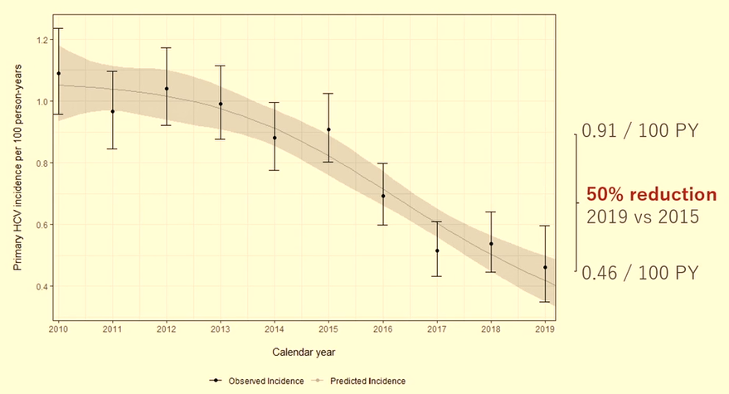
Effect of DAA on HCV Incidence Among PWH
Using data from InCHECK, calculated primary incidence from 2010-2019
Van Santen, DK. Burnet Institute, Melbourne Australia; CRPI Abstract 72
Notes:
DAA= directing acting antivirals
PWH=people with HIV
WHO HC elimination: by 2020, 30%reduction in new cases of HCV
-new absolute targets: <=5/100,000py and <=2/100 by PWID
Study aim= 1- are we on track for hcv elimination; 2- is there treatment as prevention effect of daas on hcv incidence
InCHECH=international collaboration on hepatitis c elimination in hiv cohorts; N105,402 participants from 10 cohorts; 6 of 10 cohorts from Australia and Europe have data on primary HCV infection
Timing of infection:
Midpoint between last HCV antibody negative and event date
If HCV RNA positive & HCV Ab negative, assumed 6 weeks
Analysis: Poisson model using restricted cubic splines for calendar year using the pooled dataset
In 2019: 50% achieved vs 30% expected to reach goals
Incdence was 0.5/100PY vs 5/100,000 PY (new absolute target)
Differences by country

Slide 5
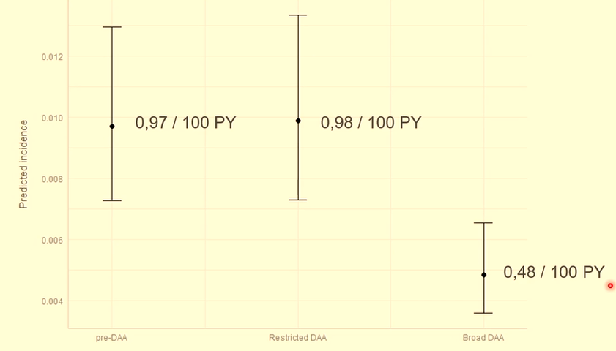
Effect of DAA on HCV Incidence Among PWH
Predicted HCV incidence per DAA period
50% reduction with broad access
Van Santen, DK. Burnet Institute, . CROI 2022 Abstract #73.
Notes:
is there treatment as prevention effect of daas on hcv incidence
InCHECH=international collaboration on hepatitis c elimination in hiv cohorts; N105,402 participants from 10 cohorts; 6 of 10 cohorts from Australia and Europe have data on primary HCV infection
Defined 3 periods of DAA access: no access, restricted access, and broad access
Changes in DAA access occurred at different times per country
Piecewise exponential model including a random effect for country
DAA TasP effect for broad access: 50% raverage reduction in HCV incidence compared to pre-DAA incidence, and no reductions during restricted access

Slide 6
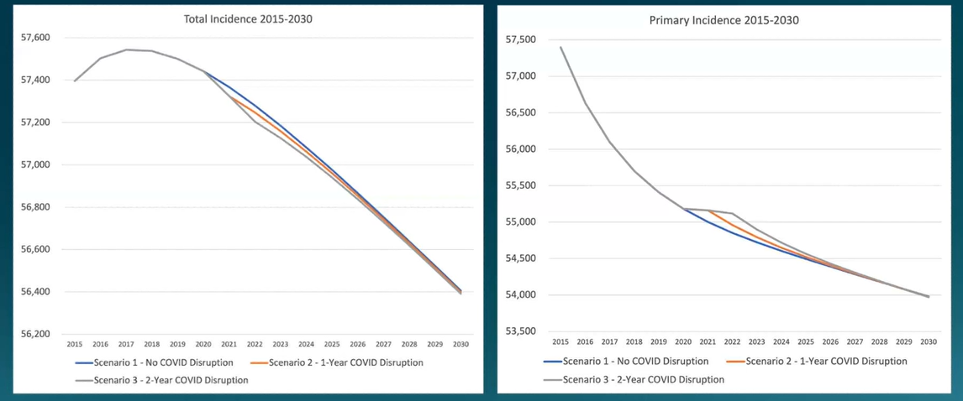
Modeling the impact of COVID-19 on HCV Elimination in US
Relative reduction in incidence from 2015-2030 in 2yr disruption scenario: 5.5% (95% CI: 5.1-5.8%)
Fores Ortea, RE. Uet al. CROI 2022, Abstract 72
Notes:
CDC Division of Viral Hepatitis 2025 strategic plan: elimination targets from 2017-2028 (90% reduction in new HCV infections, 65% reduction in HCV-related mortality
Previous analysis (Hoenigl M et al. AASLD 2021.) on treatment initiations among 2 large national labs (Quest and LabCorp) found a 30% drop in HCV treatment initiations April 2020 which did not rebound as of the endof 2020.
Model structure: general population deterministic compartmental model simulating hcv transmission and disease progression
Strategied by (1) age: 20-30, 31-51, 52+, )2) risk: PWID and non/former PWID; (3) hcv disease stage, diagnosis status, and treatment status
Incorporates transmission among PWID only
Simulates from 1990-2030
Simulated 3 scenarios with varying treatment rates
Sc1-status quo, no disruption to treatment uptake
2-one year covid-19 disruption: 30% reduction in treatment uptake from 2020-2021 (as observed in national data)
3-2-year covid-10 disruption: 30% reduction in treatment update from 2020-2022
Outcomes examined: what hs effect of tx on hcv incidence and hcv-related mortality until 2030?
Results: Relative reduction in incidence from 2015-2030 in 2yr disruption scenario: 5.5% (95% CI: 5.1-5.8%(
Relative reduction in hcv-mortality from 2015-2030 in 2yr disruption scenario: 20.6% (95%CI: 14.4-29,5%)

Slide 7
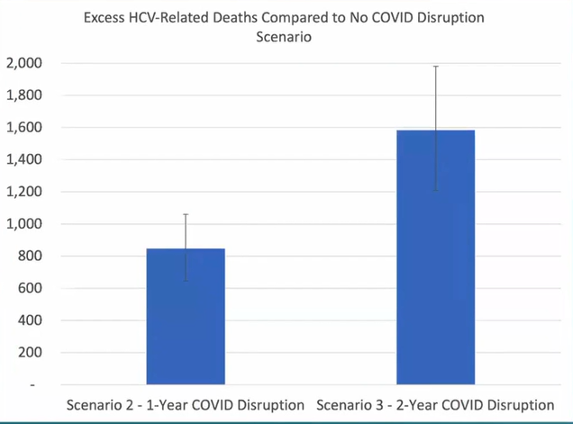
Modeling the impact of COVID-19 on HCV Elimination in US
Relative reduction in HCV-mortality from 2015-2030 in 2yr disruption scenario: 20.6% (95%CI: 14.4-29,5%)
Fores Ortea, RE. Uet al. CROI 2022, Abstract 72
Notes:
Relative reduction in hcv-mortality from 2015-2030 in 2yr disruption scenario: 20.6% (95%CI: 14.4-29,5%)
US not on track to meet NASEM/CDC elimination targets before pandemic and now fallen further behind
Limitations: need testing/treatment data for 2021/2022, pwid treatment rates unknown (assume equal among pwid/former pwid from 2015 onwards)
To meet the targets, urgent scale up required:
Identification f infected individuals through screening and diagsosis and targeting key populations
Linkage to care which includes curative treatment
Reduction in transmission through harm reduction scaleup (opiate agosist therapy and syringe programs)

Slide 8
Universal HCV Screening in Pregnancy
Move from risk-based screening to universal screening for all pregnant people
HCV IgG with reflex HCV RNA if positive on same sample
Universal screening resulted in 7.5fold increased detection rate of active HCV detection in pregnant people
Chappell, CA. CROI 2022. Abstract 27
Notes:
University of Pittsburgh PA hospital doubling of HCV among pregnant women from 2006 to 2016 (chappell et al. Pediatrics. 2018)
Note, transmission hcv to infant at rate about 5.8% in other studies
Univ of Pittsburgh rolled out universal screening during pregnancy June 2020 but no clinical pathway for cases identified; wasn’t prevention of perinatal transmission
Study objective: compare hcv screening and case detection during risk-based vs universal hcv screening amongst pregnant people at thei university
Used best practice alert
Med records were reviewed for hcv testing 9mo before and after initiationof prenatal care and compared using fisher’s exact test
Majority white, 45% Medicaid
HCV tested increased from 23% to 81%
HCV positive 11 cases to 85 cases, 5 infants wth hcv
Additional 4 infants with perinatal hcv identified
Limitations: noly one healthcare system in western Pennsylvania which limited generalizability
Some individual providers coul dhave used different screening practcs during 2 time periods
Risk based screening is insensitive
Universal screening resulted in 7.5fold increased detection rate of active hcv detection in pregnant people

Slide 9
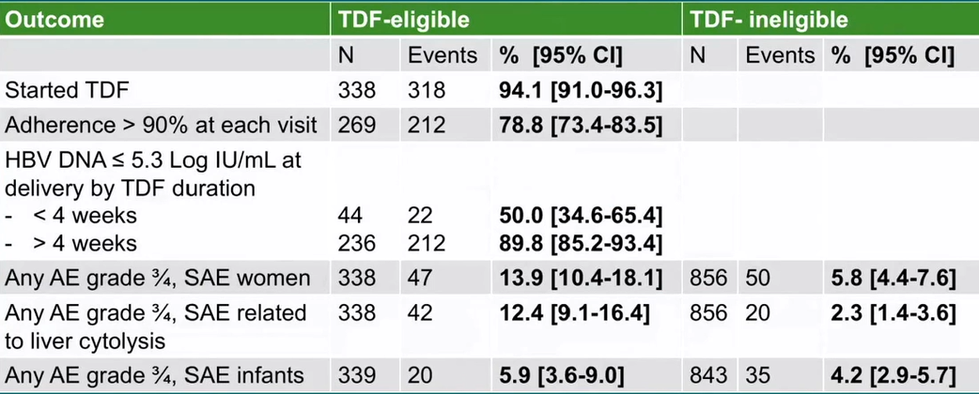
Prevention of HBV MTC Transmission
ANRS 12345 TA PROHM Study in Cambodia
HBIg-free strategy: TDF in 3rd trimester if HBV DNA VL>5.3 log, vaccinate infants in delivery room
Secondary outcomes
Segeral, O. CROI 2022 Abstract 28
Notes:
ANRS 12345 TA PROHM Study in Cambodia
HBV PMTCT: vaccination of all infants at birth + management of HBsAg positive pregnant women
HBIg at birth for infants; TDF in 3rd trimester of pregnancy if HBV DNA VL>5.3log (or positive HBeAg)
Challenges in many LMICs as Cambodia: difficulty in accessing HBIg due to financial and structural barriers so want to assess HBIg0free rgimens
Difficulty in accessing HBV DNA quanitifcation so HBeAg rapid diagnosis test as alteranative
Principal objective: effectiveness of HBIg-free strategy to prevent HBV mother-to-ichild transmission in Cambodia based on
1-use of HBsAg/HBeAg RDTs and ALT-based algorithm to screen pregnant women and decide TDF prophylaxis
2-TDF treatment for those eligible from 24 weeks of gestation including immediate treatment for those seen later
30 early vaccination for all infants at birth in delivery ropm (<2 hours)
Primary outcome: percentage of positive HBsAg infants at 6mo of life, stratified by infant’s HBIg status and maternal TDF duration (>vs<4 weeks)
Methods: single-arm prospective trial oct 2017 to Nov 2020 in 5 maternity units in Cambodia
Enrollment of positive hbsag women screened during antenatal care with hbsag rdt
Eligibility to TDF: from 10/17-12/18 hbeag-positive rdt; 1/19: hbeag-positive rdt and hbeag-neg rdt with alt>=40
Infant vaccine schedule: birth, w6, w10,w14
HGIg: not recommended n the study but could be done where availability
Sample size: 295 tdf-eligible pregnant women (Segeral, CID 2020)

Slide 10
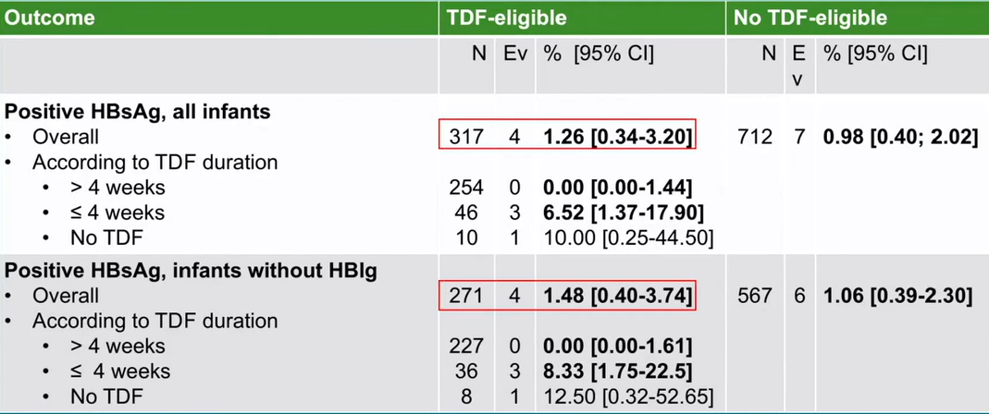
Prevention of HBV MTC Transmission
HBV transmission = 0% [95%CI:0-1.61] for women treated >4 weeks
Segeral, O. CROI 2022 Abstract 28
Notes:
ANRS 12345 TA PROHM Study in Cambodia
First large study evaluating an HBIg-free strategy with TDF prophylaxis
TDF-eligible women
Hbv transmission = 0% [95%CI:0-1.61] for women treated >4 weeks
Similar to RCTs with HBIg when TDF started 28-32 weeks
High transmission for women treated <4 weeks. Need early screening
Not TDF-eligible women
Hbv transmission = 1%. All women with HBV DNA>5.3log
Limitation of algorithm: interest of POC HBV DNA to better identify women eligible for TDF prophylaxis?
High acceptability of strategy: TDF prophylaxis, early vaccine
Limitations: high proportions fo LTFU but similar proportion of women with HBV DNA>5.3log at inclusion
Conclusion: An HBIg-free strategy with maternal use of TDF and early vaccination at birth could be effective to prevent HBV MTCT if TDF is initiated more than 4 weeks before deliver
By using a therapeutic algorithm (HBeAg RDT/ALT) accessible in district hospitals, this strategy could be used in rural settings where most pregnant women are followed in Cambodia)
New strategy to achieve WHO target of <0.1% HBsAg prevalence in infants in 2030

Slide 11
Additional CROI Topics
HIV virology and immunology
Disparities in HIV acquisition and outcomes
HIV Cure
Opportunistic infections
HIV Comorbidities
Mother-to-child transmission
Laboratory technologies
HIV Prevention
SARS CoV2 epidemiology, virology, immunology, prevention and treatment

Slide 12
References
https://www.croiconference.org/
http://www.croiwebcasts.org/y/2022
CROI 2022 Case-based Liver Workshop http://www.croiwebcasts.org/console/player/50234?mediaType=slideVideo&
Abstracts from the 2022 Conference on Retroviruses and Opportunistic Infections. Topics in Antiviral Medicine. March 2022:30(1s). https://www.iasusa.org/tam/march-2022/

Slide 13
Resources
National Clinician Consultation Center http://nccc.ucsf.edu/
HIV Management
Perinatal HIV
HIV PrEP
HIV PEP line
HCV Management
Substance Use Management
Present case on ECHO http://echo.unm.edu hivecho@salud.unm.edu
AETC National HIV Curriculum https://aidsetc.org/nhc
AETC National Coordinating Resource Center https://targethiv.org/library/aetc-national-coordinating-resource-center-0
Additional trainings scaetcecho@salud.unm.edu
www.scaetc.org

