Slide 1
Management of Treatment-Experienced Patients
Guidelines for the Use of Antiretroviral Agents in Adults and Adolescents
April 2023

Slide 2
About This Presentation
These slides were developed using the Guidelines updated in September 2022.
The intended audience is clinicians involved in the care of patients with HIV.
Because the field of HIV care is rapidly changing, users are cautioned that the information in this presentation may become out of date quickly.
It is intended that these slides be used as prepared, without changes in either content or attribution. Users are asked to honor this intent.

Slide 3
Guidelines for the Use of Antiretroviral Agents in HIV-1-Infected Adults and Adolescents
Developed by the Department of Health and Human Services (DHHS) Panel on Antiretroviral Guidelines for Adults and Adolescents – A Working Group of the Office of AIDS Research Advisory Council (OARAC)

Slide 4
Outline
Definitions: virologic response
Causes of virologic failure (VF)
Management of VF
Clinical scenarios
Optimizing ART in setting of virologic suppression (VS)
Discontinuation or interruption of ART
Poor CD4 recovery and persistent inflammation despite VS

Slide 5
Treatment-Experienced Patients
The recommended initial ARV regimens should achieve and maintain HIV suppression to below the lower level of detection (LLOD) of HIV RNA assays
Virologic rebound or failure of virologic suppression often results in resistance mutations to one or more of the ARVs in the regimen
Assessment and management of patients with extensive ART resistance is complex: expert consultation is recommended

Slide 6
Virologic Response, Definitions (1)
Viral suppression
Virologic suppression (VS):
Confirmed HIV RNA below LLOD (eg, <50 copies/mL)
Virologic failure (VF):
Inability to achieve or maintain HIV RNA <200 copies/mL
Graphic: National HIV Curriculum, hiv.uw.edu

Slide 7
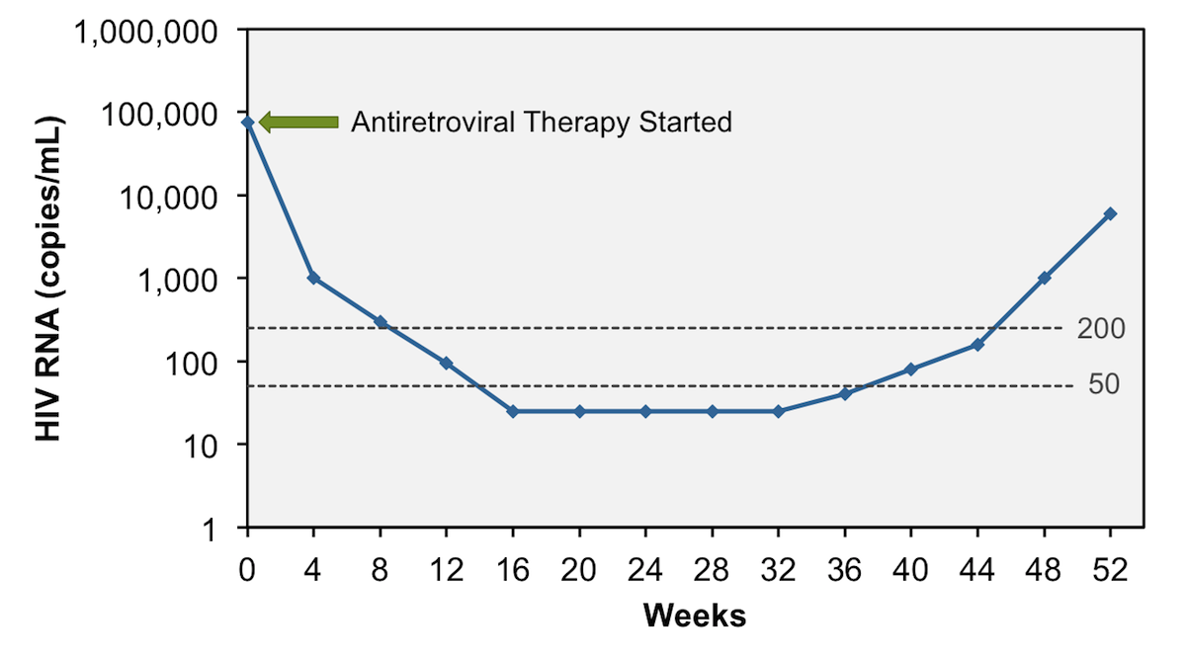
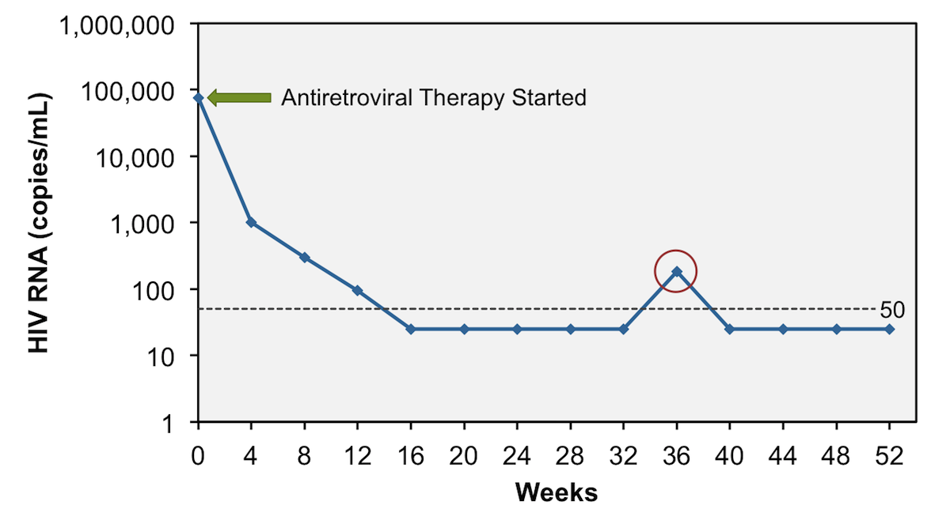
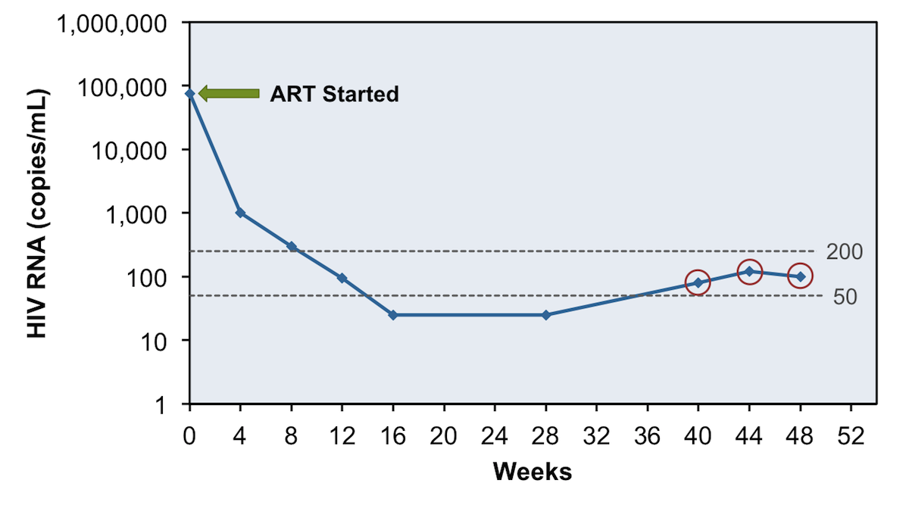
Virologic Response, Definitions (2)
Virologic rebound
Incomplete virologic response:
Decrease in VL but lack of VS to <200 copies/mL after 24 weeks on ART
Virologic rebound:
Confirmed HIV RNA ≥200 copies/mL after VS
Virologic blip:
An isolated detectable HIV RNA level followed by a return to VS
Low-level viremia:
Detectable HIV RNA <200 copies/mL
Virologic blip
Low-level viremia
Graphics: National HIV Curriculum, hiv.uw.edu

Slide 8
Causes of Virologic Failure (VF) (1)
Most common: suboptimal adherence, ARV intolerance; also transmitted drug resistance
Patient/adherence-related factors
Comorbidities that affect adherence (eg, substance abuse, psychiatric or neurocognitive issues)
Unstable housing
Missed clinic appointments
Interruptions in access to ART
Cost/affordability of ARVs
Adverse drug effects
High pill burden, dosing frequency

Slide 9
Causes of Virologic Failure (VF) (2)
HIV-related factors
Transmitted or acquired resistance mutations
Prior treatment failure
Higher pretreatment HIV RNA (depending on the ART regimen)
ARV regimen-related factors
Pharmacokinetic problems
Suboptimal ARV potency
Low genetic barrier to resistance
Prior exposure to nonsuppressive regimens
Food requirements
Drug-drug interactions with concomitant medications
Prescription errors

Slide 10
Managing Patients with VF (1)
Carefully assess causes of VF; management will vary according to cause
Review HIV RNA, CD4 count, ART history, prior and current ARV resistance test results
Resistance is cumulative; consider all past resistance
Resistance test should be done while patient is taking the failing regimen, or (for oral ARVs) within 4 weeks of treatment discontinuation, if possible
If >4 weeks since discontinuation of oral ARVs, resistance test may provide useful information, but it may not detect previously selected mutations
If on long-acting injectable (LAI) ARVs, resistance test likely to detect emergent mutations for months after discontinuation of LAI agents

Slide 11
Managing Patients with VF (2)
Goal of treatment: virologic suppression (HIV RNA <LLOD)
Select regimen based on ARV history, resistance testing, and/or novel mechanism of action
New regimen should contain at least 2 fully active agents
2 fully active ARVs may be sufficient if at least one has high resistance barrier (eg, DTG or boosted DRV)
If no fully active ARV with high resistance barrier is possible, 3 fully active ARVs are very important
Fully active: predicted to have full activity against patient’s virus, eg, an ARV from class to which patient’s virus has not developed resistance mutations; newer member of an ARV class that is likely to be fully active despite known resistance mutations to other agents in the class; drugs with novel mechanisms of actions
Partially active: predicted to have compromised activity against patient’s virus, caused by resistance mutations

Slide 12
Managing Patients with VF (3)
Some ARVs may have partial activity even if resistance mutations are present (eg, some NRTIs and PIs)
1 active drug should not be added to a failing regimen (resistance likely to develop quickly)
LAI CAB/RPV is not recommended if VF
If HIV/HBV coinfection – continue HBV-active agents, to avoid HBV flare
Monitor closely (at 4-8 weeks) for virologic response after regimen change
Consult with experts

Slide 13
Persons of Childbearing Potential
Perform pregnancy test before ART start
Some ARVs are not recommended in pregnancy; consult with expert

Slide 14
Managing VF: Level of Viremia (1)
For all:
Confirm VL, assess/address adherence, possible drug-drug and drug-food interactions
VL >LLOD - <200:
ART change not usually required. Development of resistance unlikely. No consensus re management. Check VL q 3 months.
VL ≥200 - <1,000:
Drug resistance likely (esp. if VL >500).
Check genotype (including integrase GT if patient taking INSTI).
Manage as for VL ≥1000.

Slide 15
Managing VF: Level of Viremia (2)
VL ≥1000 and no ARV resistance mutations identified:
Usually caused by suboptimal adherence: assess and address; consider ART changes, simplification
Monitor VL closely
VL ≥1000 and ARV resistance mutations identified:
Modify regimen ASAP, to avoid more resistance mutations and higher viral loads

Slide 16
Managing VF, Clinical Scenarios: Failure of 1st ART Regimen - INSTI + 2 NRTIs
Resistance considerations | ART options
If resistance to 3TC/FTC but no INSTI or other NRTI resistance | Boosted PI + 2 NRTIs (at least 1 fully active) DTG (or possibly BIC) + 2 NRTIs (include at least 1 fully active) Boosted PI + DTG
If EVG or RAL resistance but susceptibility to DTG +/- 3TC/FTC resistance | Boosted PI + 2 NRTIs (at least 1 fully active) DTG BID (if HIV is sensitive to DTG) + 2 fully active NRTIs DTG BID (or possibly BIC, if HIV is sensitive*) + boosted PI
*BIC: no data in VF + EVG or RAL resistance mutations; GL has conflicting guidance re use in this scenario (“possibly … if HIV is sensitive,” and “not currently recommended”

Slide 17
Managing VF, Clinical Scenarios: Failure of 1st ART Regimen (2) - NNRTI + 2 NRTIs
Resistance considerations | ART options
Most likely: resistance to NNRTI +/- 3TC/FTC (M184V/I) Add’l NRTI mutations may be present | DTG (or possibly BIC) + 2 NRTIs (at least 1 fully active) Boosted PI + 2 NRTIs (at least 1 fully active) Boosted PI + INSTI

Slide 18
Managing VF, Clinical Scenarios: Failure of 1st ART Regimen (3) - Boosted PI + 2 NRTIs
Resistance considerations | ART options
Most likely: no resistance, or resistance only to 3TC/FTC (M184V/I) | DTG (possibly BIC)* + 2 NRTIs (at least 1 fully active) Continue same regimen Another boosted PI + INSTI Another boosted PI + 2 NRTIs (at least 1 fully active)
*If only 1 NRTI is fully active, or if issues with adherence, DTG preferred to BIC.

Slide 19
Managing VF, Clinical Scenarios: Failure of 2nd (or subsequent) ART Regimen – ARV resistance but active ARV options
Resistance considerations | ART options
Consider past and current resistance test results and ART history to design new ART regimen | At least 2 fully active ARVs Can use partially active ARVs if no other options Consider ARVs with different mechanisms of action

Slide 20
Managing VF, Clinical Scenarios: Failure of 2nd (or subsequent) ART Regimen – Multiple or extensive resistance and few ARV options
Resistance considerations | ART options
Consider past and current resistance test results and ART history to design new ART regimen Consider tropism test (if MVC is being considered) Consult experts | Identify all active or partially active ARVs Consider ARVs with different/novel mechanisms of action (eg, FTV, IBA, LEN) Consider investigational ARVs: clinical trial or expanded access program ART discontinuation is NOT recommended

Slide 21
Managing VF, Clinical Scenarios: Suspected ARV Resistance but Limited/Incomplete ARV and Resistance History - Unknown
Resistance considerations | ART options
Obtain records, if possible Resistance testing: may identify mutations (if patient off ART, mutations may not be detected) | Consider restarting previous regimen and obtain VL and resistance test after 2-4 weeks Consider regimen with ARVs with high genetic barriers to resistance (eg, DTG and/or boosted DRV) with close VL monitoring and resistance testing if inadequate viral suppression

Slide 22
Optimizing ART in Setting of Virologic Suppression (VS)
ART may sometimes be changed from one effective ART regimen to another, eg if:
Adverse effects, pill burden, regimen complexity, drug-drug or drug-food interactions, pregnancy, cost issues
Goal: maintain VS, avoid jeopardizing future ARV options
Review full ARV history, virologic response to past regimens, adverse effects, all resistance test results

Slide 23
Optimizing ART in Setting of Virologic Suppression (VS) (2)
If no history of VF or resistance mutations:
Likely can change to any recommended (and effective) regimen for initial ART
If history of VF and resistance mutations: use principles of selecting ART in setting of VF, include fully-active high resistance barrier ARV (eg, DTG, boosted DRV, BIC)
Consult with experts
Use appropriate 3- or 2- ARV regimen; ARV monotherapy not recommended

Slide 24
Optimizing ART in Setting of Virologic Suppression (VS) (3)
Long-acting injectable (LAI) CAB/RPV:
Option if no resistance mutations to CAB or RPV, VS for 3-6 months on oral ART, and patient can reliably attend clinic/injection appointments
Not recommended in pregnancy; does not have activity against hepatitis B (HBV)

Slide 25
Optimizing ART in Setting of Virologic Suppression (VS) (4)
Pregnancy:
LAI CAB/RPV non recommended; switch to a regimen recommended for pregnancy
Hepatitis B coinfection:
Continue HBV-active ARVs (TDF or TAF), or start specific HBV medications

Slide 26
Optimizing ART in Setting of Virologic Suppression (VS) (5)
After ART switch:
Monitor closely for 3 months (eg, for ART tolerance, adherence, status of previous AEs)
Telephone call at 1-2 weeks
HIV RNA and other lab tests at 4-8 weeks

Slide 27
Discontinuation or Interruption of ART
Treatment interruption should be avoided, if possible: may cause rapid increase in HIV RNA, immune decompensation, clinical progression
Unplanned ART interruption may occur, and sometimes may be necessary

Slide 28
Discontinuation or Interruption of ART: Short-term interruptions (days-weeks)
Unanticipated:
Severe toxicity or inability to take oral medication:
Stop all oral ARV components simultaneously
Planned:
All oral ARVs have similar half-lives:
Stop all simultaneously
ARVs have different half-lives:
Some NNRTIs have long half-lives; may stop NNRTI first and stop other ARVs 2-4 weeks later, or replace NNRTI with boosted PI for 4 weeks, then stop all

Slide 29
Discontinuation or Interruption of ART: Planned long-term interruptions
Not recommended outside controlled clinical trials
If ART must be discontinued, patients should understand risks (re personal health and re HIV transmission)
Follow closely: clinical and laboratory monitoring

Slide 30
Discontinuation or Interruption of ART: Long-acting ARVs
Extended half-lives
Missed doses or discontinuation may result in VF with resistance unless oral ARV regimen is started
For planned missed/late injections, protocols/ recommendations are available (eg, oral ARV bridge)
For discontinuation: transition to effective oral ART within 4 weeks of last planned LAI doses

Slide 31
Poor CD4 Recovery and Persistent Inflammation Despite Viral Suppression
Morbidity and mortality are higher in HIV-infected individuals than in the general population, even with viral suppression
e.g., cardiovascular disease, many non-AIDS cancers and infections, COPD, osteoporosis, diabetes, liver disease, kidney disease, thromboembolic disease, neurocognitive dysfunction, frailty
Likely related to poor CD4 recovery, persistent immune activation, and inflammation, as well as health-related behaviors and ARV toxicity

Slide 32
Poor CD4 Recovery Despite VS
Low CD4 (especially <200 cells/µL, but also up to at least 500 cells/µL) despite viral suppression on ART: associated with risk of illness and mortality
Lower pretreatment CD4 counts associated with suboptimal CD4 recovery – early ART initiation may enhance CD4 recovery

Slide 33
Poor CD4 Recovery Despite VS: Management
Evaluate for underlying causes
Malignancy, coinfections (e.g., HCV), medical conditions
Medications that may decrease CD4 cells (e.g., cancer chemotherapy, interferon)
No consensus on management of patients without evident causes
Changing or intensifying the ARV regimen has not been shown to be beneficial, is not recommended
IL-2: no benefit, not recommended
Other immune-based therapies are being studied

Slide 34
Persistent Immune Activation and Inflammation Despite VS (1)
Immune activation and inflammation improve with suppression of HIV through ART, but do not return to normal
Systemic immune activation and inflammation may be independent mediators of risk of morbidity and mortality in patients with viral suppression on ART
Poor CD4 recovery on ART (e.g., CD4 <350 cells/µL) associated with greater immune system activation and inflammation

Slide 35
Persistent Immune Activation and Inflammation Despite VS (2)
Causes not completely clear: likely include HIV persistence, coinfections, microbial translocation
No proven interventions
ART intensification or modification: not consistently effective in studies
Anti-inflammatory medications and others are being studied
Clinical monitoring with immune activation or inflammatory markers is not currently recommended
Focus on maintaining viral suppression with ART, reducing risk factors (e.g., smoking cessation, diet, exercise), managing comorbidities (e.g., hypertension, hyperlipidemia, diabetes)

Slide 36
Websites to Access the Guidelines
AETC National Coordinating Resource Center https://aidsetc.org
Clinical Info https://clinicalinfo.gov

Slide 37
About This Slide Set
This presentation was prepared by Susa Coffey, MD, for the AETC National Resource Center in March 2020 and updated in April 2023.
See the AETC NCRC website for the most current version:
https://aidsetc.org

