Slide 1
September AETC E-Learn Call Caption This! Update on Section 508 Compliance & Captioning Options
Mark Urban (U.S. Centers for Disease Control and Prevention) Donna H. Setzer (Southeastern National Tuberculosis Center)

Slide 2
Learning Objectives
Upon completion of this training, participants should be able to:
Explain that accessibility is a requirement
Describe the considerations for e-learning
Learn about captioning options for your webinars

Slide 3
Presenters
Mark Urban: Section 508 Coordinator and Compliance Officer for the U.S. Centers for Disease Control and Prevention, and Co-chair for the U.S. Dept. of Health and Human Services 508 Program
Donna Setzer: Co-executive Director and Director of eLearning and Online Technology for the Southeastern National TB Center (SNTC). Donna has been at SNTC for eight years and has been involved with training technology since 1990, before any of us dreamed of email, the internet, or 508 compliance

Slide 4
Section 508 Compliance: Review & Update Mark Urban

Slide 5
The Requirement
Access by persons with disabilities:
Internal and External
Relevant Laws and why you don’t care:
ADA, Sections 508 vs. 504, International
Focus on standards: WCAG 2.0
Web Content Accessibility Guidelines at a glance

Slide 6
Accessibility vs. Accommodation
Accessibility:
Standards-based design that supports persons with disabilities (e.g. a ramp at the entrance)
Accommodation:
Individual adjustment based on individual needs (e.g. a special entrance)
BOTH are required. But you KNOW you have to be Accessible!

Slide 7
What’s Required (1)
Provide text alternatives for non-text content.
Tag pictures, avoid pictures of text
Label forms and tables.
Provide captions, descriptions and other alternatives for multimedia.
CART (captioning at real-time) for live presentations.
Captions for recorded multimedia
Describe visual-only elements

Slide 8
What’s Required (2)
Create content that can be presented by assistive technologies, without losing meaning.
Avoid technologies that require lots of work to be made accessible, such as Flash or PDF.
Make it easier for users to see and hear content.
Pre-send materials
Post-session transcripts
Make all functionality available from a keyboard.

Slide 9
What’s Required (3)
Do not use content that causes seizures. (don’t flash the screen)
Have useful Search, Table of Contents, and consistent buttons/menu options.
Avoid color ALONE.
Allow people to email/chat questions.
ASK people ahead of time if they need special ACCOMMODATIONS.

Slide 10
Summary
Accessibility and Accommodation are both required by law, learning requirements, and mission.
E-Learning developers must consider that not everyone can see, hear, speak, or use a mouse.

Slide 11
Captioning Options Donna Setzer

Slide 12
How SNTC Captions

Slide 13
Create Transcript
Transcript Service
MP4 file of audio
Presentation slides

Slide 14
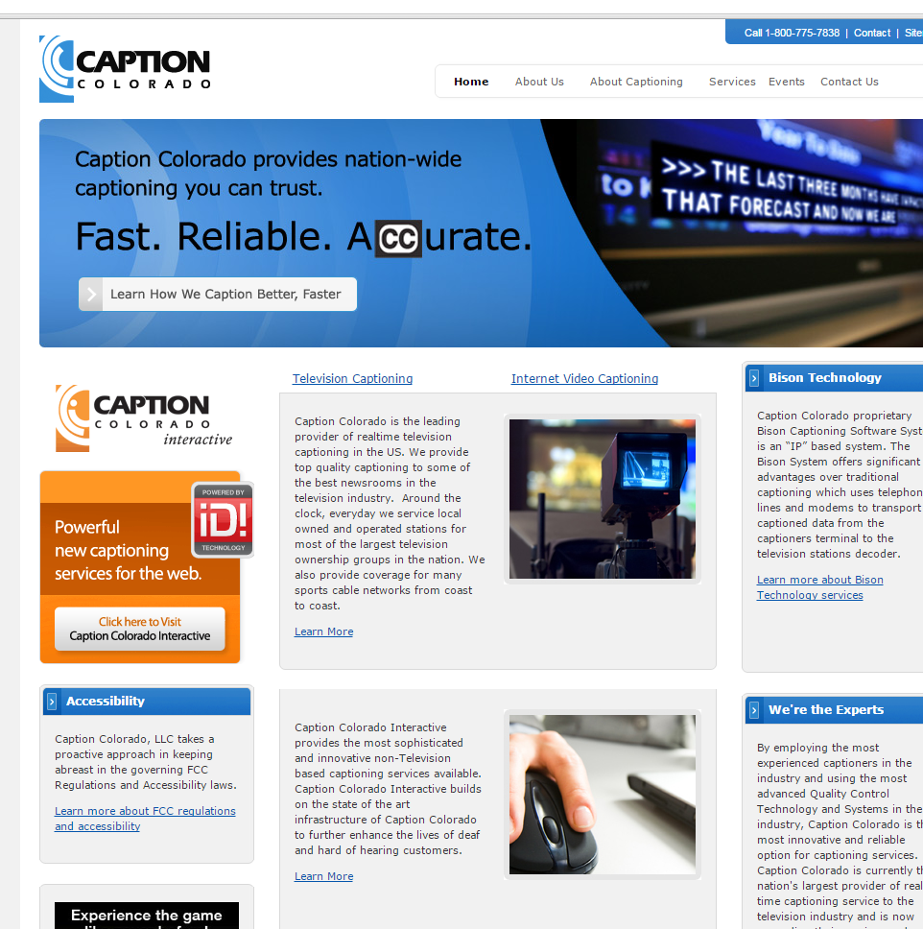
Create Transcript (1)
www.captioncolorado.com
$150/audio hour
2 hr webinar = $300

Slide 15
Create Transcript (2)
SNTC
Review and edit
Post transcript and handout to site

Slide 16
Create YouTube Closed Caption (1)
Type the text directly in YouTube – HOURS! OR
Create a transcript file – DONE!
Use blank line to force the start of new caption - DONE
Use square brackets to designate background sounds. For example, [music] or [laughter]
Add >> to identify speaker or change of speaker
Click here to visit You Tube’s Tips for creating a transcript file

Slide 17
Create YouTube Closed Caption (2)

Slide 18
Create YouTube Closed Caption (3)
Post video to YouTube

Slide 19
Create YouTube Closed Caption (4)
Go to Video Manager

Slide 20
Create YouTube Closed Caption (5)
Select arrow beside Edit.
Select Subtitles and CC.

Slide 21
Create YouTube Closed Caption (6)
Click Add new subtitles or CC
Select English

Slide 22
Create YouTube Closed Caption (7)
Select Upload a File

Slide 23
Easy button
http://www.morvimmer.com/blog/free-download-staples-easy-button/

Slide 24
Create YouTube Closed Caption
Click here to link to the SNTC webinar on YouTube

Slide 25
Questions?

Slide 26
Additional Questions and Resources
www.webaim.org – Web Accessibility
http://508.hhs.gov/ - HHS Checklists
http://ncam.wgbh.org/ - Media accessibility
508helpdesk@cdc.gov – CDC activities
https://support.google.com/youtube/answer/2734799?hl=en - YouTube closed captioning support

Slide 27
Contact
Any questions about the presentation:
Mark Urban: murban@cdc.gov
Donna Setzer: Donna.setzer@medicine.ufl.edu

Slide 28
Next Call
TBD
Contact Judy Collins at collinj3@sn.rutgers.edu if you’d like to participate in planning future E-Learn calls

