Slide 1

Occupational Exposure to HIV, HCV, HBV
Joanne Phillips, MSN, RN
François-Xavier Bagnoud Center
School of Nursing
Rutgers, The State University of New Jersey
January 15, 2014
Adapted from content by Sindy Paul, MD, MPH, FACPM

Slide 2
HIV 101: The Basics

Slide 3
Objectives
Describe two ways HIV can be transmitted
Identify two laboratory tests used to assess HIV disease
Describe the clinical progression of HIV
Discuss the purpose of antiretroviral treatment.

Slide 4
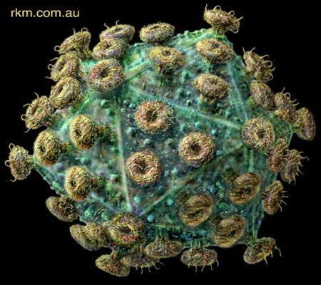
What is HIV
Human
Immunodeficiency
Virus
HIV is a retrovirus that attacks the immune system.
Its genetic material, RNA, must be converted in to DNA during replication.
Over time, the immune system and the body loses its ability to fight the virus.

Slide 5

HIV and the Immune System
The CD4 cells coordinate a body’s immune response to an invader (bacteria, virus, etc.)
BUT, when HIV enters CD4 cells for reproduction, it damages the CD4 cell, eventually killing it.
The body’s immune system works hard making more CD4 cells
Overtime, HIV destroys the CD4 cells faster than the immune system can make new ones
So, HIV damages the very system that usually protects the body from infection.

Slide 6
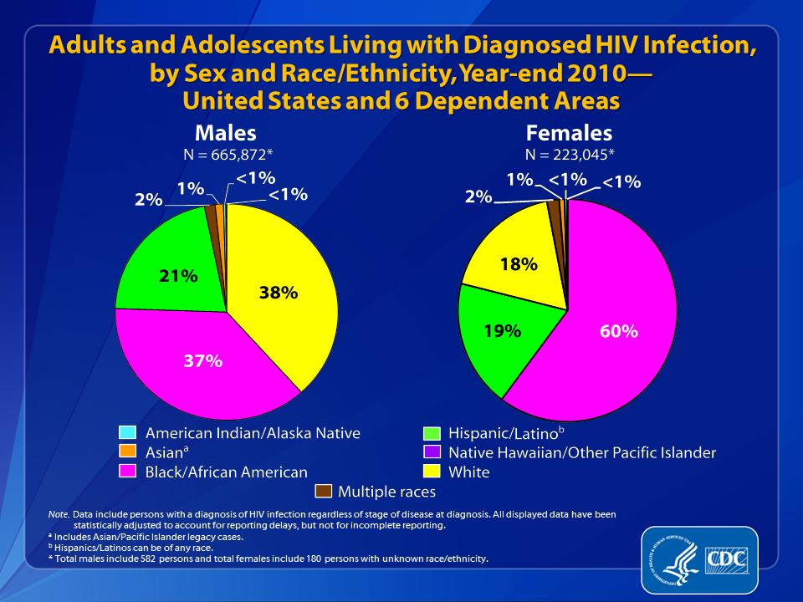
Notes:
At the end of 2010, an estimated 888,921* adults and adolescents were living with diagnosed HIV infection in the United States and 6 dependent areas.
Among the 665,872* males living with diagnosed HIV infection, 38% were white, 37% were black/African American, and 21% were Hispanic/Latino. Approximately 2% were Asian and approximately 1% were males of multiple races. Less than 1% each were American Indian/Alaska Native and Native Hawaiian/other Pacific Islander.
Among the 223,045* females living with diagnosed HIV infection, 60% were black/African American, 19% were white, and 18% were Hispanic/Latino. Approximately 2% were females of multiple races, 1% were Asian, and less than 1% each were American Indian/Alaska Native, and Native Hawaiian/other Pacific Islander.
Data include persons with a diagnosis of HIV infection regardless of stage of disease at diagnosis. All displayed data are estimates. Estimated numbers resulted from statistical adjustment that accounted for reporting delays, but not for incomplete reporting.
The Asian category includes Asian/Pacific Islander legacy cases (cases that were diagnosed and reported under the pre-1997 Office of Management and Budget race/ethnicity classification system).
Hispanics/Latinos can be of any race.
* Persons living with diagnosed HIV infection by race/ethnicity are classified as adult or adolescent based on age at year-end 2010. Total number adults and adolescents living with HIV infection is inclusive of persons of unknown sex. Total males include 582 persons and total females include 180 persons with unknown race/ethnicity.

Slide 7
HIV in New Jersey
36,648 people are living with HIV
78%
Minorities
34%
Women
(53% between 20-49)
159 perinatal exposures
3% infected
79%
40 years or older

Slide 8
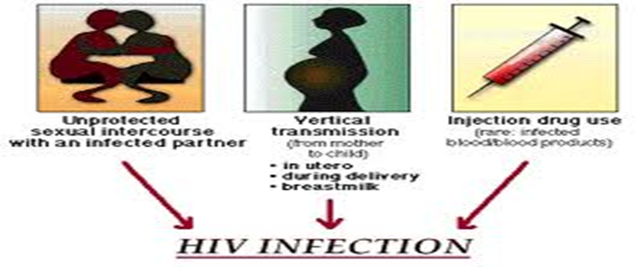
HIV Transmission
Blood
Semen
Vaginal Secretions
Breast milk
Comes into contact with:
  mucous membranes, damaged tissue, or is injected into the body
Through:
  Vaginal, anal, or oral sex
  Contaminated needles
  IV drug use

Slide 9
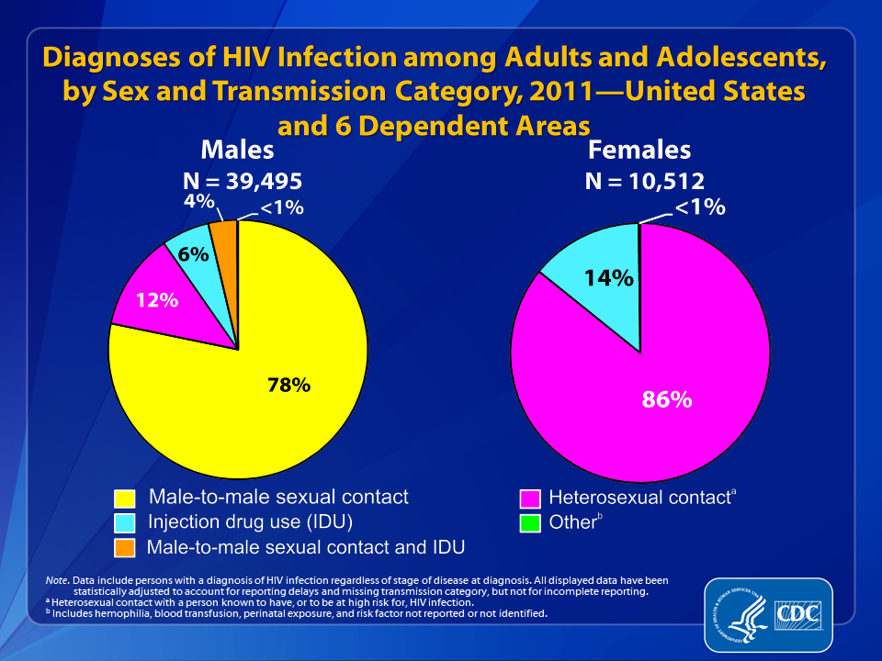
Notes:
In 2011, among adult and adolescent males diagnosed with HIV infection in the United States and 6 dependent areas, an estimated 78% of infections were attributed to male-to-male sexual contact, 12% to heterosexual contact, 6% to injection drug use, 4% to male-to-male sexual contact and injection drug use, and less than 1% to other transmission categories.
Among adult and adolescent females, 86% of diagnosed HIV infections were attributed to heterosexual contact, 14% were attributed to injection drug use, and less than 1% to other transmission categories.
Data include persons with a diagnosis of HIV infection regardless of stage of disease at diagnosis. All displayed data are estimates. Estimated numbers resulted from statistical adjustment that accounted for reporting delays and missing transmission category, but not for incomplete reporting.
Heterosexual contact is with a person known to have, or to be at high risk for, HIV infection.
Other transmission categories include hemophilia, blood transfusion, perinatal exposure, and risk factor not reported or not identified.

Slide 10
HIV Transmission
Perinatal transmission during pregnancy, labor and deliver, or breastfeeding
Occupational exposure via needle stick or exposure to eyes, nose, or open wound
  Since 1981 there have been 57 documented cases of occupational transmission in the US
Blood transfusion or organ donation from an HIV infected donor (rare in US)

Slide 11

HIV Transmission
HIV is NOT transmitted by casual contact
  Working or playing with an HIV positive person
  Closed mouth kissing
  Shaking hands
  Public pools
  Hugging
  Public toilet
HIV is not transmitted by air, food, or mosquito and does not survive long outside the body.

Slide 12

HIV Testing
CDC recommends routine HIV testing for ALL patients:
  Aged 13-64
  Initiating TB treatment
  Seeking treatment for STI’s
  Who are pregnant
Repeat Screening Recommended
  Annually people at high risk
  Before beginning a new sexual relationship
  When clinically indicated
  After an occupational exposure

Slide 13
HIV Testing
Benefits of routine opt-out HIV testing
  Reduces the stigma of testing
  Reduces transmission
  Majority of people aware of their HIV status reduce behaviors that transmit infection
  Perinatal transmission can be prevented if mother’s HIV status is known
  Improves patient outcomes (with early diagnosis of HIV)

Slide 14
Sequence of HIV Assay Reactivity During
Early HIV Infection relative to Western Blot*
WB POSITIVE
Trinity Uni-gold Recombigen (2)
OraSure Oraquick Advance (1)
Bayer ADVIA Centaur (14)
Clearview Statpak/Complete (5)
Bio-Rad Ag/Ab combo (19)
Ortho Vitros Eci/ECiQ (13)
Abbott Architect
Ag/Ab Combo (20)
Bio-Rad Mulltispot (7)
Gen-Probe Aptima (26)**
Medmira Reveal G3 (6)
BioRad GS + O (12)
DPP HIV1/HIV-2(6)
BioLytical Insti (9)
Avioq(6)
-25
-20
- 15
-10
- 5
0
NAT
4th gen IA
3rd gen Lab IA
2nd gen IA
3rd gen POC IA
1st gen WB
Estimated # of days HIV assay is reactive before a positive Western blot result is obtained
*Assay sensitivity above is based on frozen plasma only. Whole-blood and oral fluid has not been
characterized for early infection.
**Current data suggests that the Gen-Probe Aptima can detect HIV-1 RNA ~9-11 days after infection.
Adapted from Owen et al J Clin Micro 2008 and Masciotra et al J Clin Virol 2011

Slide 15
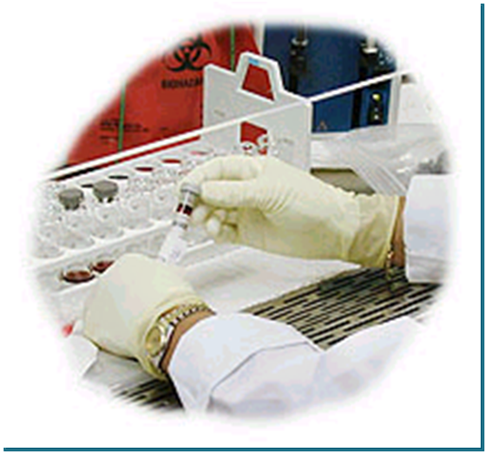
HIV Laboratory Tests – CD4 Count
CD4 count –measures state of a person’s immune function
  Adult values are approximately 500-1300
  Used to determine stage of HIV progression
  Determines risk of opportunistic infection
  Guides decisions about antiretroviral therapy (ART)

Slide 16
HIV Laboratory Tests – Viral Load
Detects the amount of virus present
  High viral loads increase risk for disease progression and HIV transmission
Guides initiation of therapy
Monitors effectiveness of ART
  Goal of therapy is an undetectable viral load
Sometimes used during acute infection to detect virus
Measured by HIV-1 RNA PCR

Slide 17
Antiretroviral Therapy
Recommended for all HIV-positive people
  To prevent disease progression
  To prevent transmission of infections
Strength of recommendation based on
  CD4 count
  Transmission risk
See Guidelines for the Use of Antiretroviral Agents in HIV-1 Infected Adults and Adolescents available at http://www.aidsinfo.nih.gov/ for more info

Slide 18
Confusing terminology?
ART = Anti Retroviral Therapy
ARV = Anti Retro Virals
HAART = Highly Active Anti Retroviral Therapy
Triple Therapy = Three Antiretrovirals
“The Cocktail”

Slide 19
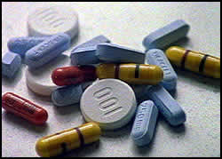
Basic Facts about ARVs
Always use 3 or more different ARV medications for therapy.
Regimen should be selected by an experienced HCW.
Other medications interact with ARVs.
ARVs are divided into classes, each of which attacks HIV in a different way.
New classes becoming available through clinical trials.

Slide 20
HIV as a Chronic Disease
ARVs change HIV from a terminal (fatal) disease to a “chronic disease”
Examples of chronic diseases:
  Diabetes
  High blood pressure
  Asthma
  Schizophrenia

Slide 21
Advantages of ARV Therapy
Improved patient health
Reduced illness
Reduced hospitalisations
Fewer deaths from AIDS

Slide 22
Goals of Treatment
Improve quality of life
Reduce HIV-related morbidity and mortality
Restore and/or preserve immunologic function
Maximally and durably suppress HIV viral load
Prevent HIV transmission

Slide 23
Occupational Exposure to HIV, HCV, HBV
Joanne Phillips, RN, MS
Adapted from content by Sindy Paul, MD, MPH, FACPM

Slide 24
Objectives
Identify the modes of occupational HIV transmission that occur in health care workers.
Review federal and state governmental agency requirements for management of occupational exposure to HIV and recommendations for postexposure prophylaxis.

Slide 25
Important Blood-Borne Pathogens
  Human immunodeficiency virus (HIV)
  Hepatitis B virus (HBV)
  Hepatitis C virus (HCV)
T

Slide 26

Healthcare Worker Definition
“All paid and unpaid persons working in healthcare settings who have the potential for exposure to infectious materials including body substances, contaminated medical supplies and equipment, and contaminated environmental surfaces”

Slide 27
Governmental Requirements
OSHA 1990
OSHA Revisions Nov. 1999
NEW JERSEY – “Safety Needle Law” – Jan. 2000
H.R. 5178 – “The Needlestick Safety and Prevention Act”- Nov. 2000
Notes:
Occupational Safety and Health Administration

Slide 28
OSHA’S 1999 & H.R. 5178 - Who has to comply?
Hospitals
Alternate site facilities
Clinical laboratories
Any facility covered by BBP Standard
Notes:
The Act applies to all employers who have employees with reasonably anticipated occupational exposure to blood or other potentially infectious materials (OPIM), including: · Hospitals · Surgery Centers · Medical Clinics · Physician offices · Nursing homes · Home Care/ Home Infusion

Slide 29

Basic Requirements – OSHA &H.R. 5178
Update BBP Exposure Control Plan – include evaluation and implementation of safer medical designed to eliminate or minimize occupational exposure. Review and update plan annually.
Continuously monitor effectiveness of engineering controls
Update employee training to include HCV and use of safer medical devices
Notes:
engineering and work practice controls shall be used to eliminate or minimize employee exposure." The revision defines Engineering Controls as "controls (e.g., sharps disposal containers, self-sheathing needles, safer medical devices, such as sharps with engineered sharps injury protections and needleless systems) that isolate or remove the bloodborne pathogens hazard from the workplace."
Exposure Control Plan? How often to I need to update it? A: In addition to what is already required by the 1991 standard, the revised standard requires the documentation of annual consideration and implementation of appropriate engineering controls, and solicitation of non-managerial workers in evaluating devices. The plan must be reviewed and updated every year.

Slide 30
Cont. OSHA & H.R. 5178
Exceptions to Sharps Safety Devices
Market Availability
Patient Safety
Safety Performance
Availability of Safety Performance Information

Slide 31
Cont. OSHA & H.R. 5178 –Sharps Injury Log
Requires each health care facility to maintain a sharps injury log with detailed information on percutaneous injuries.
Including:
  Date and time of exposure
  Type and brand of device involved in the exposure incident
  Department where exposure occurred and
  An explanation of how it occurred

Slide 32
What to do if an Occupational Exposure Occurs
Know the protocol for your site/facility
Counseling and prompt medical evaluation
First aid
Treatment should start immediately within 2 hours
Immediate postexposure baseline serologies
Employee can refuse testing and/or PEP
Documentation

Slide 33

Post-exposure Management: Wound Care
Clean wounds with soap & water
Flush mucous membranes with water
No evidence of benefit for:
  application of antiseptics or disinfectants
  squeezing puncture site
Avoid use of bleach & other caustic agents

Slide 34

Exposure Report
Date & time of exposure
Details of procedure being performed
Details of exposure, needle in use
Details about exposure source
Details about exposed person
Details about counseling, PEP and follow-up

Slide 35
Baseline Clinical History
Current medications
Underlying medical conditions (i.e renal or hepatic disease)
Pregnancy
Breast feeding

Slide 36
Baseline Serologies
Source patient
HBsAg
Anti-HCV
Rapid anti-HIV
*Confirm (+) antibody test.
*Consider testing for HCV RNA at 4-6 weeks.
** Repeat at 12 months if source is HCV (+)
Exposed HCW
HBsAb
Anti-HCV, repeat in 4-6 mo if source is positive*
ALT, repeat in 4-6 mo. if source (+)
Anti-HIV, repeat at 6 & 12 weeks, 6 months if source (+)** or if 4th generation 6 weeks, and 4 months

Slide 37

HIV Exposure

Slide 38
Updated Guidelines
Updated USPHS Guidelines for the Management of Occupational Exposures to HIV and Recommendations for Postexposure Prophylaxis
  Sept. 2013 Infection Control and Hospital Epidemiology, Vol. 34, No. 9

Slide 39
Potential Exposure to HIV
Percutaneous injury
  Needlestick or cut with a sharp object
Mucous membrane or non-intact skin
  Chapped, abraded, dermatitis
Comes into contact with:
  Blood
  Tissue
  Bodily fluids:
    Semen
    Vaginal secretions
    Cerebrospinal fluid
    Synovial fluid
    Pleural fluid
    Peritoneal fluid
    Pericardial fluid
    Amniotic fluid
Note: Feces, nasal secretions, saliva, sputum, sweat, tears, urine, and vomitus are not infectious unless visibly bloody
Notes:
Semen and vaginal secretions have not been implicated in any occupational exposures. Risk for other bodily fluids is unknown.

Slide 40
Risk for HIV Transmission
After percutaneous exposure to HIV-infected blood = 0.3%
After exposure to mucous membrane = 0.09%
  Lower for exposure to non-intact skin and fluids other than blood
Risk for transmission increases when:
  Device is visibly contaminated with blood
  Needle was in patients vein or artery
  The injury is deep
  The person is terminally ill with AIDS
Notes:
The higher the initial inoculum the greater the risk for transmission.
Transmission from a patient with an undetectable viral load may be possible and PEP should still be offered in those cases.

Slide 41
Initiating PEP
PEP is recommended in situations where a HCP has been exposed to a source person who has HIV infection or for whom there is reasonable suspicion of HIV infection.
  PEP should be discontinued if the source patient is HIV negative.

Slide 42
Consult an HIV Expert if
It is more than 72 hours after exposure
Unknown source
  Use of PEP decided on a case by case basis
  Consider the severity of the exposure and epidemiologic likelihood of HIV exposure
  Do not test instruments for HIV
HCP is pregnant or breastfeeding
  Do not delay initiating PEP while awaiting expert consultation
Known or suspected resistance of source virus
Toxicity of initial PEP regimen
Serious medical illness in the exposed person
  Ie renal disease, multiple drug interactions
PEPLine available 888-448-4911

Slide 43
PEP Regimens
ALL occupational exposures to HIV should be treated with a 3 drug antiretroviral (ART) regimen
  Severity of exposure is no longer used to determine the number of drugs to be offered
  PEP should be given ASAP after exposure and taken for 4 weeks
Preferred Regimen:
  Raltegravir 400 mg PO twice daily plus Emtricitabine/Tenofovir
  1 tab PO daily
  Several alternative regimens are described in the guidelines
Drugs not recommended or contraindicated:
  Didanosine
  Nelfinavir
  Tipranavir
  nevirapine

Slide 44
Follow-up of HIV exposed Healthcare Personnel
Counseling
  Use of barrier contraception esp. the first 6-12 weeks after exposure
  Possible drug toxicities with PEP
  Possible drug interactions with PEP
  The need for adherence to PEP
Re-evaluate 72 hours after exposure
Testing:
  HIV testing at baseline, 6 weeks, 12 weeks, and 6 months
  If 4th generation p24 antigen/AB testing used: HIV testing at baseline, 6 weeks, and 4 months
  CBC, renal and hepatic function tests at baseline and 2 weeks
    More frequently if abnormalities detected

Slide 45
Hepatitis B
Post-exposure Prophylaxis
Up to 31% risk
to unvaccinated HCW.
Updated USPHS Guidelines for the Management of Occupational Exposures to HBV, HCV and HIV and Recommendations for Postexposure ProphylaxisJune 29, 2001 MMWR Vol. 50, No. RR-11

Slide 46
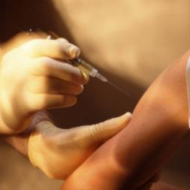
Preventing HBV Infection
Vaccinate
  Prevalence of HBV 10 times higher in HCP than general populations prior to vaccination and adoption of standard precautions.

Slide 47
HBV Prophlylaxis of HCW
Mark HCW medical chart either:
Vaccinated – known responder
Vaccinated – known non-responder
Vaccinated – response unknown
Unvaccinated

Slide 48
Hepatitis B Postexposure Management
Exposed person | HBsAg-positive | HBsAg-negative | Source not tested or unknown
Unvaccinated | HBIG* x 1 & initiate HBV vaccine | Initiate HBV vaccine | Initiate HBV vaccine
Previously vaccinated, known responder | No treatment | No treatment | No treatment
Known nonresponder (after 2 full series) | HBIG x 2 | No treatment | If known high-risk source, may treat as if source were HBsAg positive
Response unknown | Test exposed for anti-HBs. 1) If inadequate^, HBIG x1 plus HBV vaccine ‘booster’ dose. 2) If adequate no Rx. | No treatment | Test exposed for anti-HBs: If inadequate initiate re-vaccination. If adequate no Rx.
Treatment if source:
HBIG dose 0.6ml/kg IM, adequate anti-HBs >10mlU/ml

Slide 49
Hepatitis C Post-exposure Follow-up
~ 1.8 percent risk of disease transmission following a needle stick exposure to HCV

Slide 50
Postexposure Management HCV
There is no prophylaxis
  Take steps to avoid needle stick injuries

Slide 51
Postexposure Management HCV
For the source, perform testing for anti-HCV.
For the person exposed to an HCV-positive source
--- perform baseline testing for anti-HCV and ALT activity; and
--- perform follow-up testing (e.g., at 4--6 months) for anti-HCV and ALT activity (if earlier diagnosis of HCV infection is desired, testing for HCV RNA may be performed at 4--6 weeks).
Confirm all anti-HCV results reported positive by enzyme immunoassay using supplemental anti-HCV testing
Refer HCV infected HCP to a specialist for timely medical management

Slide 52
Preventing Transmission
Needlestick Precautions
  DO:
  Use protective/safety devices
  Review and revise procedures
  Slow down and THINK
  Dispose of needles IMMEDIATELY
  Use puncture-resistant, properly identified containers

Slide 53
Preventing Transmission
Needlestick Precautions
  AVOID:
  Improper needle disposal
  Recapping syringes
  Carrying or laying down needles before discarding
  Bending, breaking, or manipulating needles

Slide 54
Preventing Transmission
Use Standard Precautions Consistently
  Wash hands
  Wear personal protective equipment (PPE)
    Gloves
    Gowns
    Masks
    Eye protection
  Use warning labels and signs to identify hazards
  Clean and decontaminate environment, equipment and work surfaces

Slide 55
Preventing Transmission
When Biohazard is Present in Environment
  NO Eating
  NO Drinking
  NO Applying cosmetics or lip balm
  NO Manipulating contact lenses
  NO Smoking
  NO Mouth pipetting

Slide 56
Safe Injection Practices
A safe injection…
  Does not expose the provider to any avoidable risk
  Does not harm the recipient
  Does not result in waste that is dangerous to other people
        World Health Organization

Slide 57
Protecting HCW and Patients

Slide 58
What happens when Safe Injection Practices (SIP) are not followed?
Improper use of syringes, needles, and medication vials has resulted in:
  Infection of patients with bloodborne viruses, including hepatitis C virus, and other infections
  Notification of thousands of patients of possible exposure to bloodborne pathogens and recommendation for HCV, HBV, and HIV testing
  Referral of providers to licensing boards for disciplinary action
  Legal actions such as malpractice suits filed by patients
58

Slide 59
TRANSMISSION OF BLOODBORNE PATHOGENS VIA
CONTAMINATED EQUIPMENT OR MEDICATIONS
SOURCE
Infectious person,
e.g. chronic, acute
CONTAMINATED EQUIPMENT OR MEDICATION OR HANDS
CASE
Susceptible,
non-immune person
Notes:
This is an illustration of how person-to-person transmission may occur without people coming into contact with each other.

Slide 60
What are some of the incorrect practices that have resulted in transmission of pathogens?
Direct syringe reuse
  Using the same syringe from patient to patient
Indirect syringe reuse
  Accessing shared medication vials or IV bags with a used syringe
Reuse of single dose vials
Sharing of blood contaminated glucose monitoring equipment
60

Slide 61
Misperceptions
61
I changed the needle so I can reuse the syringe
The vial says single does but it has enough medication for more than one patient, so I can use it

Slide 62
Safe Injection Practices Coalition (SIPC)
Notes:
Since 1999, more than 125,000 patients in the United States have been notified of potential exposure to hepatitis B virus (HBV), hepatitis C virus (HCV), and HIV due to oversights in basic infection control practices. Many of these lapses involved healthcare providers reusing syringes, resulting in contamination of medication vials or containers which were used then on subsequent patients.
In response to the ever increasing number of potential exposures, the Safe Injections Practice Coalition (SIPC) was created in 2008. This coalition is comprised of patient advocacy organizations, foundations, provider associations, industry partners and the Centers for Disease Control and Prevention (CDC); and focuses its efforts on advancing and promoting safe injection practices by informing and educating healthcare professionals and the public. Issues of particular concern include the reuse of syringes and misuse of single-use and multi-dose vials.

Slide 63
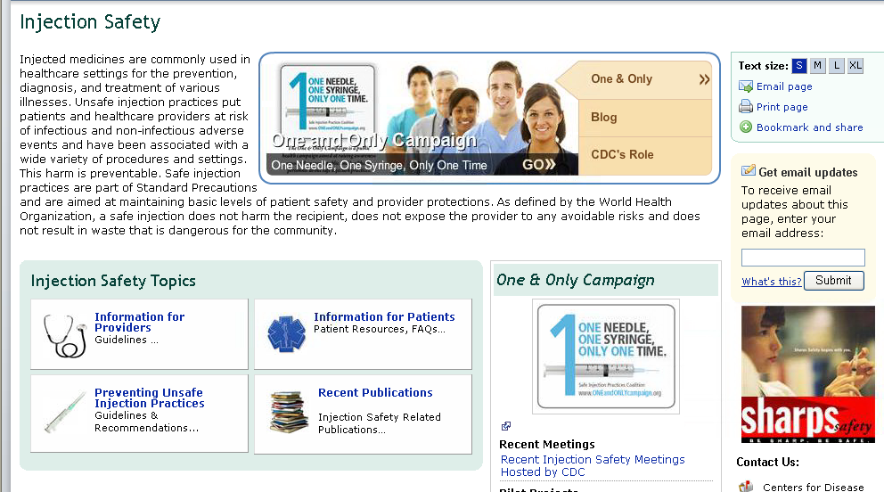
CDC Materials www.cdc.gov/injectionsafety.html
63
Notes:
This is the One and Only Campaign website.
One major accomplishment of the SIPC is the creation of an awareness campaign. The campaign, One & Only Campaign, uses various media to advance and promote safe injection practices among healthcare providers to prevent healthcare-associated infections. New Jersey joins the Nevada Department of Health and Human Services and the New York State Department of Health in disseminating key messages for the One & Only Campaign. This is the second year of state health department involvement in the Campaign. Milestones from the first year include the launch of a healthcare provider training video on safe injection practices, revamp of the Campaign's website, pubic and provider materials, and the creation of a smart phone application

Slide 64
Injection Safety – Standard Precautions
Use aseptic technique during the preparation and administration of injected medications
Do not use medication drawn into a single syringe for multiple patients, even if the needle is changed
Consider a syringe or needle contaminated after it has been used to enter or connect to a patients’ intravenous infusion bag or administration set
Do not enter a vial with a used syringe or needle
Adapted from: CDC. Guideline for isolation precautions: preventing transmission of infectious agents in healthcare settings 2007. http://www.cdc.gov/ncidod/dhqp/gl_isolation.html
64

Slide 65


65

Slide 66
PEP Management Resources
National Clinicians’ Post-exposure Hotline: 888-448-4911
Needlestick! : www.needlestick.mednet.ucla.edu
Hepatitis Hotline: 888-443-7232
CDC reporting: 800-893-0485
Pregnancy Registry: 800-258-4263
FDA (unusual/severe toxicities): 800-332-1088
HIV/AIDS Treatment Information Service: www.hivatis.org

Slide 67
Prevention and Prophylaxis for Occupational Exposure to HIV and Other Blood Borne Pathogens (PEP):
Case Studies
Instructions: Break into groups of 4-5 people and discuss the following scenarios. We will reconvene in a large group to hear from all participants.

Slide 68
Case Studies
1. A patient has just been transferred from the trauma bay to surgery. Carla works for environmental services at a hospital. While cleaning the area she is stuck by a needle left in a sheet. What are the issues around infection control? What are your considerations for post-exposure prophylaxis?
2. Sam is an intern at the hospital preparing to give his first vaccination. He will be drawing from a multi-dose vial. What education do you want to provide to him? Sam goes on to stick himself with the needle after giving his vaccination. What are your next steps?

Slide 69
THANK YOU!

